Slide 1
CONDUCTING TRAINING
BARMAN
5

Slide 2
FACTORS AFFECTING THE CONDUCTION OF TRAINING
CONDUCTING TRAINING
LEARNING
METHODS
SELF
AND GROUP
MOTIVATION
SOFT SKILL
EDUCATION
HARD SKILL
EDUCATION
TRANSFERRING
THE SUBSTANTIVE
KNOWLEDGE
TRAINER’S
SELF
PRESENTATION
TRAINERS SELF
DEVELOPMENT
TARGETING ON
THE OBJECTIVES
COOPERATION
WITH THE GROUP
ORGANISATION
OF WORK
ATMOSPHERE
CONDUCTING TRAINING IS A PROCESS OF THOSE ELEMENTS AND ALL OF THEM ARE IMPORTANT.

Slide 3
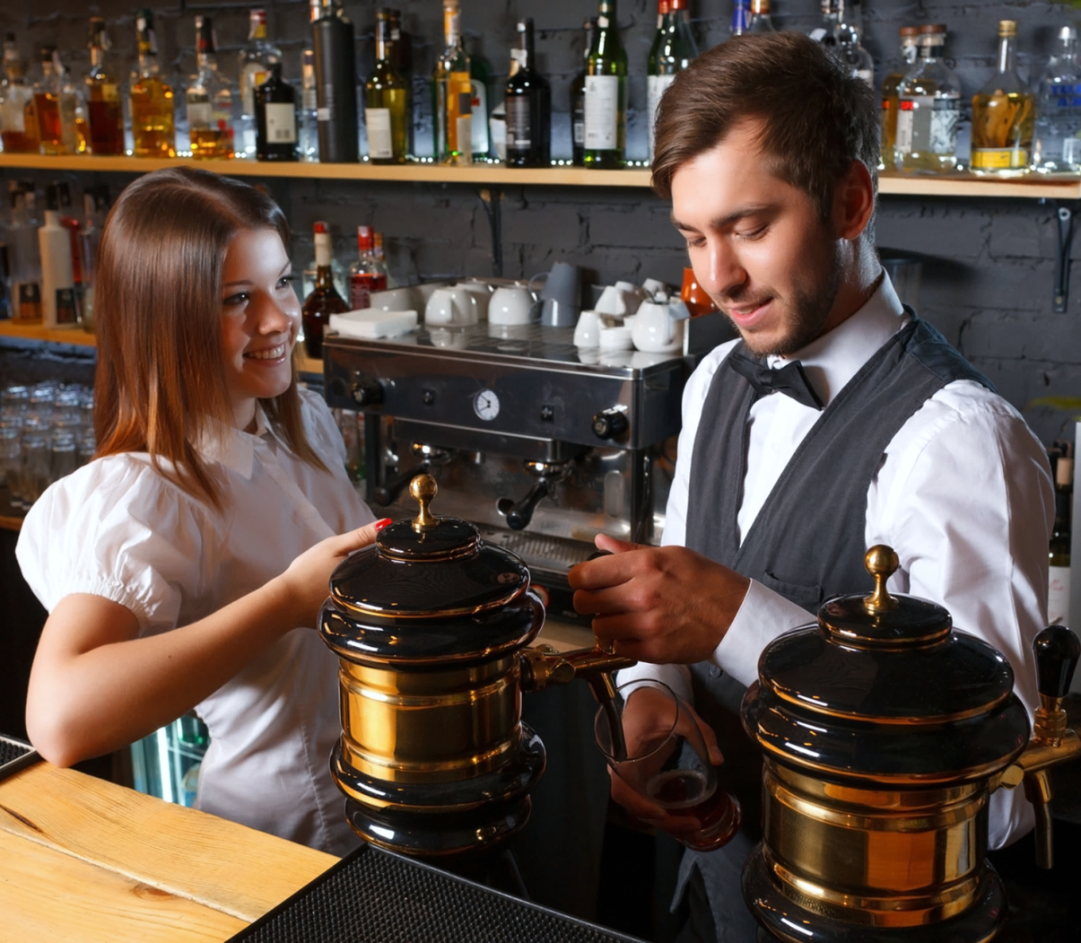
CONDUCTING TRAINING
When preparing to conduct training, the trainer should devote a lot of attention to:
CREATING OWN IMAGE
and
PROFESSIONAL COOPERATION WITH THE GROUP
PODCAST 1

Slide 4
CONDUCTING TRAINING
You start training in modern trends of decorating cocktails:
You stand before a group, you are watched and assessed by its members. They expect you to be of high-class competence and that you will teach them at the appointed time of what they came for.
They wonder if you can create wonderful sculptures of fruits, or show them how to do it and explain the next steps of the procedure.
So let’s answer the question:
WHAT SHOULD THE TRAINER BE LIKE?

Slide 5
TRAINER PROFILE
is competent and treats participants as competent and able to achieve specific effects after the course: he can use various decorative materials: grasses, leaves, sugar masses, fruits and others, prepare individual decorative elements, use them to make attractive compositions and adapt to the type of cocktail , its taste and colour,
knows how to speak fluently and clearly about what and how to do in turn and uses professional terms,
listens carefully to learners, responds appropriately to their needs,
builds a climate of confidence in a group that encourages creativity,
CHARACTERISTIC OF
A GOOD TRAINER (1)
EXAMPLE DOCUMENTS
WORK CARD 3
PODCAST 1

Slide 6
TRAINER PROFILE
is involved in training, cares for the provision of appropriate decorative materials, small equipment and utensils and watches over every participant,
is tolerant when someone has a problem with cutting out a pretty spiral of orange peel, but he is also looking forward to progress,
is flexible when you need to spend more time on activities and operations that are difficult or when any detail arouses special interest,
is socially mature, i.e. knows how to appreciate the participant's efforts regardless of his predisposition and way of working,
is capable of self-criticism - knows what he cannot do and he can can, sees the directions of self-improvement
CHARACTERISTIC OF
A GOOD TRAINER
(2)

Slide 7
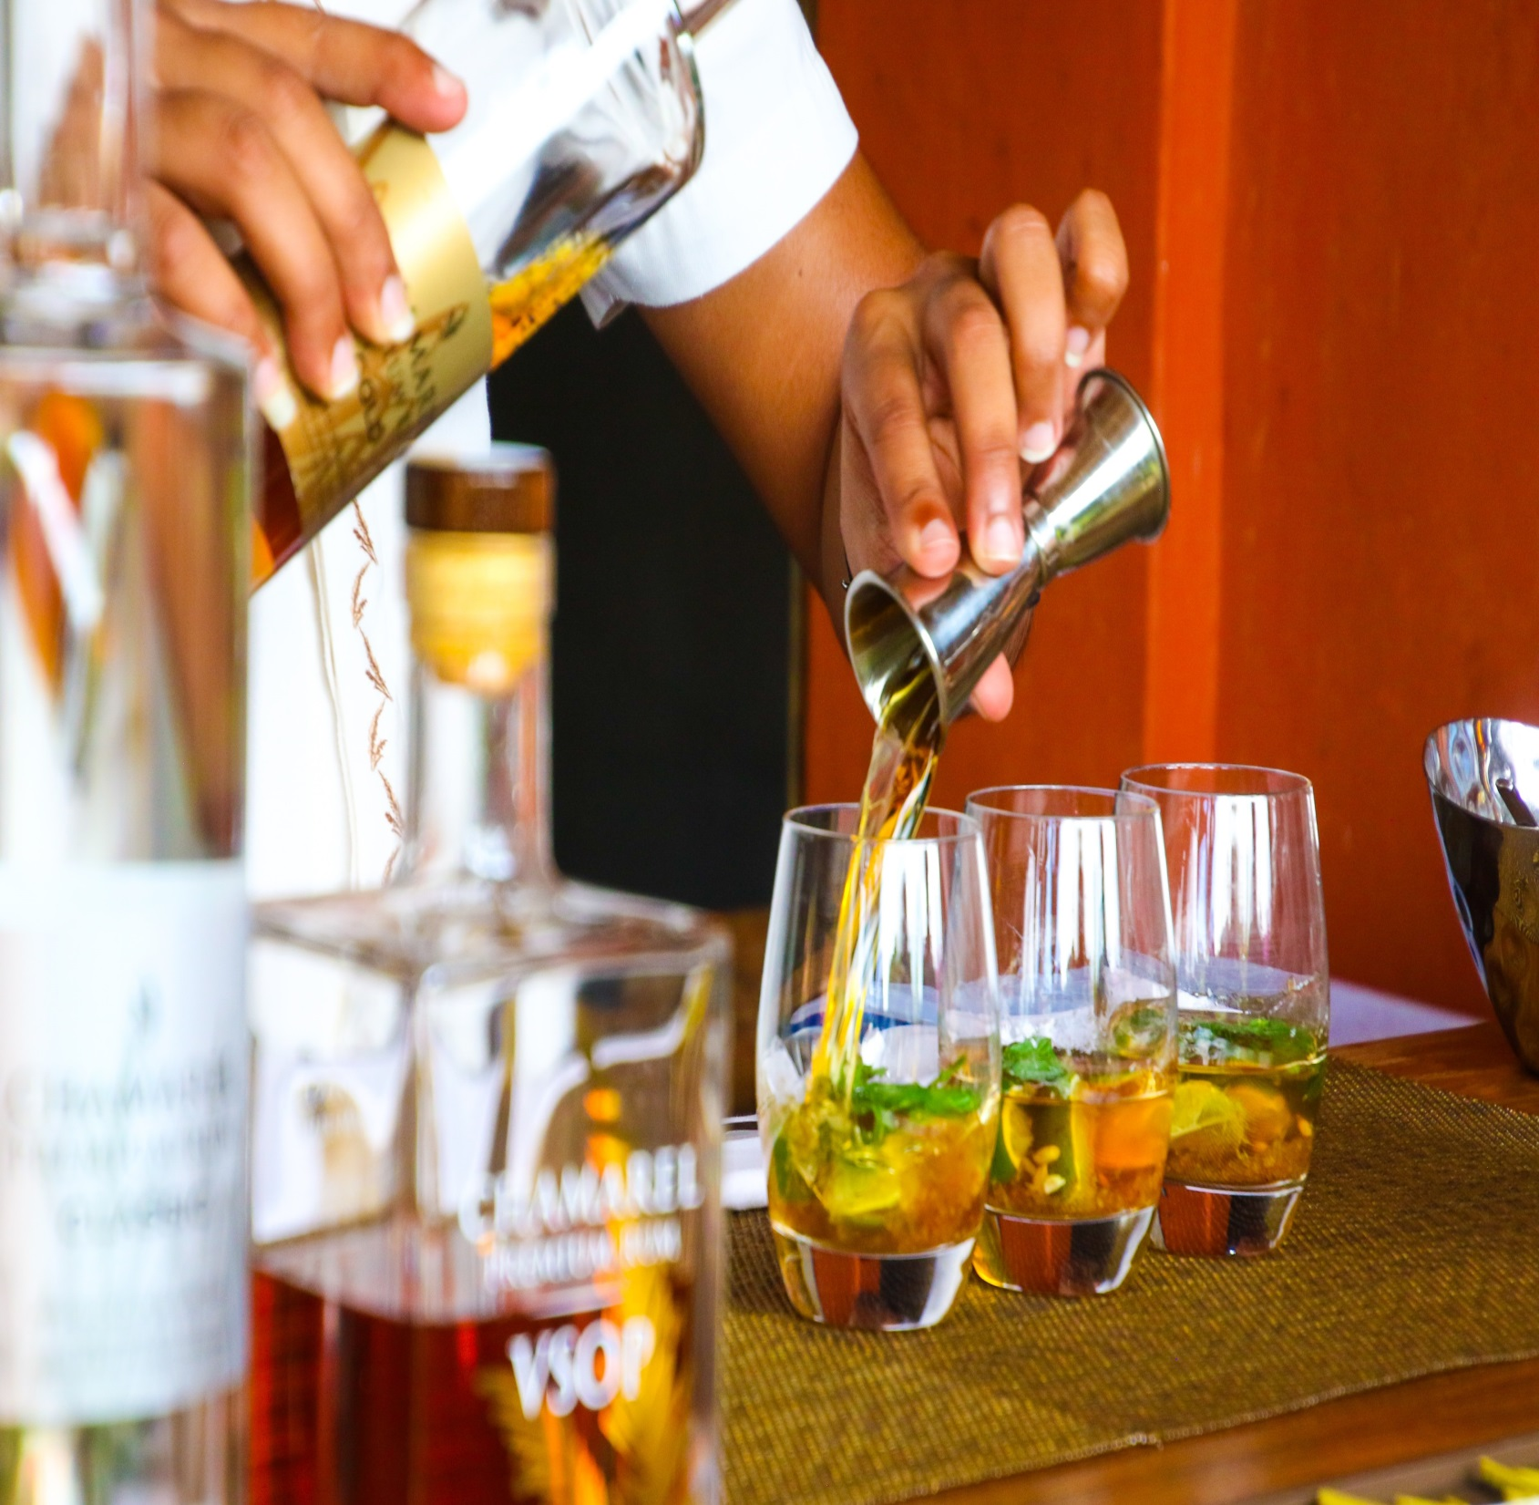
TRAINER PROFILE
When you start training bartenders, regardless of whether it is a bartending course and a degree, baristas, whiskey or flair, you have to remember about proper self-presentation.

Slide 8
TRAINER PROFILE
Its main purpose is to cause the trainer to be positively received as a competent and at the same time friendly and kind. The trainer who trains bartenders should:
wear a bartender outfit adapted to the type of training: when it covers the skills and competences required in a high-class bar it has to be elegant or more casual, non-binding movements when it concerns, for example, the Flair course,
be aware of your body language and control it,
efficiently perform all the professional activities,
keep in touch with the group,
be open to the expectations and signals of the training participants.
SELF PRESENTATION
PODCAST 1

Slide 9
SELF-PRESENTATION
it is a process that involves controlling an individual's perception of the environment. Usually, the image that is created by the person corresponds to reality, although sometimes it has a tendency to select real information about yourself.

Slide 10
TRAINER PROFILE
FIRST IMPRESSION
appropriate attire
punctuality
cheerful look,
smile,
body slightly inclined towards the recipients.
BASIC FEATURES
OF PROFESSIONAL
TRAINING
EXAMPLE DOCUMENTS
WORD CARD 4
PODCAST 1

Slide 11
TRAINER PROFILE
DESIRED
INADVISIBLE
open attitude, maintaining eye contact,
balanced, open gestures, friendly face expression,
maintaining physical distance,
cheerful voice, clear articulation, fluency of speech
closed attitudes (crossed arms or legs),
excessive and overly expressive gesticulation,
restless fidgeting in a chair, obstruction over mimicry,
signs of insincerity.
BASIC FEATURES
OF PROFESSIONAL
TRAINING

Slide 12
TRAINER PROFILE
When you conduct training on modern trends in decorating drinks, using whiskeys or others, your speeches regarding both the theory of the properties of sugar masses, the characteristics of individual whiskeys, and practices such as demonstrations and instructions on the preparation of decorations should be:
specific and factual, ie not loaded with content, which, with the characteristics of e.g. alcohol, is quite difficult,
clear and understandable,
demonstrative - based on meaningful comparisons with issues known to bartenders from their daily practice,
aimed at the assumed learning outcomes,
interspersed with humour,
effectively completed, especially when they have a workshop character.
WHAT CHARACTERIZES A GOOD PRESENTATION?

Slide 13
TRAINER PROFILE
While conducting the training, you also look at the participants.
At the beginning, you do not know much about them, you do not know their characteristics, possibilities, how to acquire knowledge and what group they will create. With time, you get to know them better and better.
One of your tasks is to direct the group to create an atmosphere and conditions that allow everyone to achieve the desired results, regardless of the style of learning and predispositions that are the domain of each of them.
FROM A TRAINERS POINT OF VIEW
PODCAST 2

Slide 14
COOPERATION WITH THE GROUP
ACTIVE PARTICIPANT
committed, open, flexible, works quickly - without deep thought, likes risk, tends to work independently.
On the course of decorating drinks, he will want to immediately create spatial decorations for different types of glass, use numerous raw materials, show the results of his own work.
OBSERVER listens and gathers experience, works after thorough consideration, cautious, approaches problems methodically, prefers to stay out of the way.
Before taking on the self-decorated glass, he will carefully watch the show and listen to the instruction. Decorations will be prepared carefully.
TYPES
OF TRAINING
PARTICIPANTS
PODCAST 2

Slide 15
COOPERATION WITH THE GROUP
THEORIST thinks logically, rationally and objectively, likes analyses and syntheses. Weakly tolerates uncertainty, ambiguity of subjectivism and intuition.
During the observation of the show on combining individual decorative elements in the composition, he will be happy to note the order and type of activities, and by doing the exercises himself he will try to reproduce exactly what he has seen before.
PRAGMATIST interested in practical action, impatient, avoids theories, principles, wills to choose the first beneficial solution, cuts the pattern without hesitation.
Decorating cocktails and other professional tasks, the bartender comes down to it according to the necessary, sequentially performed tasks. If it is more convenient for him, he will apply his own solutions or choose the easiest way to the goal without fear.
TYPES
OF TRAINING
PARTICIPANTS
PODCAST 2

Slide 16
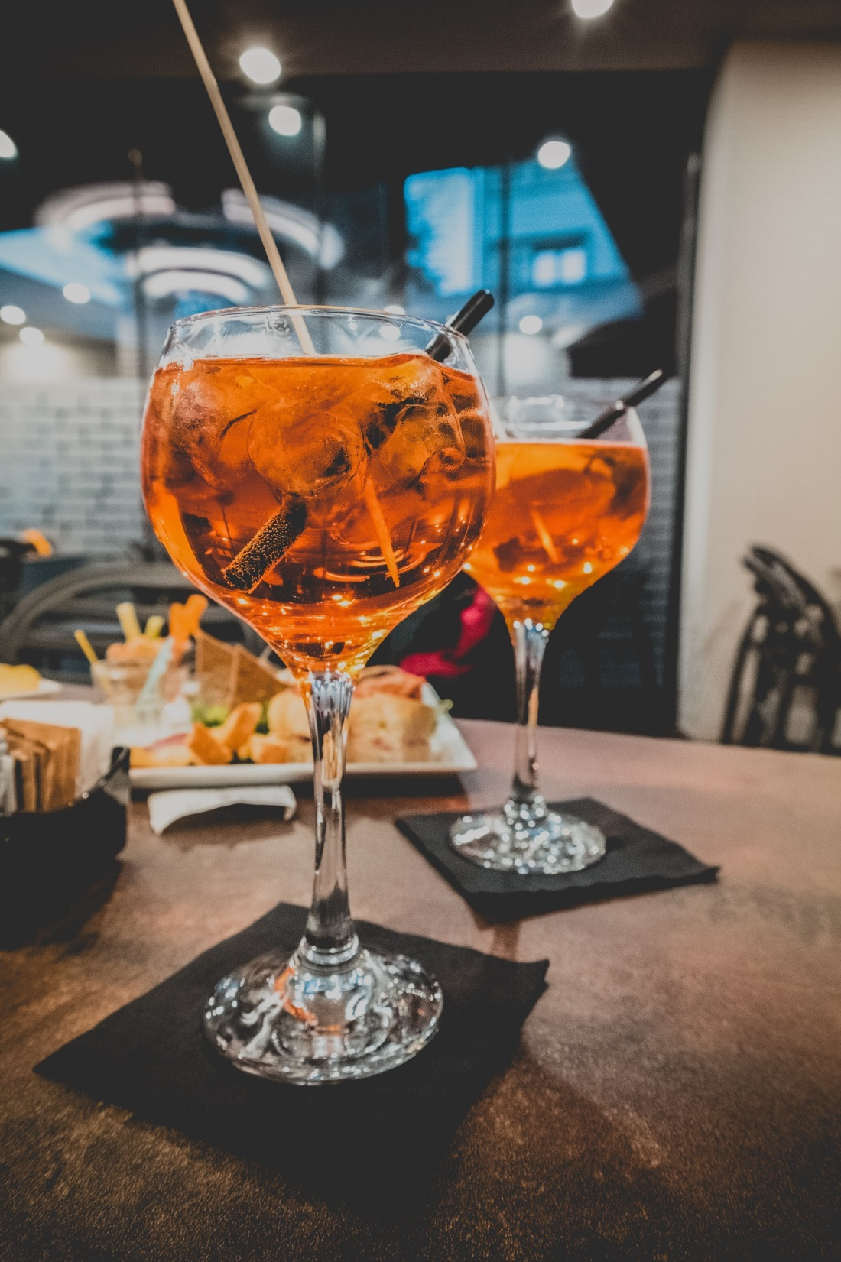
The average training group meets all types of participants. Rarely, individual members of the group represent one strictly defined type. Depending on the professional experience of individual people, they can be combined in different proportions.
Bartenders are a professional group focused primarily on action, and in the course of their contacts, despite their kindness and openness, the guests keep their distance, staying on the other side of the bar.
During training, however, they accept the typical role characteristic of the functioning of each team. During the training, the trainer becomes the leader of the group.
PODCAST 2

Slide 17
COOPERATION WITH THE GROUP
CREATIVITY new ideas, solutions and proposals.
The trainer should be creative and expect the same from the participants of the training. Before you get to the demonstration of making decorations from grass make the participants seek the path to reach the goal and do not block their initiatives, unless they lead to high losses and results of failure.
COORDINATION AND PARAIPATION finding links between ideas or proposals of group members.
Listen to different opinions about decorating cocktails. Explain which ideas are better than others or that can be supplemented with new solutions.
ROLES IN THE GROUP RELATED TO THE IMPLEMENTATION OF TASKS
EXAMPLE DOCUMENTS
WORK CARD 1
PODCAST 2

Slide 18
COOPERATION WITH THE GROUP
NAVIGATION keeping an eye on the topic, the problem.
WAll activities must be in relation to the goals and scope of the training. You can opt out of a single exercise, for example, creating long, hanging from a glass decorations, but do not lose the essence of training activities.
EXPERTISE AND INFORMATION sharing knowledge and asking questions, analysis of materials.
During the whole training, provide reliable knowledge and experience. Explain the use of new ideas for decorating cocktails and their compliance with accepted rules.
Assistant work
On a daily basis, bartenders perform many auxiliary works, ranging from glass polishing, maintenance of equipment, the order of missing raw materials and equipment. So do not avoid engaging the participants in this work during training.
ROLES IN THE GROUP RELATED TO THE IMPLEMENTATION OF TASKS

Slide 19
COOPERATION WITH THE GROUP
POSITIVE ROLES RELATED TO CONTACTS BETWEEN PEOPLE SHOULD NOT BE ALIEN TO BARTENDERS OR THE TRAINER. THESE INCLUDE:
LISTENING
both the bartender and the trainer must be able to listen to others, not necessarily expressing their own opinions on a given topic. And be discreet.
MEDIATION
relies on mitigating conflict situations, striving for cooperation. This skill is very useful for every bartender.
WATCHING THE RULES
remembering the rules and goals of the work, eg "We are here to learn how to decorate cocktails and not to make the decorations effective but useless".
MOTIVATING
encouraging passive group members to be active, eg by showing other attractive elements of the group or interesting compositions made by them to other members of the group.
SUPPORTING
accepting ideas and behaviours, especially those that can improve the course of classes or lead to a better solution.

Slide 20
COOPERATION WITH THE GROUP
In adult education, behaviours that hamper their good functioning appear less frequently than in children and adolescents.
Bartenders can meet among their customers people who particularly under the influence of alcohol are: aggressive, push their own opinion, want to dominate and influence others or be submissive and cannot refuse, want to focus attention on themselves or behave completely passively and indifferently.
If members of the training group assume similar roles, due to their adverse impact on other people, they should be mastered or eliminated. In the adult education the participants may help the trainer.
ROLES IN THE GROUP RELATED TO THE IMPLEMENTATION OF TASKS

Slide 21
COOPERATION WITH THE GROUP
In short trainings, lasting up to several hours, e.g. Baristic 1ST degree or in the field of modern trends in decorating drinks, the changes taking place in a group of participants can be unnoticeable.
The development of the group rarely goes beyond the stage of formation, in which its members are distrustful towards themselves and towards the trainer, they observe each other, they only know their own expectations.
The first impression that the trainer will have on the participants plays a huge role here and how he will present himself. If he can create a favourable atmosphere, trust and respect and he is interested in the subject, then his work with the group will bring good results
GROUP PROCCESS,
GROUP MANAGEMENT

Slide 22
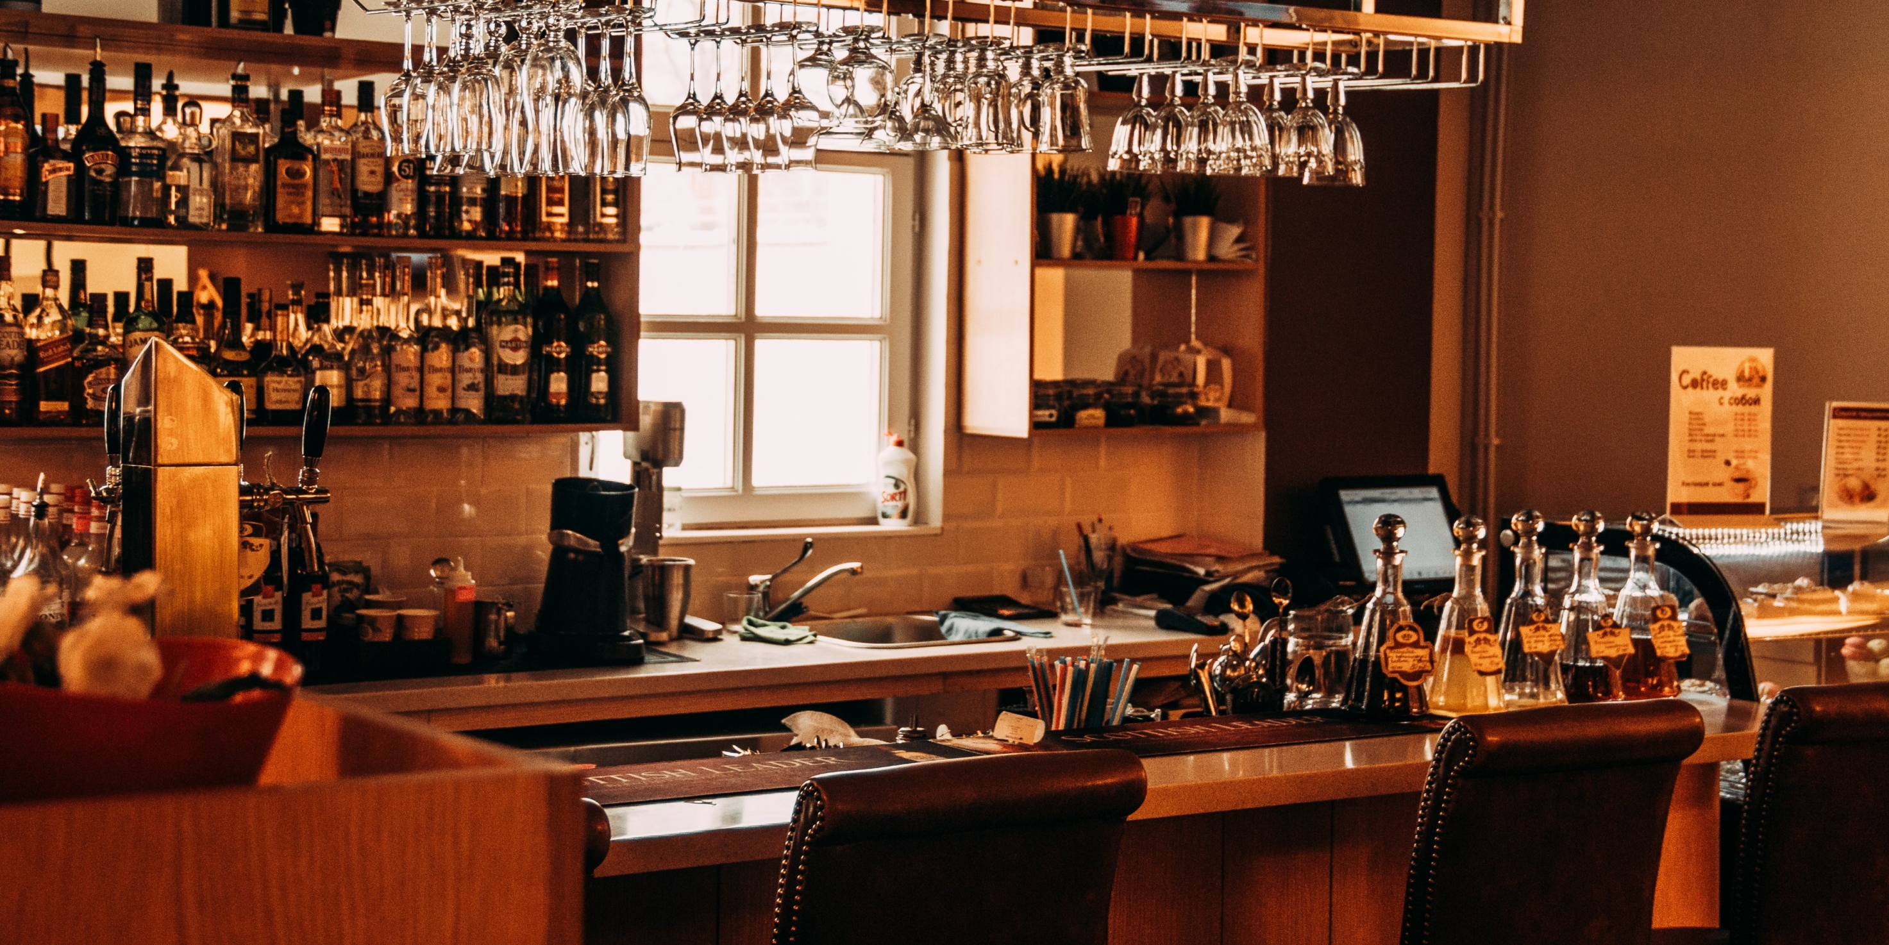
COOPERATION WITH THE GROUP
In longer courses, such as first and second degree bartending, flair or other training, group development is easier to see. It results from the mutual learning of its members and building mutual relations.
Irrespective of the stage of development in which the group is located, managing it must be based on mutual respect, striving to achieve the goals set in an attractive way for the participants.

Slide 23
COOPERATION WITH THE GROUP
STAGES OF GROUP DEVELOPMENT
1
2
3
4
FORMATING
STORMING
NORMING
PERFORMING
curiosity, expectations, uncertainty,
lack of a sense of security, observation,
establishing the position of the participants and the trainer
discussions regarding rules, methods,
mutual verification of group members
cooperation, stabilised realtionships,
trust, openness and suport appears
effective time management
ability to solve problems, certainty of
23

Slide 24
POSITIVE
assertive – direct, honest and firm expression of your feelings, opinions, attitudes without violating the rights of others and protecting your own.
NEGATIVE
agressive – brutal pursuit of the goal in all possible ways, treating the interlocutor as an opponent who needs to be destroyed.
submissive – succumbing to the pressure of the group; respecting the rights of others, but disregarding your own.
manipulative – using people often so that they would not know; through blackmail, lies, gossip.
TYPES OF INTERPERSONAL BEHAVIOURS that can be found in the training group do not differ from those that can be observed among the bar customers.
THE BARTENDER WOLL DEAL WITH THEM MORE EASILY THAN PEOPLE WHOSE WORKING CONDITIONS ARE COMPLETELY DIFFERENT.
EXAMPLE DOCUMENTS
WORK CARD 2

Slide 25
COOPERATION WITH THE GROUP
SUCH BEHAVIOURS SHOULD BE ELIMINATED BECAUSE THEY ARE INSUFFICIENT AND ARE DAMAGING TO THE GROUP
you’re doing a show of whiskey-based cocktails preparation or a lecture on the influence of the period of aging on the colour and taste of rum or wine and you see group members talking on the side,
you listen to someone's commentary on the work of women in the bartending profession and other participants of the training interrupt it,
you see someone's negative influence on others,
someone diverts the attention of the training group from the trainer's actions,
you have in the group people who often object to you or express their comments to others.
EXAMPLE DOCUMENTS
WORK CARD 2
PODCAST 2

Slide 26
CONDUCTING TRAINING
THE EFFECTIVENESS OF THE GROUP IS AFFECTED BY THE WAY OF DRIVING ITS WORK ON CLASSES THROUGH CHOICE OF DIFFERENT ORGANIZATIONAL FORMS. BELONG TO THEM:
TEAMWORK
GROUP WORK
INDIVIDUAL WORK
EXAMPLE DOCUMENTS
WORK CARD 3

Slide 27
GROUP MANAGEMENT
TEAMWORK
jointly accomplishing the same task
Examples of tasks: listening to a lecture on the technology of production of sparking wines, discussion on the serving of bar snacks, observation of a new trend show.
If the group number is:
3 – 6, everyone is active,
7 – 10, half is activite and the other half is less active,
11 – 18, only 5-6 are constantly active,
19 – 30, only 3-4 are active; this group size needs to be split into groups of a smaller size.

Slide 28
GROUP MANAGEMENT
GROUP WORK
completing tasks by smaller groups.
A GROUP OF 2-3
is great when a task is clearly selected eg. Preparation of non-alcoholic cocktails.
A GROUP OF 4
is good when it comes to judging but is not good when it comes to making decisions eg. They will select the prettiest cocktail rather than decide wether the raw materials selected are appropriate
A GROUP OF 5
is optimal to achieve complex results such as preparing a scenario on a flair show

Slide 29
BENEFITS OF WORKING IN A SMALL GROUP
GROUP MANAGEMENT
Part of the bartenders work is individual, but mainly depends on cooperation with the team. Exercises during training conducted in small groups can bring good results because in this form:
the quality of the work grows,
the skills and abilities of group members are added together,
there are less frequent random errors,
ideas are created that could not appear during individual work,
a small group provides support and a sense of security, especially when making decisions.

Slide 30
GROUP MANAGEMENT
INDIVIDUAL WORK
Consists of performing separate tasks by each participant.
Used when the level of represented skills is different and the pace and way of aquiring tchem is highly individual eg. Making cocktails.
EXAMPLE DOCUMENTS
WORK CARD 3

Slide 31
GROUP MANAGEMENT
WHEN TOU TRAIN A GROUP OF BANTENDERS IN THE FIELD OF
for example, latte art, brandy cocktails, or decorating drinks, then:
GROUP
INDIVIDUAL PARTICIPANTS

Slide 32
TASKS CONDUCTED TO THE GROUP
GROUP MANAGEMENT
in this group there are interactions on which you should pay attention and use them if they are beneficial for the implementation of the training,
be tolerant especially towards those who have problems with mastering new skills; support them,
solve conflicts directly related to the training,
listen and react to group signals,
carry out the evaluation.
PODCAST 2

Slide 33
TASKS CONDUCTED ON INDIVIDUAL PARTICIPANTS
GROUP MANAGEMENT
giving instructions during the exercise depending on the individuals ability,
guaranteeing and providing help and support in issues that cause trouble,
inclusion of people standing on the side in the joint work,
asking questions that help to solve problems,
the confrontation of real achievements with the trainer's expectations.

Slide 34
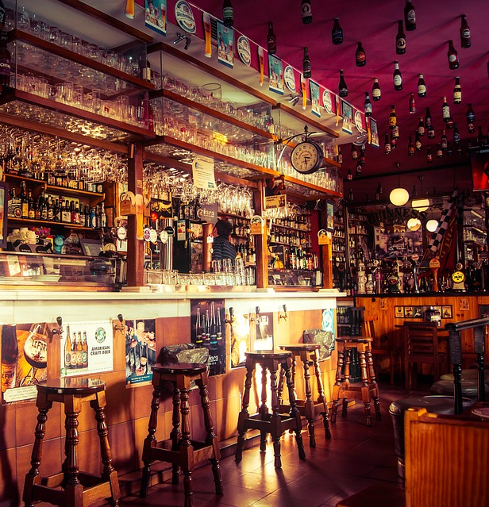
EFFECTIVE COOPERATION WITH THE GROUP IS POSSIBLE ONLY IF BOTH THE TRAINER AND THE PARTICIPANTS HAVE A SENSE OF THEIR OWN WORTH AND RESPECT IN WITH OTHERS.
If you are training in the area of bartending skills and competence, respect the progress of each participant even if they do not even have proficiency and skills like yours.

Slide 35
COOPERATION WITH THE GROUP
PHYSICAL SAFETY
no risk of injury
MISSION
feeling sense and direction
EMOTIONAL SAFETY
we do not experience fear or humiliation
INGREDIENTS OF SELF ESTEEM
GROUP PROCESSES,
COOPERATION
WITH THE GROUP
COMPETENCE knowing that we can do something
AWARENESS OF YOUR IDENTITY
when you know who you are
SENSE OF GROUP BELONGINNG
35

Slide 36
COOPERATION WITH THE GROUP
when you rate someone or you are judged yourself, remember that the evaluation made by one person is never completely objective, is always a private opinion and the person concerned may agree with it or not it
can be taken into account only when the ratings of many other people are similar.
NOTES FOR THE TRAINER

Slide 37
COOPERATION WITH THE GROUP
learn to take critical information,
however, do not criticize the person who criticizes you and do not give her what she did not say,
do not assign any interlocutor to you who is hostile to you,
try to understand what he means, let me understand that you have accepted the accusation,
give yourself time, organize your thoughts and consider the reasonableness of the charges.
NOTES FOR THE TRAINER

Slide 38
CONDUCTING TRAINING
Mostly, trainings for bartenders are workshops, where the emphasis is on training practical skills. They require an adequate amount of time, allowing preparation, conducting, summary of exercises and cleaning activities.
Training for bartenders sometimes takes place in the bar. The advantage of this situation is that it is an authentic workplace, but the disadvantage is that the trainers are not able to do the same type of individual exercises simultaneously.
ORGANISATION OF WORK

Slide 39
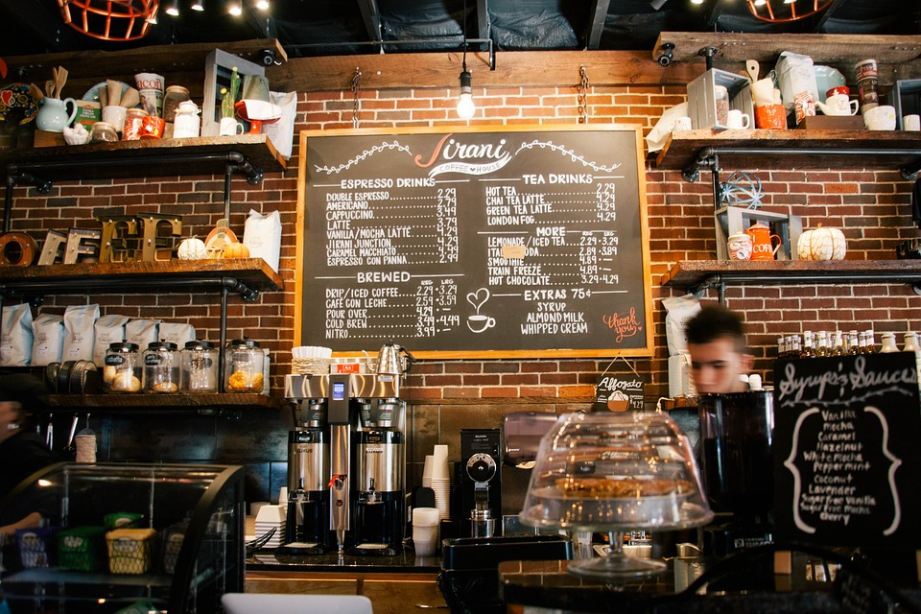
CONDUCTING TRAINING
ORGANISING WORKS, IT DEPENDS ON:
the topic,
charakter of training,
group size,
selecting the teaching methods,
type, quantity and duration of the workshop,
necessary to carry out organisational activities,
the duration of the entire training, individual classes and the number of meetings between the trainer and the group.

Slide 40
CONDUCTING TRAINING
1. BEGINNING
welcome
introduction of the trainer (at the first workshop)
explaining the topic and aims of the training
2. INTRODUCTION
introducing organisational issues/terms
introduction of the substantive content
3. MAIN PART
focuses on transferring the content and training skills with the use of different but carefully selected methods of training
ORGANISATION OF WORK
4. SUMMARY PART
summary of all content
summary and analyis of tasks
conclusions
5. EVALUATION AND CLOSURE
defining the benefits that training participants have gained
summary of activities and thanks
PODCAST 2

Slide 41
CONDUCTING TRAINING
ORGANISING WORK
Preparatory activities before the training:
finding and verifying content on: modern trends in decorating, types and properties of materials and decorative raw materials, rules for decorating glass,
preparation of teaching materials: presentations, slides, printed materials, ready-made exhibits, various types of materials, decorative materials,
organising and providing the right amount and type of materials, decorative raw materials, auxiliary equipment, glass needed, technical means, work stations,
adaptation of training conditions to the goals set - organisation and equipment of the room.
TRAINING
modern trends
in decorating cocktails

Slide 42
CONDUCTING TRAINING
ORGANISING WORK
Actions during its running:
preparation of a room for workshops: a visible place to conduct a lecture, presentations and work stations,
preparation of the right amount and type of materials, decorative raw materials, auxiliary equipment, glass needed, technical means,
adjusting the duration of individual parts of the training to their nature and general time frame (the longest time should be spent on the formation of decorative elements and glass decoration along with instruction, as well as individual exercises in this field and their discussion),
organisation of cleaning activities.
TRAINING
modern trends
in decorating cocktails
EXAMPLE DOCUMENTS
WORK CARD 4

Slide 43
GO TO THE NEXT MATERIALS
FROM THE MODULE

