Slide 1
PREPARING TRAINING (2)
WAITER
4

Slide 2
AIM OF TRAINING PREPARATION
THANKS TO PREPARING TRAINING WHICH INCLUDES THE AREA OF GROUP WORK METHODS AND USING APPROPRIATE RESOURCES, THE TRAINER WILL MAKE IT EASIER FOR THE PARTICIPANTS TO ACHIEVE THE SET GOALS.
IN ORDER FOR THIS TO BE POSSIBLE, THE TRAINER SHOULD TAKE MANY ELEMENTS INTO CONSIDERATION.
PODCAST
Recording no 1

Slide 3
AIM OF TRAINING PREPARATION
THIS MODULE IS BASED ON TRAINING PREPARATION FROM THE TECHNICAL SIDE AND TOOL SELECTION.
IT WILL FOCUS ON SELECTING METHODS OF GROUP WORK AND DIDACTIC RESOURCES.

Slide 4
EFFECTIVE TEACHING
YOU LEARN THROUGH WHAT YOU…
SEE
WIDZISZ
HEAR
DO
TASTE
IMAGINE
SMELL
FEEL
TOUCH
THINK

Slide 5
EFFECTIVE TEACHING
YOU KNOW WHAT YOU HAVE TO LEARN BUT HOW TO DO IT BEST?
In order to transfer new knowledge to the waiters on French service, the trainer should know that the effect depends on the ways of transferring and accepting knowledge.
We learn from :
What we read - 10%,
What we hear - 20%,
What we see - 30%,
What we see and hear - 50%,
What we say - 70%,
What we say and do - 90%.

Slide 6
EFFECTIVE TEACHING
HOW TO RECOGNISE TYPES OF LEARNERS?
VISUAL
AUDITORY
Usually sits straight and follows the lecturer with his eyes. To recall information, he often recreates the image associated with it
He can repeat words silently or nod. In order to remember the information, he "is listening to the recording in his head
KINESTHETIC
TACTILE
YOU KNOW WHAT YOU HAVE TO LEARN.
BUT HOW TO DO IT BEST?
usually it sits comfortably on a chair, sways or moves in a different way
likes to play with various objects while listening, can also play with hair or rub his hands
KINESETHTIC AND TACTILE ARE OFTEN REFFERED TO AS THE „ACTIVE’’ TYPE
EXAMPLE DOCUMENTS
Work card 1

Slide 7
EFFECTIVE TEACHING
DURING A FRENCH SERVICE TRAINING COURSE:
A visual learner will benefit the most from a visual or cinematic presentation showing how meals are served, as well as observing colleagues at work and remembering what he is doing
A listener will benefit most from the commentary to the presentation, lecture, and instruction preceding the exercise of the French service
An active learner will benefit the most from participation in the presentation of the French service, independent implementation of the role of both waiters participating in the service, or in the simplified version - by presenting the dish and serving it to the guest so that he comfortably puts it on the plate.

Slide 8
EFFECTIVE TEACHING
EACH OF THE PARTICIAPANTS HAS ALL OF THE LEARNING STYLES COMBAINED.
Regardless of their interests, predispositions and experiences, participants of different waiter degree courses, as well as specialist courses, eg in the area of taste consultancy or suggestive sales, use all kinds of knowledge and skills.
Differences between learners depend on different proportions in the participation of individual types of reception and, in general, the domination of one of them.
That's why you always need to remember to keep the right proportions between the different types of reception and learning.
.

Slide 9
EFFECTIVE TEACHING
The trainer should remember that training in the scope of any form of service, selection of wine for dishes, preparation of banquet halls, suggestive sale, boning and other skills needed in this profession, he must :
discuss and explain what they are about,
show how it's done,
guide participants during the self-fulfillment of the task,
provide them with access to training materials,
allow to take notes, ask questions and exchange of opinions.

Slide 10
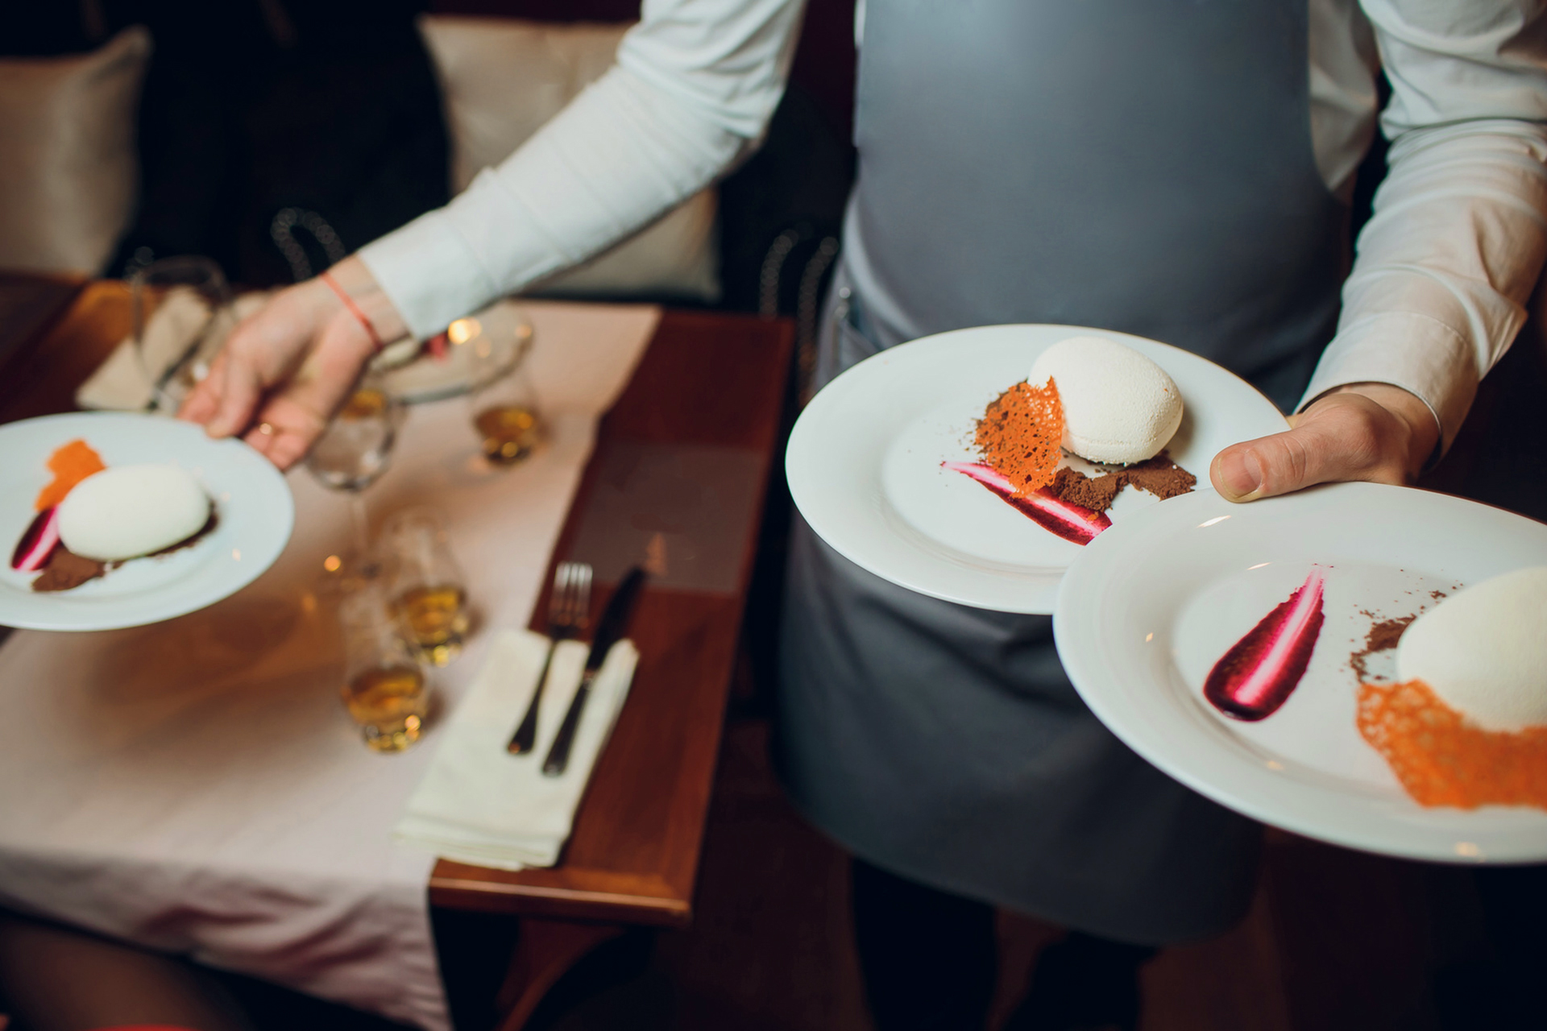
METHOD SELECTION
EXPOSITORY METHODS
They are traditional methods of transferring knowledge to adults and young people.
Focusing on what you hear does not last long.
Remember that listeners will only remember around 20% of what you said in the lecture.
EXAMPLE DOCUMENTS
Work Card 2
PODCAST
Recording no 1

Slide 11
METHOD SELECTION
EXPOSITORY METHODS MOST OFTEN USED IN TRAINING
LECTURE | verbal information transfer Eg the information on how to oprate a card machine
DISCUSSION | A discussion with participants of the training and referring to their knowledge and experience e.g. About how to set out the tables for a party
NARRATIVE | Verbal presentation of some action or event Eg. Resolving a conflict between guests

Slide 12
METHOD SELECTION
EXPOSITORY METHODS MOST OFTEN USED IN TRAINING
DESCRIPTION | characterisation of objects, phenomena, activities unknown to participants – e.g. The steps of separting the fish filet from the bone
ANEGDOTE | short story about some funny or unusual event, ended with a surprising, witty point
INSTRUCTION | explanation for understanding the phenomenon, Eg is it possible to flambeed ice cream

Slide 13
METHOD SELECTION
PROBLEM METHOD
Require the greater involvement of the participants than expository methods due to the requirement to solve problems set up by the trainer.
The effectiveness of these methods is much greater than the expository method because the listeners actively particpate in searching for possible solutions to the problems.
EXAMPLE DOCUMENTS
Work Card 3 and 4
PODCAST 1

Slide 14
METHOD SELECTION
PROBLEM METHOD
PROBLEM LECTURE | Lecture consisting in proposing a problem by the trainer and then pointing out possible solutions and consequences, for example: the client requested that the tables are set out in a way that allows all guests to see each other however the number of the guests makes it impossible in a given hall.
CONTROVERSIAL LECTURE | It consists in interleaving it with the participants' statements or carrying out their tasks E.g. After carrying out the French seafood service for an appetiser, it is required to go to the English service of the main show. Participants ask what to pay attention to efficiently in order to change the form of the service and ensure smooth operation, despite mixing two very demanding styles of the service.
CLASSIC PROBLEM METHOD | It consists in solving the problem situation by the learners themselves and indicating possible solutions, e.g. The leader describes a situation where the waiter gets knocked over by a guest during a standing service party.

Slide 15
METHOD SELECTION
ACTIVATING METHODS
MOSTLY USED AT TRAININGS AND COURSES
CASE AND SITUATIONAL METHODS | rely on presenting participants with a description of a case or situation and motivating them to evaluate events, indicating possible solutions, eg the guests order a mid rare stake however, he receives a rare steak and complains to the waiter. How should the waiter behave?
DIFFERENT TYPES OF DISCUSSION | they rely on the exchange of ideas and views on a given topic in a different way, they support both substantive training and social competences, eg. What are the current difficulties in the professional development of waiters and how can they be solved for the benefit of them?
PRACTICAL METHODS | rely on practicing practical exercises including new professional tasks. They are discussed later.

Slide 16
METHOD SELECTION
PROBLEM METHODS - ACTIVATING
they are the best methods for gaining knowledge and skills, because they involve more senses than sight and hearing,
when they are used learning is active.

Slide 17
METHOD SELECTION
PROGRAM METHODS
The most important element of this kind of teaching is a proper computer program, in which a properly ordered set of commands is contained.
The execution of the command may be conditioned by the execution of the previous one. This process does not have to involve a trainer.
AN EXAMPLE:
designing the lay out of the banquet hall before the organisation of a large reception, with the use of computer simulation

Slide 18
METHOD SELECTION
DEMONSTRATING METHODS
(involving mainly the sense of sight) DEMONSTRATING METHODS
(involving mainly the sense of sight) used during training courses
SHOWS | they rely on the presentation of the way the task is performed, eg the trainer shows how a French service should run
FILMS | they are particularly useful when the training conditions differ significantly from the actual ones in which the vocational training tasks are to be performed or when they do not allow to conduct a demonstration or exercises Eg. A presentation of preparation and service of an American Banquet with a large number of guests

Slide 19
METHOD SELECTION
DEMONSTRATING METHODS
(involving mainly the sense of sight) used during training courses
SCENES | used mainly during the training of social competences, they show possible responses and behaviours of people e.g different types of clients and behaviours during a visit to the restuarant
EXHIBITIONS | they are extensive expositions, organized mainly at trade fairs and competitions e.g an exhibions on modern ways of decorating tables for parties

Slide 20
METHOD SELECTION
PRACTICAL METHODS
It is a group of activating methods. They involve doing activities that are to be mastered. These methods have the best effect, because they combine the verbal message, imagery and participant's independent work. Thanks to it, you can gain knowledge and skills in a gradual way, by carrying out the activities from the easiest to the most complex ones.
EXAMPLE DOCUMENTS
Work card 2
PODCAST
Recording no 1 and 2

Slide 21
METHOD SELECTION
PRACTICAL METHODS
Most often used in training of waiters
SHOW WITH EXPLANATION | Connecting the show with explanations regarding the presented object or phenomenon, e.g the lay out of cutlery in relation to serving dinner containing several courses
SHOW WITH INSTRUCTIONS | a combination of a demonstration explaining how to proceed and the order in which the activity is carried out, e.g. a high-class bottle opener demonstration with instructions on how to use it
EXAMPLE DOCUMENTS
Work card 2
PODCAST
Recording no 2

Slide 22
METHOD SELECTION
PRACTICAL METHODS
Most often used in training of waiters
COURSE, LABORATORY AND PRODUCTION EXERCISES | practical execution of professional tasks in contractual, low-simulated and real conditions, eg preparing a Viennese breakfast , guest service in different situations, filleting the fish
PROJECT METHOD | development of a service, system or object design along with relevant information E.G. Preparing a banquet for the Jubilee of the Polish Theater

Slide 23
METHOD SELECTION
PRACTICAL METHODS – action learning
The action learning method is constructed "vice versa". It focuses on the analysis of actions already taken, from which knowledge emerges leading to the improvement of skills and quality of future behaviours.
This analysis includes answering questions: WHERE? WHO? WHEN? WHAT? WHY? HOW MUCH? HOW MANY?
For example: after observing the French service of venison (or during the observation of a recording), you should point out:
all correctly performed activities,
all errors noticed,
how many of them were
why they were committed,
what to do to avoid them in the future.

Slide 24
METHOD SELECTION
PRACTICAL METHODS
JUST DO IT!
You learn how to speak by speaking
You learn how to walk by walking
You learn how to drive by driving
You learn proffestional tasks of a waiter by performing them
THAT’S WHY:
you learn to present wine - present all the bottles you have at hand,
you learn French service - serve.

Slide 25
METHOD SELECTION
SELECT TRAINING METHODS
Each issue can be presented using different methods. Choose and use the ones that:
give the best results in terms of achieving the goals set,
take into account the diversity of participants,
are adapted to the nature of the training,
let you create a good atmosphere,
guarantee a reliable message,
can be used under certain conditions.

Slide 26
METHOD SELECTION
DIFFERENT TRAINING METHODS DO NOT EXCLUDE EACH OTHER.
IF YOU SEE THAT CONNECTING THEM WILL BE EFFECTIVE, DO IT.
THANKS TO THIS, YOU WILL GET A BETTER DYNAMIC OF WORKSHOPS AND WILL STRONGLY DIRECT THE PARTICIPANTS' ATTENTION TO THE ISSUE YOU ARE DISCUSSING.

Slide 27
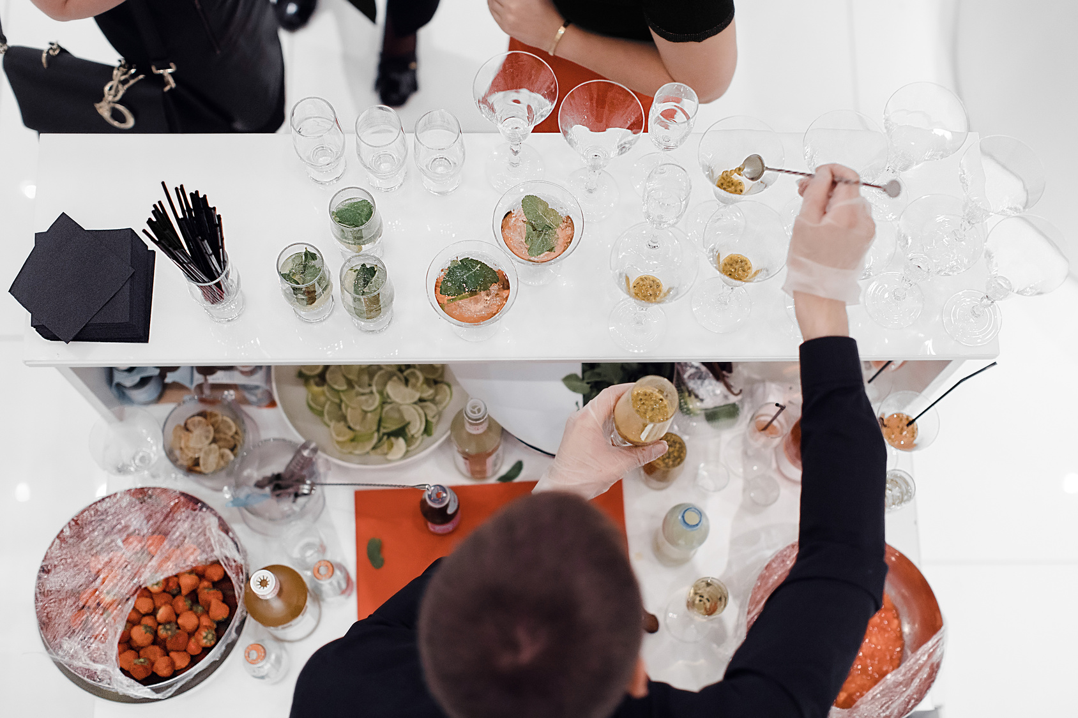
DIDACTIC RESOURCES
THESE ARE THE SPECIFIC OBJECTS WHICH FACILITATE THE PROCES OF GAINING AND TRANSFEERING OF SKILLS AND KNOWLEDGE.
They can fulfill their task of facilitating learning if they:
trigger certain stimuli
Have a teaching function,
Are close to reality
Are consistent with the content and purpose of the message
DIDACTIC RESOURCES

Slide 28
TEACHING AIDS
DIDACTIC RESOURCES
TECHNICAL AIDS
LEARNING MATERIALS
PEDAGOGICAL WORKING AIDS
28

Slide 29
DIDACTIC RESOURCES
VISUAL
graphic (maps, charts)
pictorial (illustrations, photographs)
books
Example: A diagram of table lay out
SPATIAL
static (exhibits, models)
movable (exhibits, models)
Example:a correctly set out table
TEACHING AIDS

Slide 30
DIDACTIC RESOURCES
VISUAL
AUDITORY
AUDIO-VISUAL
SLIDES
e.g. a slide show on health and safety rules when flambeeing dishes
PRINT OUTS
E.g. menus
RECORDINGS
e.g. A conversation with a client ordering food
FILMS
E.g. preparing a hall for a banquet
PROGRAMS
e.g. a report on serving an organised group
TEACHING AIDS

Slide 31
DIDACTIC RESOURCES
COMPUTER
RECORDING
PLAYERS
INTERNET
MULTIMEDIA PRESENTATIONS
CAMERA
VIDEO CAMERA
DICTAPHONE
TAPE RECORDER
MULTIMEDIA
CD
DVD
TECHNICAL AIDS

Slide 32
DIDACTIC RESOURCES
DIDACTIC RESOURCE CHARACTERISTICS:
Resources which are visual should be clear, highlighting the details you need,
Exhibitions and models should be close to reality,
Print out materials should relate only to the subject of the training,
Recorded materials should be of good quality, clear and without any unnecessary background noises
Films and short programs which from a few to several minutes,
multimedia presentations clear, clearly visible, without excess text,
technical means efficient, adapted to the training conditions

Slide 33
DIDACTIC RESOURCES
PEDAGOGICAL WORKING AIDS
MACHINES AND DEVICES
for example: for example, a coffee machine that boils water, grinds coffee, dispenses it, brews and pours and froths milk, ice cube maker
WIDZISZ
ITEMS / RAW MATERIALS
e.g. drinks, dishes, plates
TOOLS
for example: wine and bottle openers
INSTRUMENTS
e.g. carving knife, cutlery for French service

Slide 34
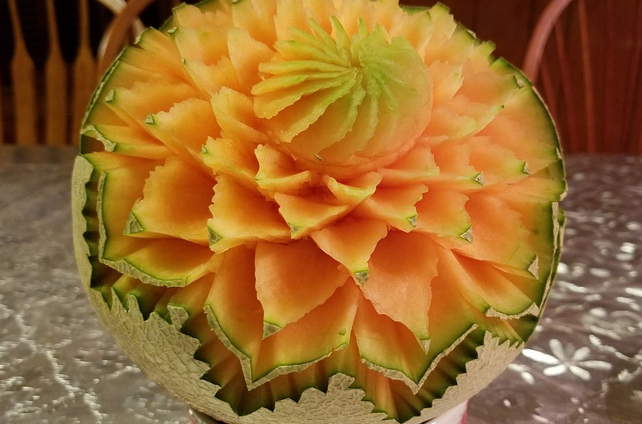
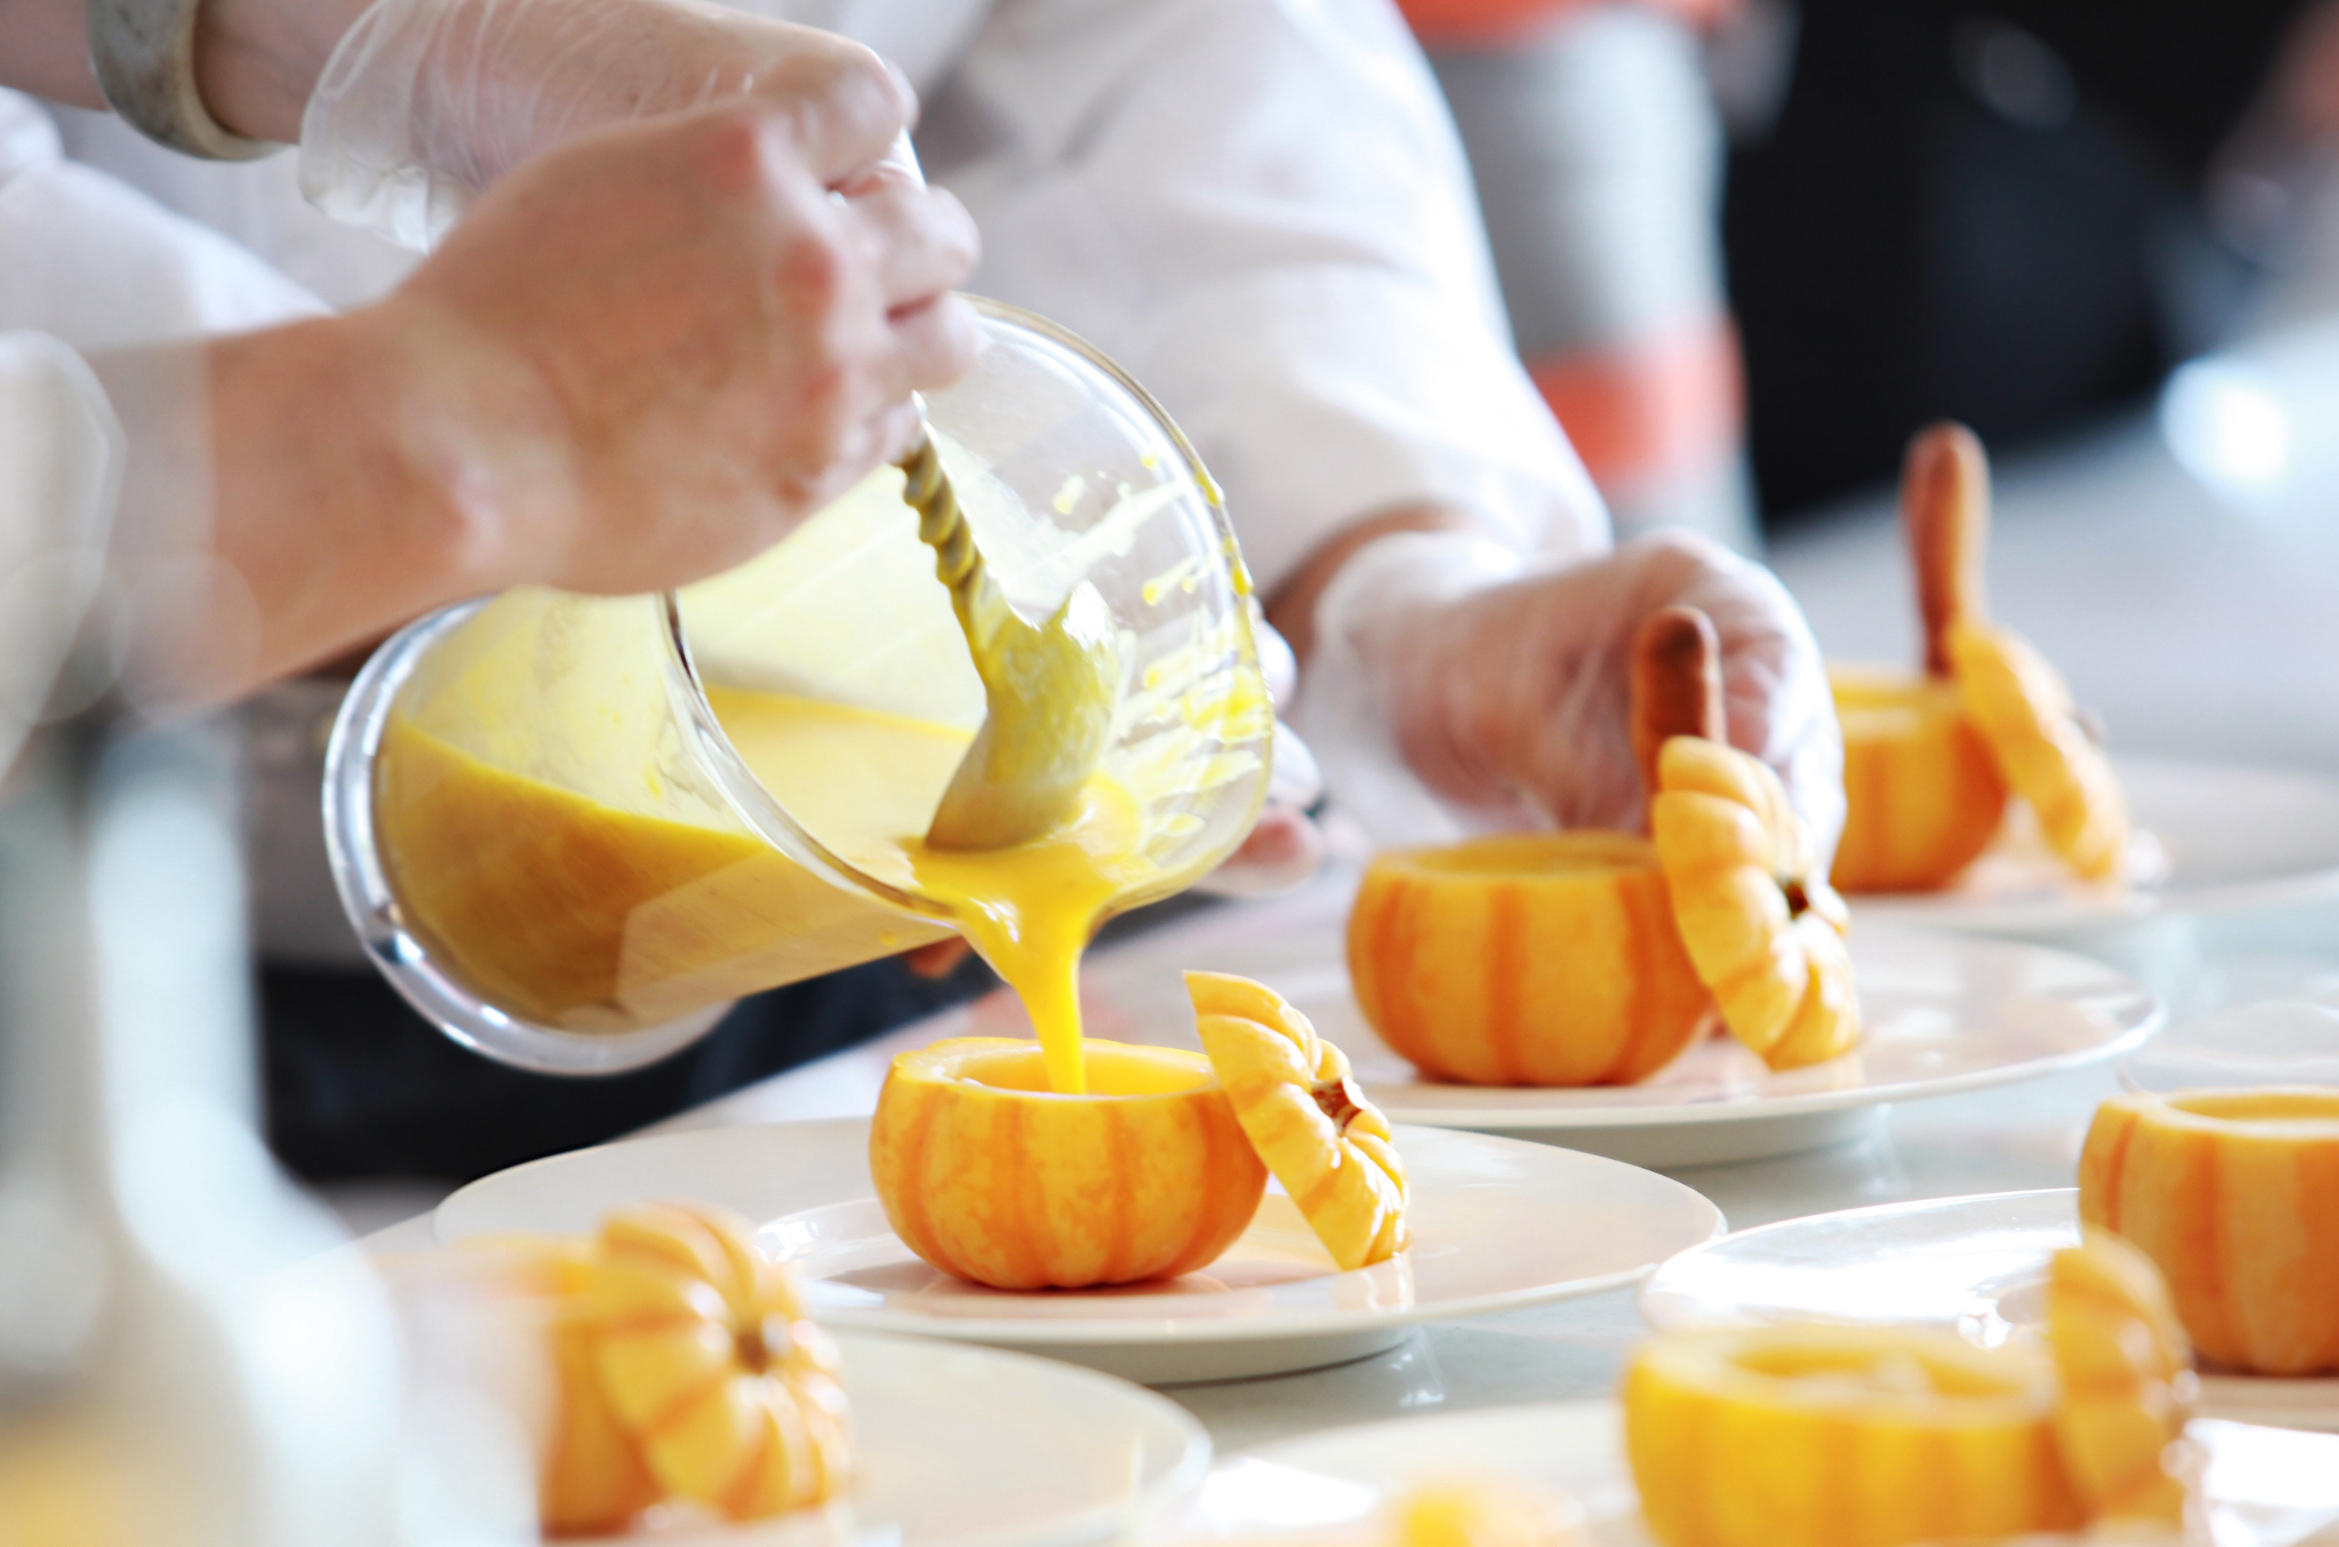
MUTUAL SUPPORT OF METHODS AND DIDACTIC RESOURCES
A GOOD WAY TO COMPOSE METHODS AND MEANS OF TEACHING, SO THAT THEY WOULD SUPPORT EACH OTHER AND COMPLEMENT EACH OTHER, IS THE BASIS FOR THE PREPARATION AND IMPLEMENTATION OF THE TRAINING.
Good preparation will allow you to reliably conduct training and provide participants with the necessary knowledge and skills, and most importantly - guarantee you achieve the desired learning outcomes.
PODCAST
Recording no 1 and 2

Slide 35
THE APPLICATION OF EXPOSITORY METHODS IN THE "FRENCH SEVICE" TRAINING COURSE.
SELECTING METHODS AND DIDACTIC RESCOURCES- EXAMPLES
You can start from telling about elegant service methods. To present the course of the service, use an information lecture interleaved with an interesting description.
In order to illustrate the lecture you can use: a movie or several slides from a multimedia presentation. Do not forget about barriers to perception - if you speak too long, you lose track of the listeners, tell anecdotes about the course of the service, relax the atmosphere and allow you to re-catch the attention of the participants of the training.
EXPOSITORY METHODS
35

Slide 36
APPLICATION OF PROBLEM METHODS IN THE TRAINING ”FRENCH SERVICE "
SELECTING METHODS AND DIDACTIC RESCOURCES- EXAMPLES
Provide a description of the situation when you and your colleague where serving lamb to the guests.
Provoke a brainstorming discussion
You can show a fragment of a similar situation on a film reconstructed from the Internet using a computer or a player.
PROBLEM METHODS

Slide 37
APPLICATION OF PRACTICAL METHODS IN THE TRAINING ”FRENCH SERVICE”
SELECTING METHODS AND DIDACTIC RESCOURCES- EXAMPLES
Prepare a meat dish and side orders. With the application of presentation with explanation explain to the listeners how to lift the tray by performing the roles of one waiter, and then present how the second waiter serves a dish from the tray.
Then do the presentation with the instruction to get involved in the participants' show. Ask one of them to lift the dish, and then serve it to the guests plate, in which the next participant can play the role.
In addition to the dishes and side orders, to perform the exercise you will need equipment: cutlery for service, platter, tableware and table linen - so-called. work items.
PRACTICAL METHODS
37

Slide 38
APPLICATION OF PRACTICAL METHODS IN THE TRAINING ”FRENCH SERVICE”
SELECTING METHODS AND DIDACTIC RESCOURCES- EXAMPLES
Now it is time for the participants to take part in the exercise - each of them is supposed to play the role of the waiter holding the platter, and as the waiter serving the dish . Each participant must have access to exactly the same teaching aids you used during the show.
While doing exercises, do not forget to closely watch the participants and give them your comments about what they are doing.
PRACTICAL METHODS
38

Slide 39
APPLICATION OF PRACTICAL METHODS IN THE TRAINING ”FRENCH SERVICE”
SELECTING METHODS AND DIDACTIC RESCOURCES- EXAMPLES
Based on the observation of direct or filmed participants during work using a camera, you can use the action learning method.
To do this, the participants should analyse the implementation of the exercise by answering the following questions:
Who did the exercise right?
What errors were noted?
Why did they happen ?
How to avoid them in the future?
PRACTICAL METHODS
39

Slide 40
GO TO THE NEXT
MODULE MATERIALS

