Slide 1
PREPARING TRAINING (2)
CHEF
4

Slide 2
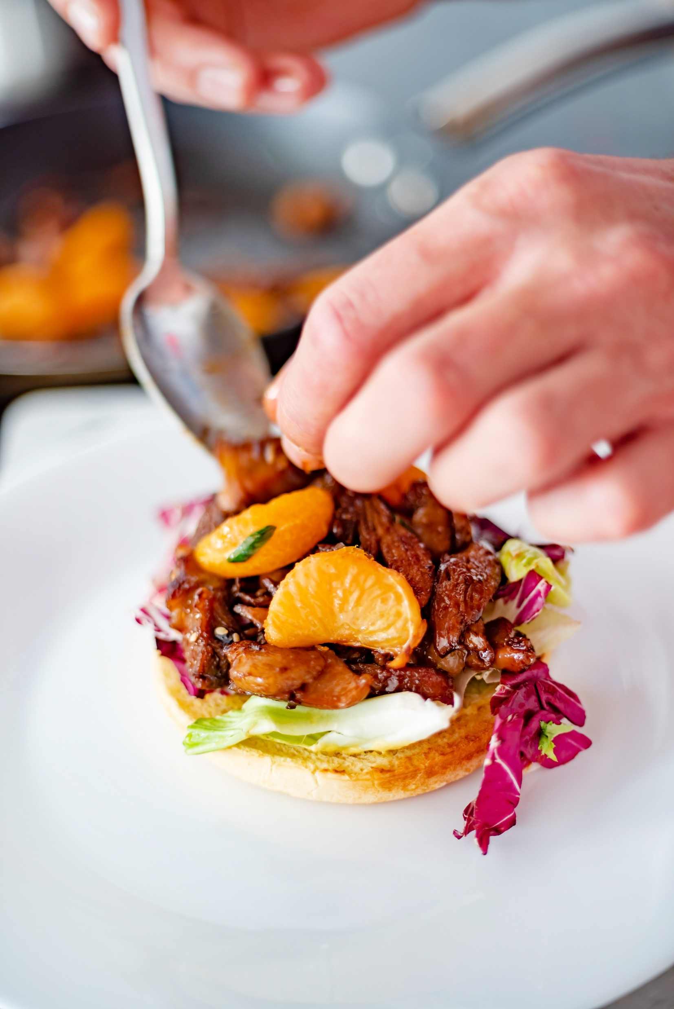
AIM OF TRAINING PREPERATION
RIGHTLY SELECTED METHODS OF TEACHING ALLOW TO ACHIEVE THE SET GOALS .
THANKS TO THAT , THE SKILLS AQUIRED DURING TRAINING APPLY TO EVERYDAY WORK EXERCISES.
IN ORDER TO CHOOSE THE MOST EFFECTIVE METHODS, YOU HAVE TO THINK ABOUT MANY ASPECTS
PODCAST
Recording no 1

Slide 3
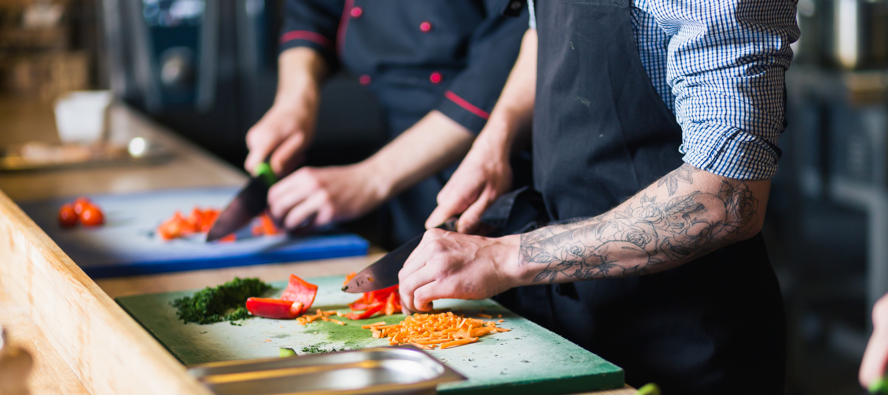
AIM OF TRAINING PREPERATION
IN THIS MODULE, WE WILL LOOK AT PREPARING TRAINING FROM THE TECHNICAL SIDE, AND SELECT THE BEST METHODS OF WORKING WITH THE GROUP AND TEACHING RESOURCES.

Slide 4
EFFECTIVE TEACHING
YOU LEARN THROUGH WHAT YOU…
SEE
WIDZISZ
HEAR
DO
TASTE
IMAGINE
SMELL
FEEL
TOUCH
THINK

Slide 5
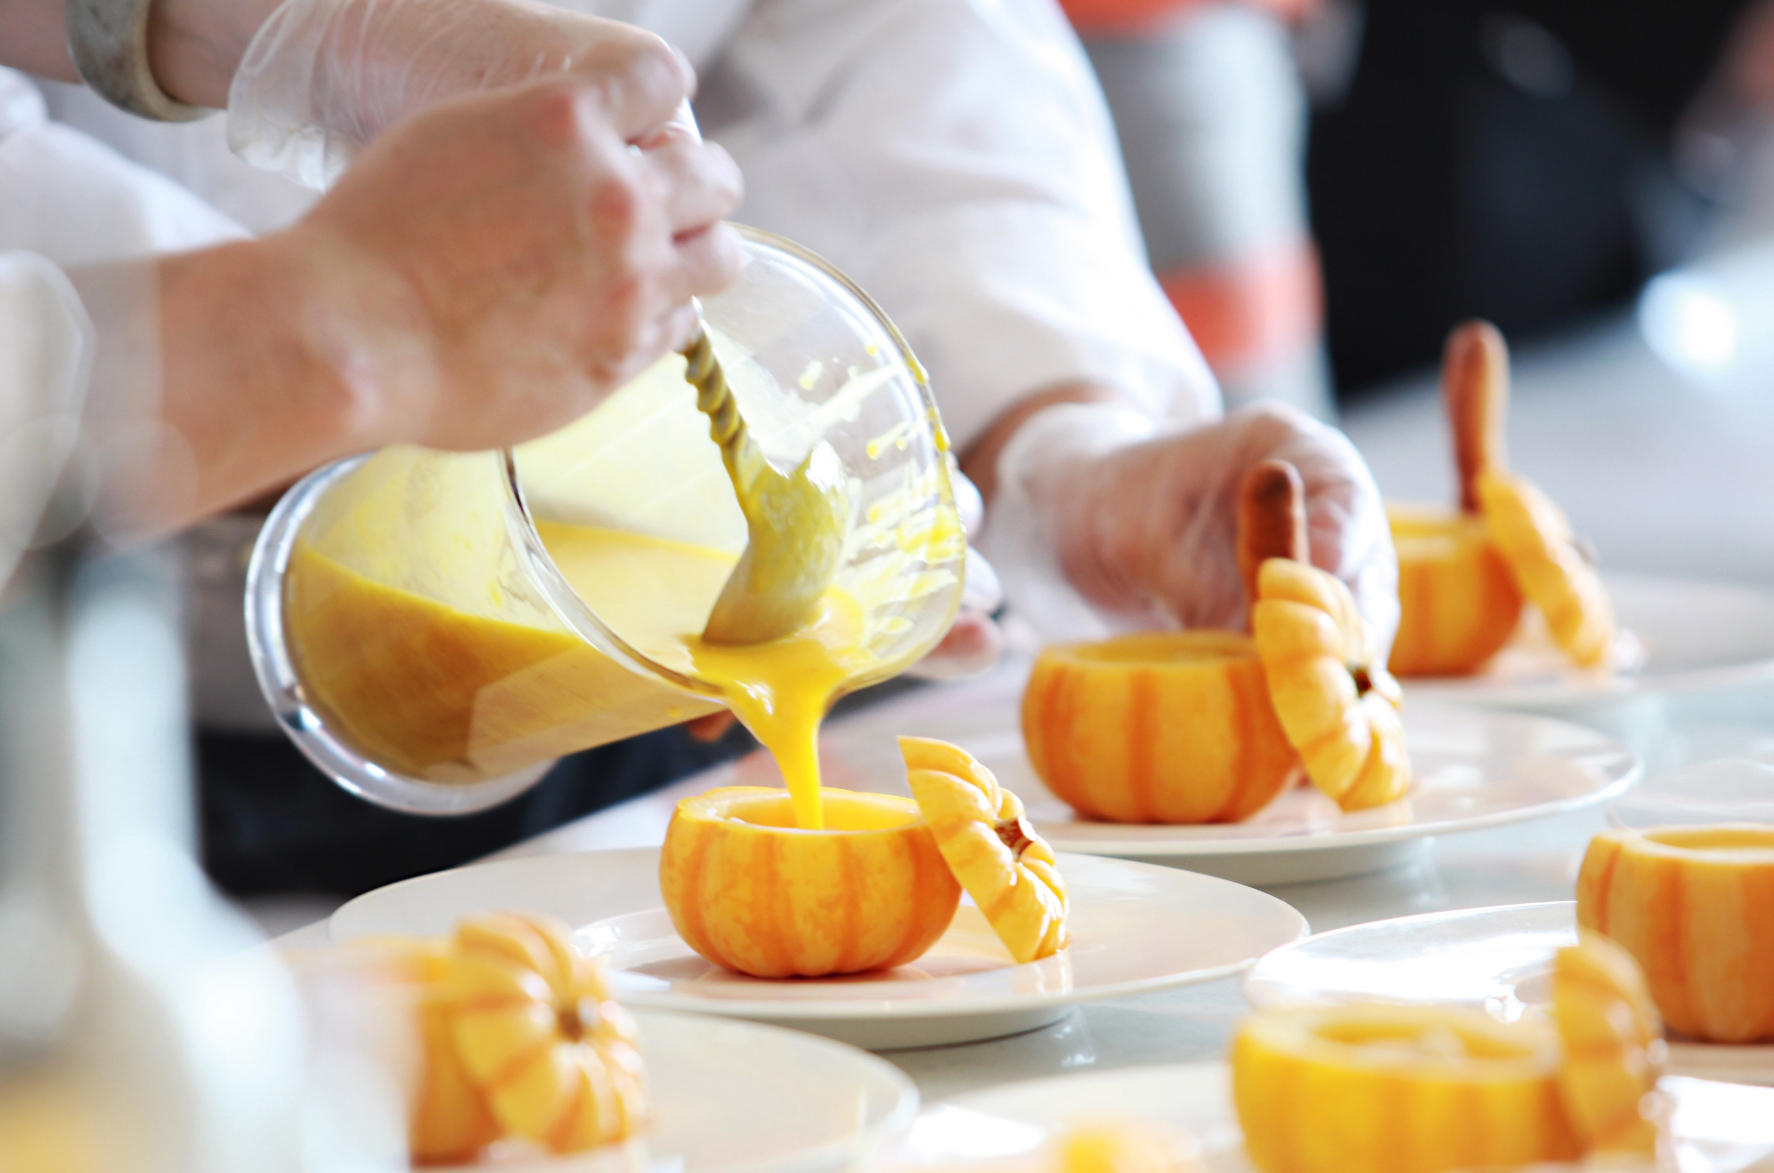
EFFECTIVE TEACHING
In order to transfer new knowledge to the chefs and teach them new skills, the trainer should know that the effect depends on the ways of communication and the preferred learning style
YOU KNOW WHAT YOU HAVE TO LEARN BUT HOW TO DO IT BEST?
We learn from :
What we read - 10%,
What we hear - 20%,
What we see - 30%,
What we see and hear - 50%,
What we say - 70%,
What we say and do - 90%.

Slide 6
EFFECTIVE TEACHING
HOW TO RECOGNISE TYPES OF LEARNERS?
VISUAL
AUDITORY
Usually sits straight and follows the lecturer with his eyes. To recall information, he often recreates the image associated with it
He can repeat words silently or nod. In order to remember the information, he "is listening to the recording in his head
KINESTHETIC
TACTILE
YOU KNOW WHAT YOU HAVE TO LEARN.
BUT HOW TO DO IT BEST?
usually it sits comfortably on a chair, sways or moves in a different way
likes to play with various objects while listening, can also play with hair or rub his hands
KINESETHTIC AND TACTILE ARE OFTEN REFFERED TO AS THE „ACTIVE’’ TYPE
EXAMPLE DOCUMENTS
Work card 1

Slide 7
EFFECTIVE TEACHING
DURING A FIRST DEGREE CARVING COURSE:
A visual learner will benefit the most from viewing carving knives, photographs depicting the course of creating particular sculptures, observing the show, colleagues at work and remembering the picture of what he is doing, he will remember the colours of vegetables and fruits he sees and uses.
A listener will benefit most from the use the commentary for the presentation, lecture, and instruction preceding the exercises,
An active learner will benefit the most from practical exercises: cutting, sculpting and arranging compositions

Slide 8
EFFECTIVE TEACHING
EACH OF THE PARTICIAPANTS HAS ALL OF THE LEARNING STYLES COMBAINED.
Regardless of their interests and predispositions, both participants of cooking courses or carving of various degrees, confectionary as well as specialist trainings concerning eg vegan, French, Italian or Thai cuisine, use all kinds of learning and skills.
Differences between learners depend on different proportions in the participation of individual types of reception and, in general, the domination of one of them.

Slide 9
EFFECTIVE TEACHING
ALL KEYWORDS CAN BE PRESENTED USING VARIOUS METHODS. SELECT AND APPLY THOSE WHICH:
Give the best effects,
Guarantee a clear message,
Allow to create a good atmosphere,
Are able to be applied in specified conditions.
SELECT APPROPRIATE METHODS OF TRANSFERRING KNOWLEDGE

Slide 10
METHOD SELECTION
EXPOSITORY METHODS
They are traditional methods of transferring knowledge.
Remember that focusing on what you hear does not last long.
Listeners will only come out with around 20% of what you said in the lecture.
EXAMPLE DOCUMENTS
Work Card 2
PODCAST
Recording no 1

Slide 11
METHOD SELECTION
EXPOSITORY METHODS MOST OFTEN USED IN TRAINING
LECTURE | verbal information transfer Eg the differences between hard and soft fruits
DISCUSSION | A discussion with participants of the training and referring to their knowledge and experience g. About using fruits and their characteristics
NARRATIVE | Verbal presentation of some action or event Eg. The last carving contest

Slide 12
METHOD SELECTION
EXPOSITORY METHODS MOST OFTEN USED IN TRAINING
DESCRIPTION | characterisation of objects, phenomena, activities unknown to participants – e.g. Carving techniques used by master chefs from Thailand
ANEGDOTE | short story about some funny or unusual event, ended with a surprising, witty point, for example about exchanging sentences with guests, such as: a story about a swan carved from a watermelon which fell apart during a party
INSTRUCTION | explanation for understanding the phenomenon, Eg why should we keep sculptures from fruit and vegetables in cold water

Slide 13
METHOD SELECTION
PROBLEM METHOD
These methods are much more effective than expository methods. Thanks to the involvement of the participants in solving problems set up by the trainer, they become active and strive for the final solution.
It should not be forgotten that such methods are more demanding from the participants, but also from the trainer, who must actively correct and determine the way to solve the problem.
EXAMPLE DOCUMENTS
Work Card 3
PODCAST
Recording no 2

Slide 14
METHOD SELECTION
PROBLEM METHOD
MOST OFTEN USED DURING TRAINING AND COURSES
PROBLEM LECTURE | Lecture consisting in proposing a problem by the trainer and then pointing out possible solutions and consequences, for example: Herring was ordered for a wedding reception of 60 people. The recipe assumes a 10% vinegar use however, there is not enough of it in storage but there is enough of wine vinegar 6%.
CONTROVERSIAL LECTURE | It consists in interleaving it with the participants' statements or carrying out their tasks E.g. The strengths and weaknesses of using the cook&chill system during organising large events.
CLASSIC PROBLEM METHOD | It consists in solving the problem situation by the learners themselves and indicating possible solutions, e.g. the trainer describes a situation where a chef gets a complaint that the guest who ordered the roasted pheasant found a bullet in it.

Slide 15
METHOD SELECTION
ACTIVATING METHODS
MOSTLY USED AT TRAININGS AND COURSES
CASE AND SITUATIONAL METHODS | rely on presenting participants with a description of a case or situation and motivating them to evaluate events, indicating possible solutions, eg there is a reservation for 60 people however, 10 more show up
DIFFERENT TYPES OF DISCUSSION | they rely on the exchange of ideas and views on a given topic in a different way, they support both substantive training and social competences, eg. Is it worth to apply the sous vide method in gastronomical establishments?
PRACTICAL METHODS | rely on practicing practical exercises including new professional tasks. They are discussed later.

Slide 16
METHOD SELECTION
PROBLEM METHODS-ACTIVATING
Activity and creativity is the quintessence of every chef's work. These methods involve all the senses of participants in the training, which makes them the best for learning new knowledge and gaining skills.
Their use makes learning become active and creative just like the work in the kitchen.

Slide 17
METHOD SELECTION
PROGRAM METHODS
The most important element of this kind of teaching is a proper computer program, in which a properly ordered set of commands is contained.
The execution of the command may be conditioned by the execution of the previous one. This process does not have to involve a trainer.
AN EXAMPLE:
Creating a raw material order using a computer software for a work anniversary party.
AN EXAMPLE:
Creating a raw material order using a computer software for a work anniversary party.

Slide 18
METHOD SELECTION
EXPOSITORY METHOD
(engaging mainly the visual sense) used in training and courses
METODY EKSPONUJĄCE (angażujące głównie zmysł wzroku) wykorzystywane w szkoleniach i na kursach
SHOWS | they rely on the presentation of the way the task is performed, eg the trainer shows how to carve a rose in a watermelon
FILMS | they are particularly useful when the training conditions differ significantly from the actual ones in which the vocational training tasks are to be performed or when they do not allow to conduct a demonstration or exercises e.g. roasting a salmon on a spit during a garden party
SCENES | used mainly during the training of social competences, they show possible responses and behaviours of people e.g the chef’s reaction to negative feeback from the customers
EXHIBITIONS | they are extensive expositions, organized mainly at trade fairs and competitions e.g an exhibion of sculptures done using the carving method
PODCAST
Recording no 1

Slide 19
METHOD SELECTION
PRACTICAL METHODS
Commonly used in the training of chefs, because they are connected directly with the activities that are to be mastered. These methods have the best effect, because they combine the verbal message, image and activation of the participant.
They assume the full activity of participants on training.
EXAMPLE DOCUMENTS
Work Card 2
PODCAST
Recording no 1 and 2

Slide 20
METHOD SELECTION
METODY PRAKTYCZNE
PRACTICAL METHODS
Most often used in training of chefs
SHOW WITH EXPLANATION | Connecting the show with explanations regarding the presented object or phenomenon, e.g. a show of a new convection oven with an explanation of it functions
SHOW WITH INSTRUCTIONS | a combination of a demonstration explaining how to proceed and the order in which the activity is carried out, e.g. showing how to carve a flower from a courgette with instructions

Slide 21
METHOD SELECTION
METODY PRAKTYCZNE
PRACTICAL METHODS
Most often used in training of chefs
COURSE, LABORATORY AND PRODUCTION EXERCISES | practical execution of professional tasks in contractual, low-simulated and real conditions, eg Using sweet potato in dishes
PREPARING THE PROJECT | development of a service, system or object design along with relevant information, e.g a project of banquet table decoration using sculptures from fruit done by the carving technique

Slide 22
METHOD SELECTION
PRACTICAL METHOD
Demonstrations, exercises, projects are very effective methods, thanks to which one can acquire knowledge and skills gradually and with increasing difficulty.
The action learning method is constructed "vice versa". It focuses on the analysis of actions already taken, from which knowledge emerges leading to the improvement of skills and quality of future behaviours. This analysis includes answering questions:
Where?, who?, when?, what?, why?, how big?, how many?

Slide 23
METHOD SELECTION
PRACTICAL METHOD – action learning
For example after an observation of :
Carving sculptures from hard vegetables (carott, cellery, raddish)
Making decorations from caramel
A film which shows how to compose dishes based on molecular kitchen
you should point out all correctly completed activities, all errors noticed, consider how many of them were, why they were committed and what to do to avoid them in the future.

Slide 24
METHOD SELECTION
PRACTICAL METHODS
JUST DO IT !
There are no skills that can be taught efficiently without practical exercises.
Without effort it won’t work!

Slide 25
METHOD SELECTION
DURING METHOD WORK THE TRAINER SHOULD CONSIDER:
set goals,
types and scope of the content of education,
diversity of participants,
training conditions (time, number of participants, available funds, etc.).
The methods can be combined with each other which will enable a flexibility of going from one keyword to another.

Slide 26
METHOD SELECTION
BECAUSE THE BRAIN CANNOT FOCUS ON EVERYTHING, THE BORING AND MONNOTONE WORKSHOPS WILL NOT BE REMEMBERED

Slide 27
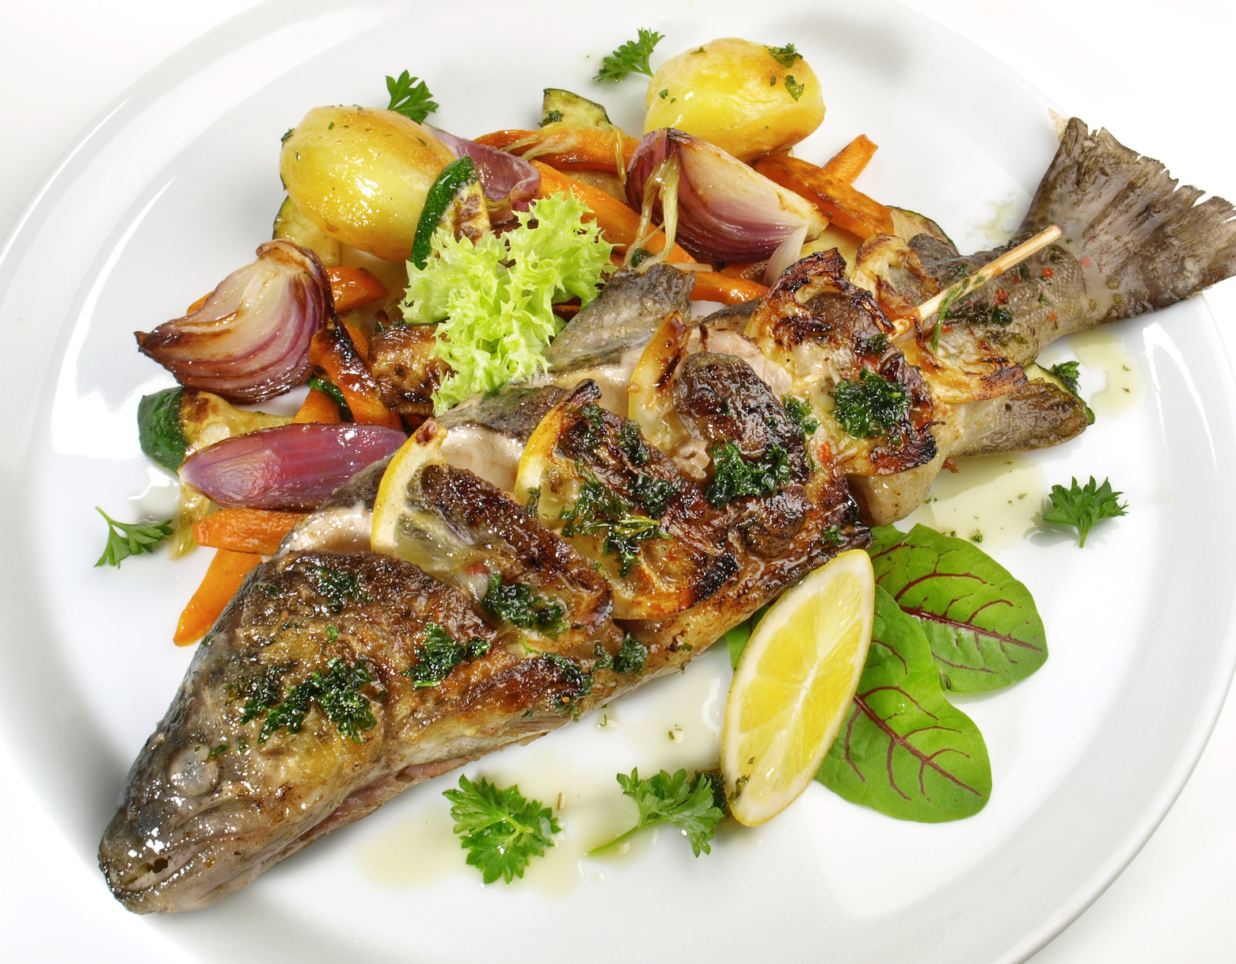
DIDACTIC RESOURCES
These are the specific objects which facilitate the proces of gaining and transfeering of skills and knowledge
They can fulfill their task of facilitating learning if they:
trigger certain stimuli for sight, hearing, touch and smell,
teach what they should,
unambiguously present the characteristics of objects, phenomena,
Are consistent with the content and purpose of the message
DIDACTIC RESOURCES
PODCAST
Recording no 1 and 2

Slide 28
TEACHING AIDS
DIDACTIC RESOURCES
TECHNICAL AIDS
LEARNING MATERIALS
PEDAGOGICAL WORKING AIDS
28

Slide 29
DIDACTIC RESOURCES
VISUAL
graphic (maps, charts)
pictorial (illustrations, photographs)
books
Example: A diagram of a convection oven
SPATIAL
static (exhibits, models)
movable (exhibits, models)
Example: movable confectionery model
TEACHING AIDS
PODCAST
Recording no 1

Slide 30
DIDACTIC RESOURCES
VISUAL
AUDITORY
AUDIO-VISUAL
SLIDES
e.g. a slide show on CCP monitoring
PRINT OUTS
E.g. recepies
RECORDINGS
e.g. An interview with a chef on student nutrition in schools
FILMS
E.g. presentation of preparing a pasta by a Chinese chef by stretching method
PROGRAMS
e.g. a report on a carving contest
TEACHING AIDS
PODCAST
Recording no 2

Slide 31
DIDACTIC RESOURCES
COMPUTER
RECORDING
PLAYERS
INTERNET
MULTIMEDIA PRESENTATIONS
CAMERA
VIDEO CAMERA
DICTAPHONE
TAPE RECORDER
MULTIMEDIA
CD
DVD
TECHNICAL AIDS

Slide 32
DIDACTIC RESOURCES
DIDACTIC RESOURCE CHARACTERISTICS:
Resources which are visual should be clear, highlighting the details you need,
Exhibitions and models should be close to reality,
Print out materials should relate only to the subject of the training,
Recorded materials should be of good quality, clear and without any unnecessary background noises
Films and short programs which from a few to several minutes,
multimedia presentations clear, clearly visible, without excess text,
technical means efficient, adapted to the training conditions

Slide 33
DIDACTIC RESOURCES
PEDAGOGICAL WORKING AIDS
WIDZISZ
MACHINES AND DEVICES
for example: freezer, convection oven, electric grill
ITEMS / RAW MATERIALS
e.g. meat, flour, dishes
and alcoholic, coffee
TOOLS
for example: scales, can openers
INSTRUMENTS
e.g. carving knife, cutting knife

Slide 34
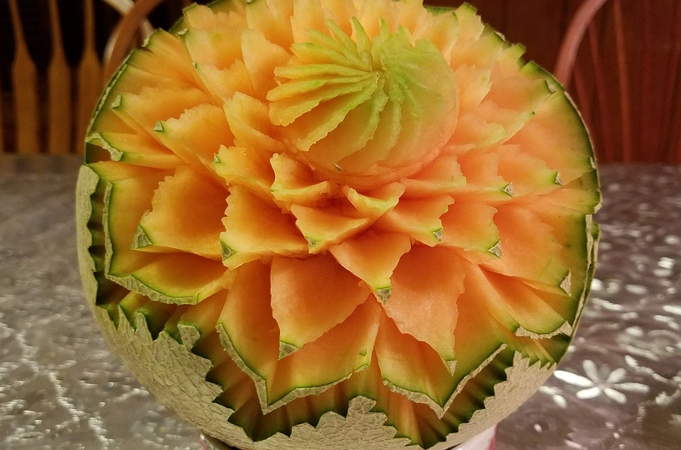
MUTUAL SUPPORT OF METHODS AND DIDACTIC RESOURCES
ALLOWS FOR A FULL AND CLEAR KNOWLEDGE AND SKILL TRANSFER.
ACTIVATES THE SENSES, FACILITATES REMEBERING AND ACHIEVING SET GOALS.

Slide 35
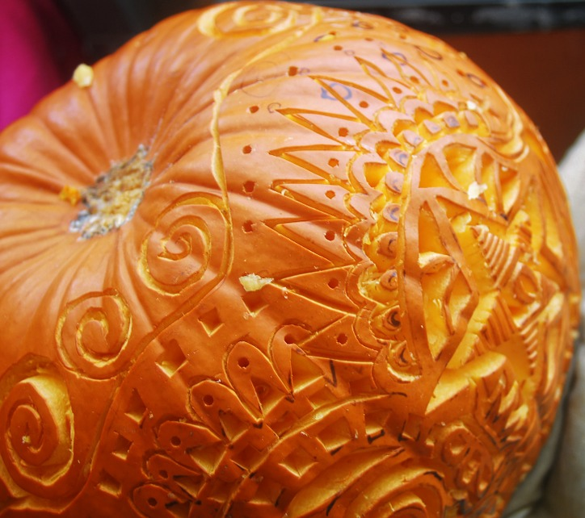
APPLICATION OF EXPOSITORY METHODS IN THE TRAINING ”FIRST DEGREE CARVING"
SELECTING METHODS AND DIDACTIC RESCOURCES- EXAMPLES
You can start with a short story about why carving is used. To present the history of carving use an information lecture interspersed with anecdotes and fun facts.
To illustrate the lecture, you can use: photography, film or slides from a multimedia presentation.
If you want to relax the atmosphere a bit, talk about your own experience related to the topic.
EXPOSITORY METHODS

Slide 36
APPLICATION OF PROBLEM METHODS IN THE TRAINING ”FIRST DEGREE CARVING"
SELECTING METHODS AND DIDACTIC RESCOURCES- EXAMPLES
Provide a description of the situation when you or your colleague started for the first time in the ”Art of carving" contest or a similar event and something unexpectedly happened.
Provoke a brainstorming discussion of how you can behave in a similar situation and what the consequences may be.
You can show a fragment of a similar event on a film reconstructed from the Internet using a computer or a player.
PROBLEM METHODS

Slide 37
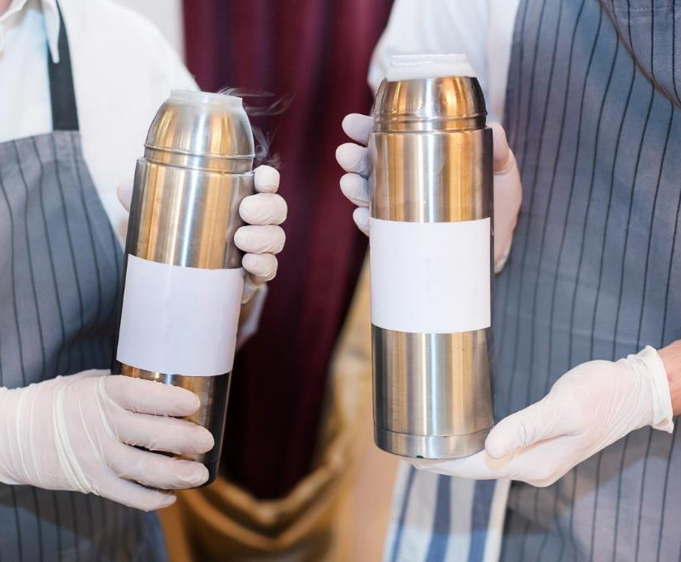
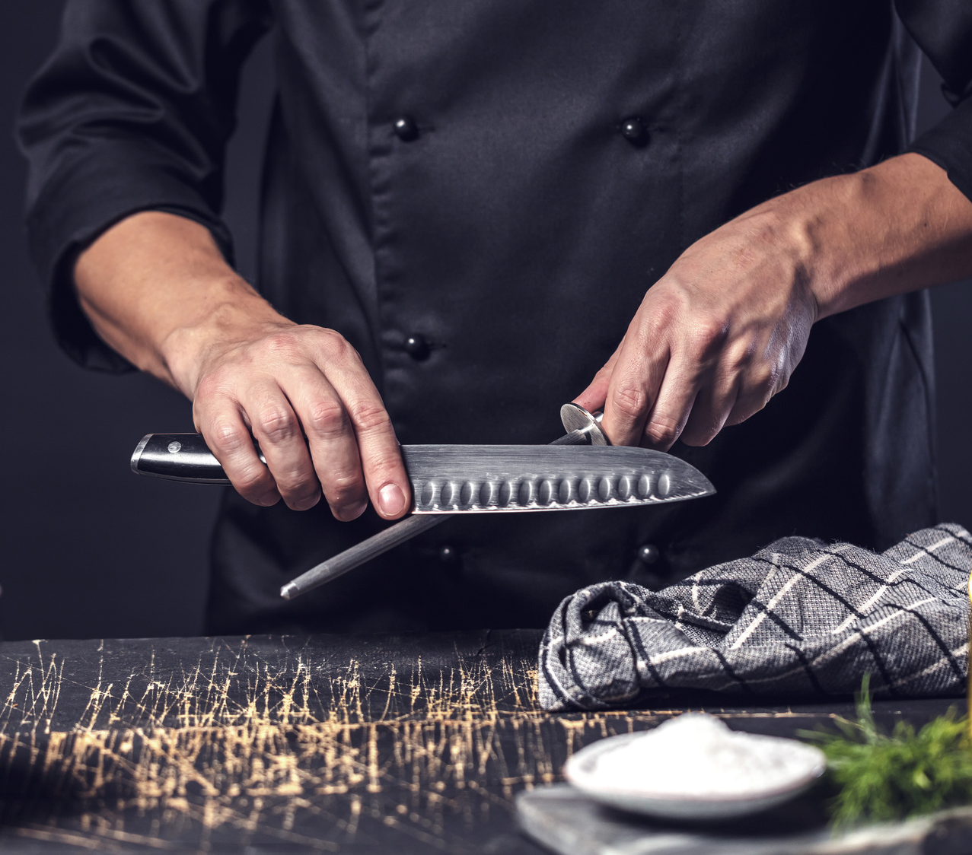
APPLICATION OF PRACTICAL METHODS IN THE TRAINING ”FIRST DEGREE CARVING"
SELECTING METHODS AND DIDACTIC RESCOURCES- EXAMPLES
Prepare a stand for the preparation of carving from fruit and vegetables. Show products that are best for this.
Using the presentation with explanation, present the knives used for carving and their uses.
Then do the demonstration with instructions on how to perform the sample sculpture from for example a carrot.
To carry out the exercise you will still need work items; a bowl, water, chopping board
PRACTICAL METHODS

Slide 38
SELECTING METHODS AND DIDACTIC RESCOURCES- EXAMPLES
APPLICATION OF PRACTICAL METHODS IN THE TRAINING ”FIRST DEGREE CARVING"
Participants should join individual exercise classes, i.e. each of them has the task to perform;
a number of sculptures from fruit and vegetables according to your instructions with the possibility of using the same means and materials as used during the show.
During the exercise, the trainer shares observations and comments.
PRACTICAL METHODS
38

Slide 39
APPLICATION OF PRACTICAL METHODS IN THE TRAINING ”FIRST DEGREE CARVING"
SELECTING METHODS AND DIDACTIC RESCOURCES- EXAMPLES
Based on the observation of direct or filmed participants during work using a camera, you can use the action learning method.
To do this, the participants should analyse the implementation of the exercise by answering the following questions:
Who did what right?
What errors were noted when using the carving knives?
Why did they happen ?
How to avoid them in the future?
PRACTICAL METHODS
39

Slide 40
GO TO THE NEXT
MODULE MATERIALS

