Slide 1
PREPARING TRAINING (2)
BARMAN
4

Slide 2
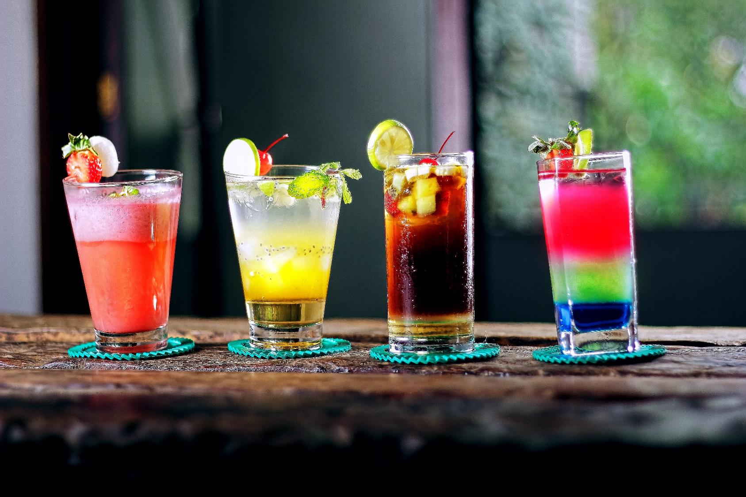


AIM OF TRAINING PREPERATION
The selection of appropriate training methods and supporting teaching and technical resources will facilitate the achievement of the assumed effects by the participants of the course.
PODCAST
Recording 1

Slide 3


AIM OF TRAINING PREPERATION
IN THIS MODULE, WE WILL CONCENTRATE ON PREPARING TRAINING FROM THE TECHNICAL SIDE AND SELECTING THE METHODS OF WORKING WITH THE GROUP AND DIDACTIC MEASURES

Slide 4

EFFECTIVE TEACHING
YOU LEARN THROUGH WHAT YOU…
SEE
WIDZISZ
HEAR
DO
TASTE
IMAGINE
SMELL
FEEL
TOUCH
THINK

Slide 5


EFFECTIVE TEACHING
If the trainer wants to train bartenders in the field of new skills, he should know that the results obtained depend on the methods used.
The average person will learn:
from what he reads once - about 10%,
from what he hears - about 20%,
from what he sees - about 30%,
from what he sees and hears - about 50%,
from what he says - about 70%,
from what he says and does - about 90%.
YOU KNOW WHAT YOU HAVE TO LEARN BUT HOW TO DO IT BEST?

Slide 6


EFFECTIVE TEACHING
CHOOSE METHODS TO TRANSFER KNOWLEDGE, REMEMBER THEIR EFFICIENCY OF EFFECT.
VISUAL
AUDITORY
Usually sits straight and follows the lecturer with his eyes. To recall information, he often recreates the image associated with it
He can repeat words silently or nod. In order to remember the information, he "is listening to the recording in his head"
KINESTHETIC
TACTILE
YOU KNOW WHAT TO LEARN.
BUT HOW TO DO IT BEST?
usually it sits comfortably on a chair, sways or moves in a different way
likes to play with various objects while listening, can also play with hair or rub his hands
KINESETHTIC AND TACTILE ARE OFTEN REFFERED TO AS THE „ACTIVE’’ TYPE
EXAMPLE DOCUMENTS
WORK CARD 1

Slide 7

EFFECTIVE TEACHING
During the training on modern trends in decorating cocktails:
A visual learner will benefit most from image presentation or film on preparation of decorative elements, photographs or slides depicting ready decorations, observation of real decorative materials, demonstration, work of colleagues and remembering the image of what he does himself,
A auditory learner will benefit mostly from the commentary on the presentation, discussing different materials, the rules for their use, the pre-exercise instruction on the preparation of decorative elements and composition decorations,
An active learner will benefit mostly from active participation in the presentation of the preparation of the workplace, the formation of decorations and the independent performance of these activities.

Slide 8

EFFECTIVE TEACHING
.
Every person is a bit of a auditory, visual, tactile and kinesthetic learner
However, individual features dominate to different degrees and are used in various ways, depending on the situation.
Regardless of the subject of the training, participants of bartending courses of various degrees, baristas or sommeliers as well as specialist trainings, use all methods of acquiring knowledge and skills.

Slide 9

EFFECTIVE TEACHING
Regardless of the topic and objectives of the training, regardless of whether it concerns basic bartending or specialist skills, such as flair or latte art and other necessary skills in this profession, the trainer's duties include discussing, explaining, showing and enabling participants to perform similar tasks in practice, sharing materials, recording observations, or the use of different training methods.

Slide 10


METHOD SELECTION
ALL KEYWORDS CAN BE PRESENTED USING VARIOUS METHODS. SELECT AND APPLY THOSE WHICH:
Give the best effects,
Guarantee a clear message,
Allow to create a good atmosphere,
Are able to be applied in specified conditions.
SELECT THE METHODS OF TRANSFERRING KNOWLEDGE

Slide 11
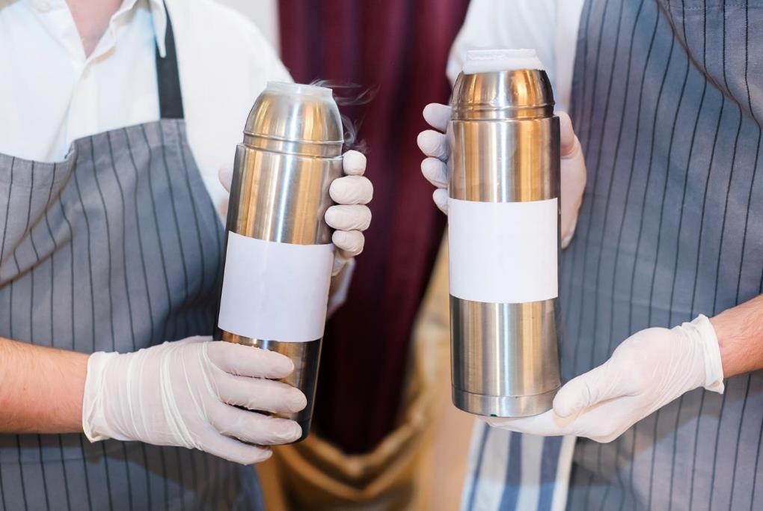

METHOD SELECTION
EXPOSITORY METHODS
They are traditional methods of transferring knowledge.
They rely on providing information orally.
Their effectiveness is not high - around 20%, unless they are supported by the use of appropriate teaching resources
EXAMPLE DOCUMENTS
Word card 2
PODCAST
Recording no 1

Slide 12
METHOD SELECTION
EXPOSITORY METHODS MOST OFTEN USED IN TRAINING
LECTURE | verbal information transfer - eg content on the characteristics of whiskey, beer, rum-based cocktails
DISCUSSION | A discussion with participants of the training and referring to their knowledge and experience, eg on the use of martini glasses for various types of cocktails
NARRATIVE | verbal presentation of some action or event, e.g. resolving a conflict situation between guests

Slide 13
METHOD SELECTION
EXPOSITORY METHODS MOST OFTEN USED IN TRAINING
DESCRIPTION | characterisation of objects, phenomena, activities unknown to participants – e.g. differences in the colour of rum, depending on the time of aging
ANEGDOTE | short story about some funny or unusual event, ended with a surprising, witty point, for example about exchanging sentences with guests, such as: How should this beer taste? So, that Chelsea wins.
INSTRUCTION | explanation for understanding the phenomenon, eg how to pour ingredients into campari with orange juice, so that they do not mix

Slide 14

METHOD SELECTION
PROBLEM METHOD
They involve much more commitment on the part of training participants than the expository methods.
They require active participation related to the solution of a given problem posed in a way that that trainer determines.
The effectiveness of these methods is much higher than the expository method , because it forces the need to find the final solution.
EXAMPLE DOCUMENTS
Word card 3
PODCAST
Recording no 2

Slide 15
METHOD SELECTION
PROBLEM METHOD
MOST OFTEN USED DURING TRAINING AND COURSES
PROBLEM LECTURE | Lecture consisting in proposing a problem by the trainer and then pointing out possible solutions and consequences, for example: It is time to close, and a group of guests are still sat at the bar having a great time.
CONTROVERSIAL LECTURE | It consists in interleaving it with the participants' statements or carrying out their tasks, eg. After discussing the rules for cutting out decorative elements from sugar masses, participants sketch designs of these decorations.
CLASSIC PROBLEM METHOD | It consists in solving the problem situation by the learners themselves and indicating possible solutions, eg. The leader describes the situation in which the bartender brings the ordered drink to the table and at the same time the guest sitting at the bar smashes a glass of cocktail.

Slide 16
METHOD SELECTION
ACTIVATING METHODS
MOSTLY USED AT TRAININGS AND COURSES
CASE AND SITUATIONAL METHODS | rely on presenting participants with a description of a case or situation and motivating them to evaluate events, indicating possible solutions, eg a guest complains that the glass of white wine ordered by him is insufficiently chilled. How should the bartender react?
DIFFERENT TYPES OF DISCUSSION | they rely on the exchange of ideas and views on a given topic in a different way, they support both substantive training and social competences, eg. Why do only a few women work in the bartender's profession?
PRACTICAL METHODS | rely on practicing practical exercises including new professional tasks. They are discussed later.

Slide 17

METHOD SELECTION
PROBLEM METHODS-ACTIVATING
they are the best methods for gaining knowledge and skills, because they involve more senses than sight and hearing,
when they are used,
learning is active.
EXAMPLE DOCUMENTS ]
Work Card 3
PODCAST
Recording no 2

Slide 18
METHOD SELECTION
PROGRAM METHODS
The most important element of this kind of teaching is a proper computer program, in which a properly ordered set of commands is contained.
The execution of the command may be conditioned by the execution of the previous one. This process does not have to involve a trainer.
An example can be:
calculation of raw material demand for a bar order for a garden party for 90 people, using a computer program

Slide 19
METHOD SELECTION
EXPOSITORY METHOD
(engaging mainly the visual sense) used in training and courses
SHOWS | they rely on the presentation of the way the task is performed, eg the trainer shows the correct way of filling the glass with a cocktail with different density components
FILMS | they are particularly useful when the training conditions differ significantly from the actual ones in which the vocational training tasks are to be performed or when they do not allow to conduct a demonstration or exercises, e.g. presentation of the flair show on a big stage, for example during a garden party
PODCAST
Recording no 1

Slide 20
METHOD SELECTION
EXPOSITORY METHOD
(engaging mainly the visual sense) used in training and courses
SCENES | used mainly during the training of social competences, they show possible responses and behaviours of people, eg various typical behaviours of customers while sitting in a bar
EXHIBITION | they are extensive expositions, organized mainly at trade fairs and competitions, e.g. an exhibition devoted to modern trends in decorating cocktails

Slide 21

METHOD SELECTION
PRACTICAL METHODS
They are associated with the performance of activities that are to be mastered. These methods have the best effectiveness because they combine the verbal message, image and activation of the participant and practice skills, inseparable from the work of the bartender.
These are the methods that activate not only the senses but can exercise the physical fitness of the bartenders, which is necessary during the Flair training
EXAMPLE DOCUMENTS
Work card 2
PODCAST
Recording 2

Slide 22
METHOD SELECTION
EXPOSITORY METHOD
(engaging mainly the visual sense) used in training and courses
SHOW WITH EXPLANATION | Connecting the show with explanations regarding the presented object or phenomenon, e.g. a display of a modern ice cube machine with an explanation of its function
SHOW WITH INSTRUCTIONS | a combination of a demonstration explaining how to proceed and the order in which the activity is carried out, e.g. show of decoration from grass and fruit combined with explanation of fixing it on a bar glass

Slide 23
METHOD SELECTION
EXPOSITORY METHOD
(engaging mainly the visual sense) used in training and courses
COURSE, LABORATORY AND PRODUCTION EXERCISES | practical execution of professional tasks in contractual, low-simulated and real conditions, eg preparation of decorative elements from different materials, composition and decorating of glass
PREPARING THE PROJECT | development of a service, system or object design along with relevant information, e.g. designs for decorating cocktails based on brandy.

Slide 24
METHOD SELECTION
PRACTICAL METHODS– action learning
The method is based on the observation of:
Events (e.g. flair presentations),
the process (eg changes in the colour of the cocktail when combining the ingredients),
performing a job task in reality or on a recording (eg preparing decorations and decorating a cocktail)
and then to analyse the regularity, errors, the causes of them, and how to avoid them in the future

Slide 25
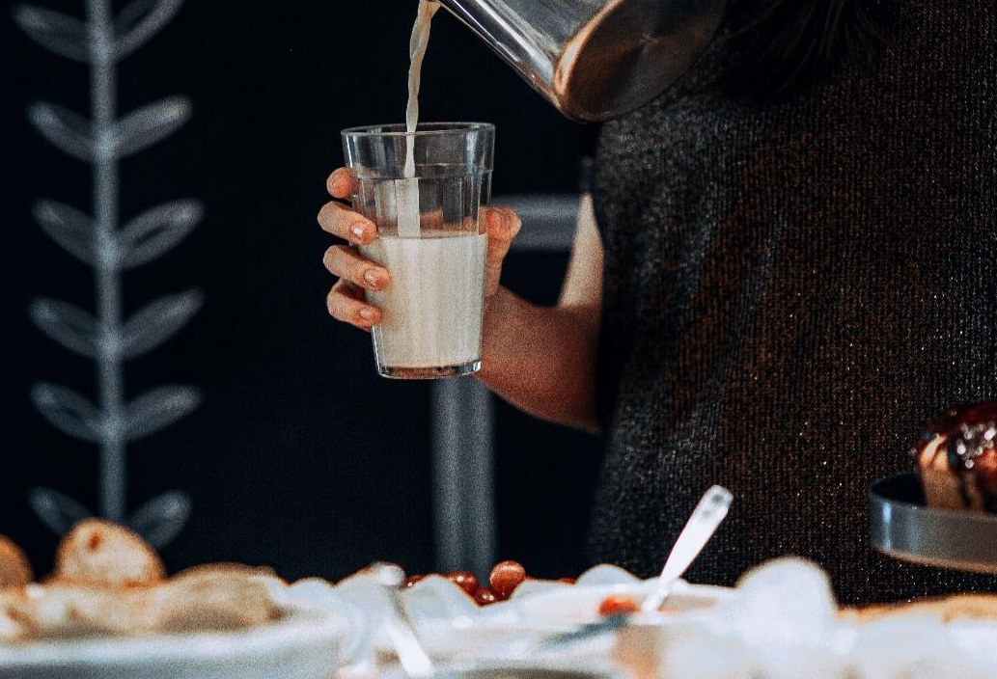

METHOD SELECTION
SHOULD ACKNOWLEDGE:
set goals,
types and scope of the content of education,
diversity of participants,
training conditions (time, number of participants, available funds, etc.).
The methods can be combined with each other. This allows you to get a better dynamic of activities anddirecting the participants' attention to presented issues.

Slide 26
METHOD SELECTION
SHOULD BE WELL THOUGHT THROUGH
The training subject to some extent suggests the choice of methods.
However, it should be remembered that training focused mainly on the transfer of content, e.g. in the field of health and safety, should not be based solely on expository method.
Similarly, practical and workshop training, such as the Flair or Latte Art course, must contain a certain well-balanced portion of theory.

Slide 27

METHOD SELECTION
There are no strategies, methods or techniques
of teaching-learning which are
uniquely the best.
In your work, apply the principle:
SAFETY IN VARIETY

Slide 28

DIDACTIC RESOURCES
These are material objects supporting the process of transferring and acquiring knowledge and skills.
Their selection depends on:
the function they will perform,
the training method they will support,
themes that they will illustrate.
DIDACTIC RESOURCES
PODCAST
Recording no 1

Slide 29

TEACHING AIDS
DIDACTIC RESOURCES
TECHNICAL AIDS
LEARNING MATERIALS
PEDAGOGICAL WORKING AIDS
29

Slide 30

DIDACTIC RESOURCES
VISUAL
graphic (maps, charts)
pictorial (illustrations, photographs)
books
Examples: illustrations showing different bar arrangements, different patterns of presenting cocktails
SPATIAL
static (exhibits, models)
movable (exhibits, models)
Examples: folded coffee maker mode
TEACHING AIDS
PODCAST
1

Slide 31

DIDACTIC RESOURCES
VISUAL
AUDITORY
AUDIO-VISUAL
SLIDES
e.g. showing systems for suspending glasses over a bar counter
PRINT OUTS
E.g. cocktail recepies
RECORDINGS
e.g. a bartender conversation with guests placing orders
FILMS
E.g. flair show
PROGRAMS
e.g. a report from the flair competition
TEACHING AIDS
PODCAST
2

Slide 32


DIDACTIC RESOURCES
COMPUTER
RECORDING
PLAYERS
INTERNET
MULTIMEDIA PRESENTATIONS
CAMERA
VIDEO CAMERA
DICTAPHONE
TAPE RECORDER
MULTIMEDIA
CD
DVD
TECHNICAL AIDS

Slide 33
DIDACTIC RESOURCES
IN ORDER TO FULFILL THEIR FUNCTION THEY SHOULD BE:
clear, highlighting the details you need,
close to reality,
related to the subject of the training,
good quality,
films and short programs which from a few to several minutes,
multimedia presentations clear, clearly visible, without excess text,
technical means efficient, adapted to the training conditions

Slide 34
DIDACTIC RESOURCES
PEDAGOGICAL WORKING AIDS
WIDZISZ
MACHINES AND DEVICES
for example, a coffee machine that boils water, grinds coffee, dispenses it, brews and pours and froths milk, ice cube maker
ITEMS / RAW MATERIALS
e.g. dishes, bar glass, non-alcoholic beverages
and alcoholic, coffee
INSTRUMENTS
e.g. muddler, shaker, wine openers, bottle openers
TOOLS
for example, decoration cutters, dispensers

Slide 35
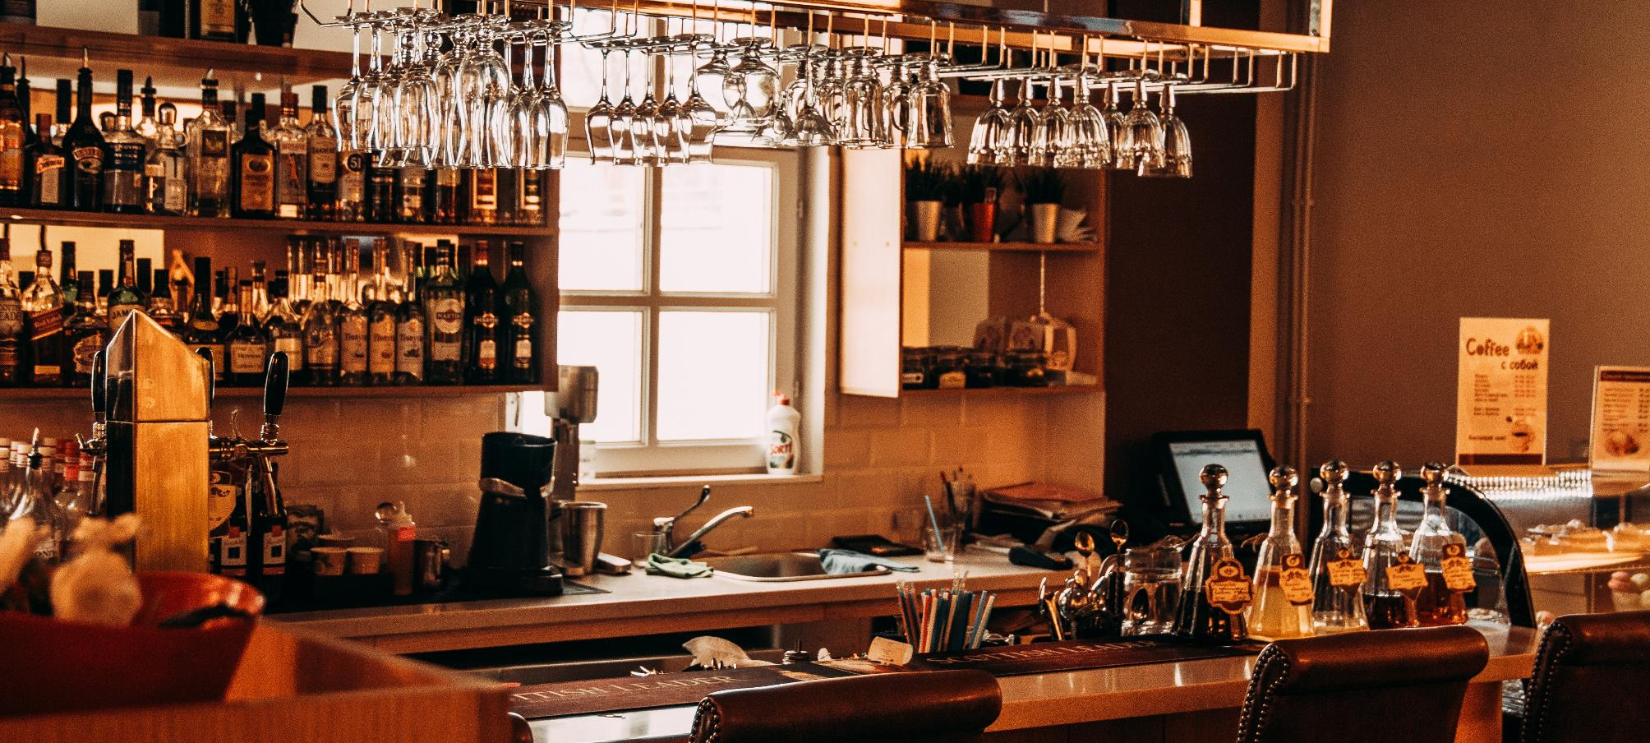
APPLICATION OF EXPOSITORY METHODS IN THE TRAINING ”MODERN COCKTAILS DECORATIONS"
SELECTING METHODS AND DIDACTIC RESCOURCES- EXAMPLES
You can start with a short story about why cocktails are decorated. To present: rules for the selection of decorative materials, use an information lecture interspersed with anecdotes and fun facts.
To illustrate the lecture, you can use: photography, film or slides from a multimedia presentation.
If you want to relax the atmosphere a bit, talk about your own experience related to the topic.
EXPOSITORY METHODS

Slide 36
” APPLICATION OF PROBLEM METHODS IN THE TRAINING ”MODERN COCKTAILS DECORATIONS"
SELECTING METHODS AND DIDACTIC RESCOURCES- EXAMPLES
Provide a description of the situation when you or your colleague started for the first time in the "Drink-Art" bartending contest or a similar event and something unexpectedly happened.
Provoke a brainstorming discussion of how you can behave in a similar situation and what the consequences may be.
You can show a fragment of a similar event on a film reconstructed from the Internet using a computer or a player.
PROBLEM METHODS

Slide 37
APPLICATION OF PRACTICAL METHODS IN THE TRAINING ”MODERN COCKTAILS DECORATIONS"
SELECTING METHODS AND DIDACTIC RESCOURCES- EXAMPLES
Prepare a stand for the preparation of decorative elements. Show products that are best for this.
Using the presentation with explanation, present the necessary equipment and the possibility of using it.
Then do the demonstration with instructions on how to perform the sample decoration, for a specific group of cocktails.
To carry out the exercise you will still need work item; bartender glass, decorative materials.
PRACTICAL METHODS

Slide 38
SELECTING METHODS AND DIDACTIC RESCOURCES- EXAMPLES
APPLICATION OF PRACTICAL METHODS IN THE TRAINING ”MODERN COCKTAILS DECORATIONS”
Participants should join individual exercise classes, i.e. each of them has the task to perform; a number of decorative elements according to your instructions with the possibility of using the same means and materials used during the show. During the exercise, the trainer shares observations and comments.
PRACTICAL METHODS
38

Slide 39

APPLICATION OF PRACTICAL METHODS IN THE TRAINING ”MODERN COCKTAILS DECORATIONS”
SELECTING METHODS AND DIDACTIC RESCOURCES- EXAMPLES
Based on the observation of direct or filmed participants during work using a camera, you can use the action learning method.
To do this, the participants should analyse the implementation of the exercise by answering the following questions:
Who did what right?
What errors were noted?
Why did they happen ?
How to avoid them in the future?
PRACTICAL METHODS
39

Slide 40
GO TO THE NEXT
MODULE MATERIALS

