Slide 1
BUILDING A CAREER PATH
WAITER
2

Slide 2
WHAT IS A CAREER PATH?
CAREER PATH is a system of education stages leading to a particular profession or a higher professional position.
PODCAST
Recording no 1

Slide 3
WHAT IS A CAREER PATH?
WAITER CAREER PATH : YOUNG PEOPLE
In order to become a waiter a student:
Finishes their GCSEs,
Does a BTEC in hospitality and successfully passes

Slide 4
WHAT IS A CAREER PATH?
WAITER CAREER PATH: ADULT
The adult himself decides about his professional career, which can include:
adjusting qualifications to the actual requirements related to the job position,
extending qualifications

Slide 5
WHAT IS A CAREER PATH?
WAITER CAREER PATH: ADULT
An adult who would like to become a qualified waiter can:
Complete courses in the qualifications of the waiter (TG.10, TG.11) and confirm these qualifications with a professional exam or,
gain work experience as a waiter without qualification for at least 2 years or
graduate from college or sixth form and confirm the qualification TG.10, TG.11 with a professional exam or,
complete 1st and 2nd degree waiter courses.

Slide 6
WHAT IS A CAREER PATH?
WAITER CAREER PATH
An adult working in a profession who would like to expand their qualifications can complete various refresher courses and trainings, which will allow to broaden professional qualifications and professional performance of additional tasks.
In a dynamically changing reality, we all need to educate ourselves to find a place in the labour market (learning throughout life).

Slide 7
WHAT IS A CAREER PATH ?
WAITER CAREER PATH
In order to implement your own educational and professional development plan in the profession of a waiter, it is necessary to develop the skills of self-realisation and self-assessment. In addition, the following questions are important:
What do I really want to do in the future?
Do I think about working in my profession or about retraining?
Do I want to work in a large hotel restaurant or in a small but good place?
ATTACHMENT
WORK CARD 1

Slide 8
PREPARATION OF THE EDUCATIONAL AND PROFESSIONAL DEVELOPMENT PLAN
DIRECTION AND VOCATIONAL DEVELOPMENT PLAN ALSO DEPENDS ON THE EMPLOYER
From the employer's point of view, the primary direction of professional development of waiters is the vision and mission of the company's development and the improvement of the quality of provided services.
In relation to an employee, this is a set of actions aimed at recognising and verifying their needs, aspirations and abilities. Then constructing a series of ventures that allow self-realisation and significant meaning and contribution to the development and standards of the operation of a catering establishment or hotel.

Slide 9
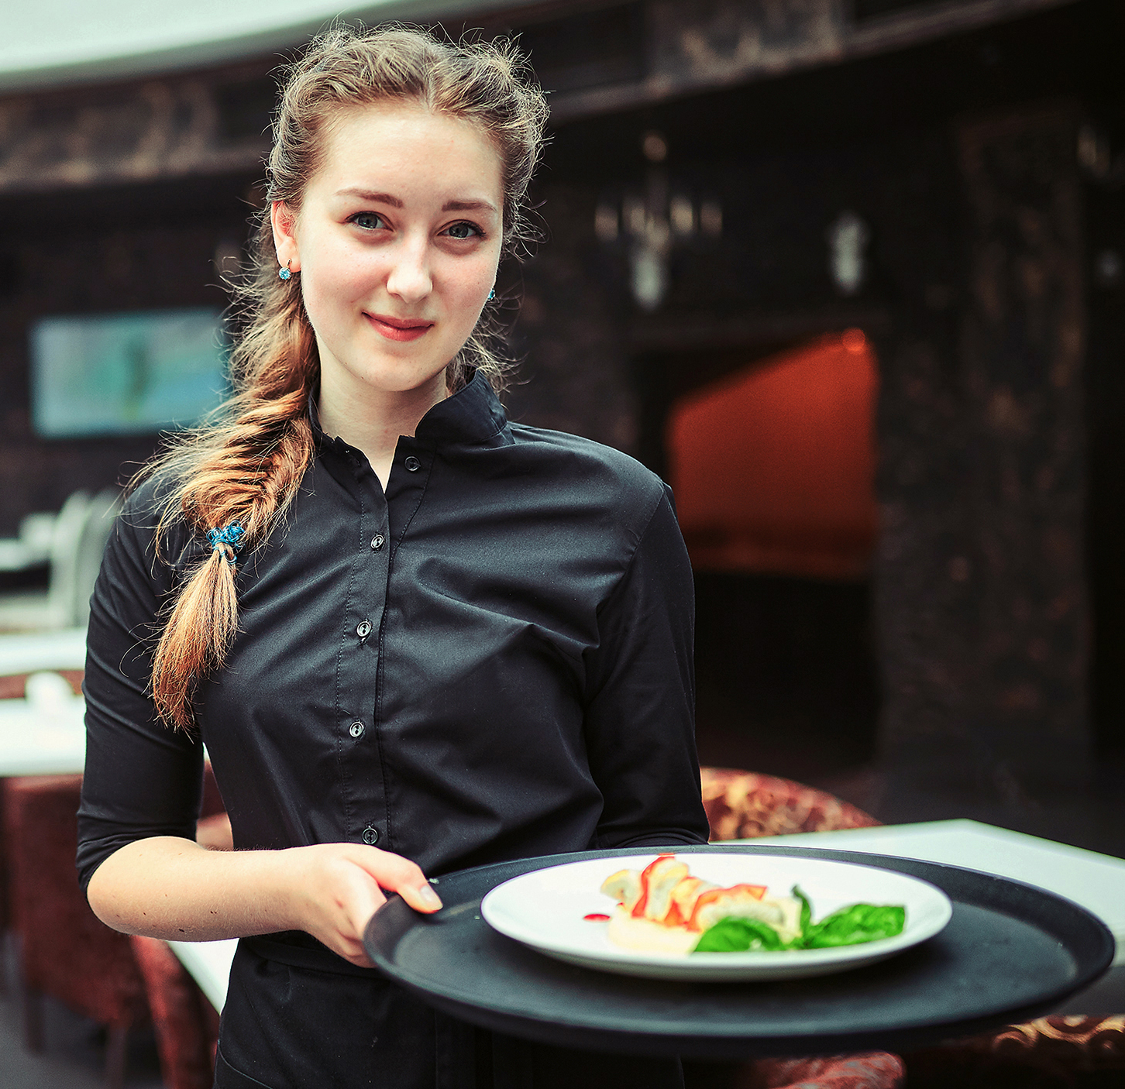
PREPARATION OF THE EDUCATIONAL AND PROFESSIONAL DEVELOPMENT PLAN
PREPARING A PLAN IS BASED ON:
defining further goals (eg job positions, qualifications or competences) as possible to achieve at a given position or profession,
indicating the necessary professional experience,
precise determination of space-time, in which it is possible to achieve the goal set, eg to be promoted to a given position,
taking into account social factors and development processes to which every human being is subject (age, health, family obligations, needs and possibilities of the company, etc.).

Slide 10
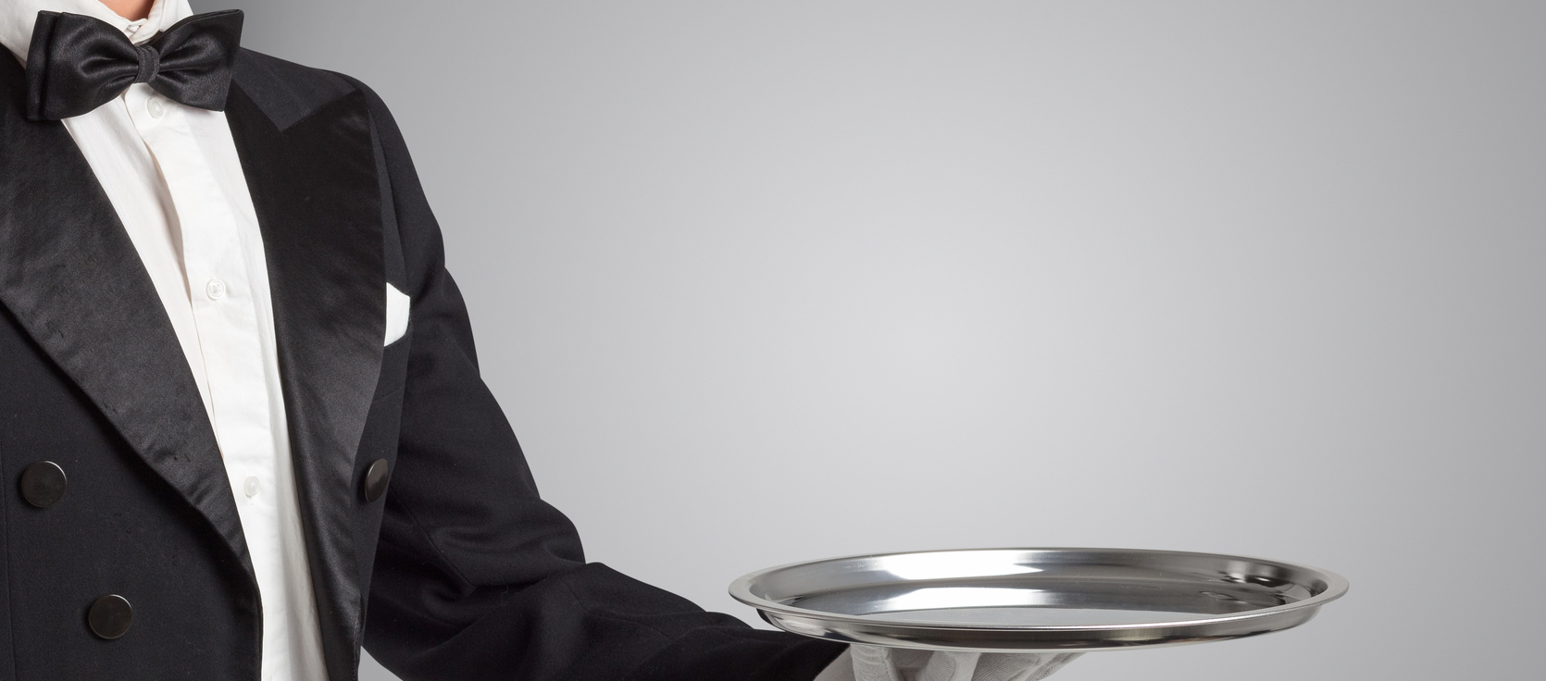
PREPARATION OF THE EDUCATIONAL AND PROFESSIONAL DEVELOPMENT PLAN
THESE SKILLS REQUIRE A PERFECT PERFORMANCE ACCORDING TO CHANGING TRENDS, FASHION AND DEVELOPMENT OF TECHNOLOGY.
The waiter's professional development plan should take into account professional skills that are already available and those that need developing.
The basic skills of a waiter are:
preparation of consumer halls for guest service,
performing activities related to the service of guests,
settlement of waiter services.

Slide 11
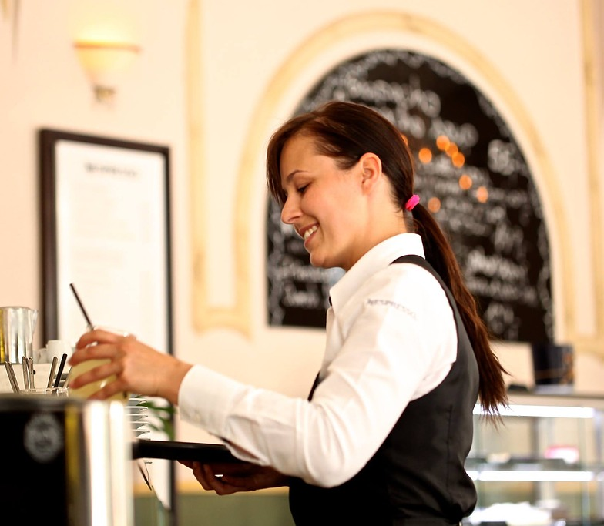
WAITRESS
DRESS CODE
BLACK SKIRT
WHITE SHIRT OR BLOUSE
TIGHTS
WAITER APRON
BLACK SHOES
JEWELLERY: WEDDING RING, SMALL WATCH

Slide 12
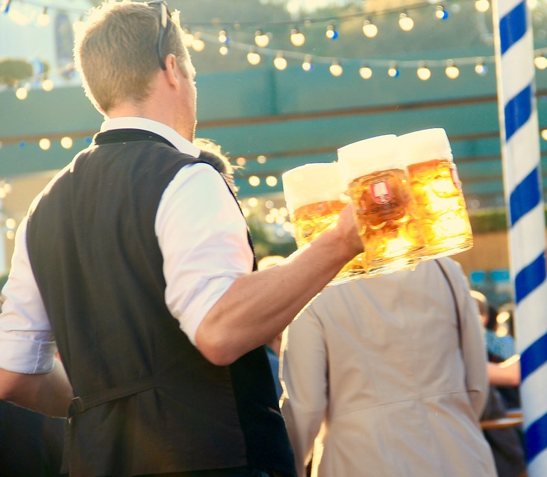
WAITER
DRESS CODE
BLACK TROUSERS
BLACK SHOES
WHITE SHIRT
BOWTIE
BLAZER OR WAISTCOAT
WAITER APRON
JEWELLERY: WEDDING RING, SMALL WATCH

Slide 13
THE IMAGE OF A WAITER IS INFLUENCED BY:
IMAGE OF A WAITER
ELLEGANT AND PLEASANT APPEARANCE
THE WAY THEY WALK
SMILE
FRIENDLY ATTITUDE TOWARDS GUESTS
NATURALNESS IN COMMUNICATING WITH CLIENTS

Slide 14
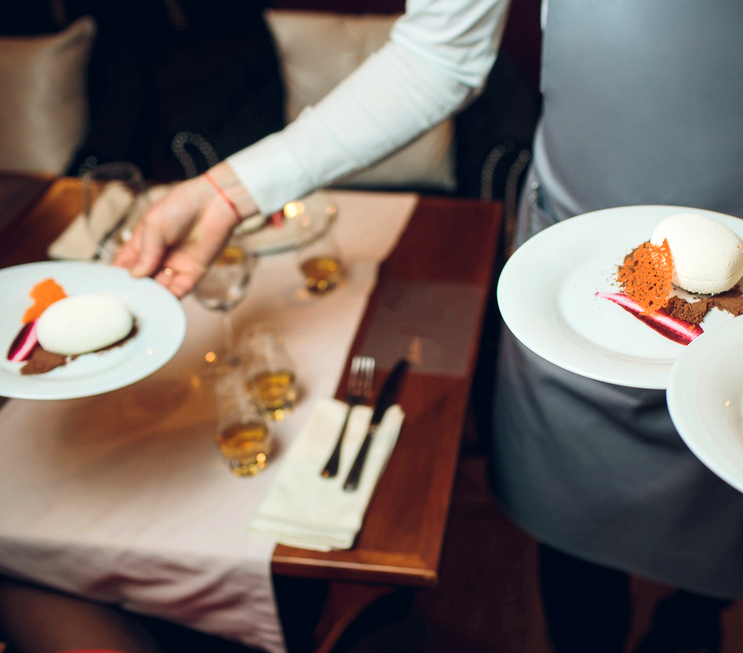
A WAITERS PROFESSIONAL EQUIPMENT INCLUDES:
PROFESSIONAL EQUIPMENT
napkin
multi-purpose pocket knife
tools for receiving guest orders
Lighter or matches
Card machine or a purse
Staff ID

Slide 15
A PROFESSIONAL-EDUCATIONAL CAREER PATH OF A WAITER
WAITER ASSISTANT
WAITER
HEAD WAITER
SUPERVISOR
RESTUARANT MANAGER
GASTRONOMY MANAGER (HOTEL OR A RESTAURANT CHAIN)
PODCAST
Recording no 1

Slide 16
A PROFESSIONAL-EDUCATIONAL CAREER PATH OF A WAITER
WAITER ASSISTANT
Filleting fish on the restaurant floor
WAITER
Waiter savoir-vivre I and II degree.
Barista course I i II degree.
In a conscious proffesional-educational path there is a constant desire to develop qualifications by participating in trainings and courses.
HEAD WAITER
Hydro-sommelier course
SUPERVISOR
Waiter course I i II degree.
Sommelier course
RESTUARANT MANAGER
Poultry carving
GASTRONOMY MANAGER (HOTEL OR A RESTAURANT CHAIN)
Proffesional banquet waiter
Waiter- culinary advisor

Slide 17
RAISING QUALIFICATION -ADULTS
RULES OF PLANNING THE EDUCATIONAL AND PROFESSIONAL PATH
gathering and analysing information about yourself - learning about your abilities, skills, and interests, defining your predispositions, values,
determining the type of job sought,
recognition of the labour market,
creating goals,
defining the way of achieving goals,
providing feedback on the effectiveness of your activity.

Slide 18
RAISING QUALIFICATION -ADULTS
In adult education you should consider:
an adult is autonomous and independently guides the learning process,
has more or less professional experience,
That adult learning needs arise from changing social roles and employment conditions,
the adults are oriented on the problem, not on the subject,
adults have inner motivation

Slide 19
RAISING QUALIFICATION -ADULTS
CHARACTERISTICS OF LEARNING ADULTS :
different levels of life and professional experience and different age,
diversified educational activity,
different habits regarding styles, techniques and learning skills,
already formed professional habits and attitudes towards work,
lack of time resulting from professional and family responsibilities,
the practical dimension of decisions regarding professional development or the beginning of education,
the skill of abstract thinking,
ability to focus

Slide 20
RAISING QUALIFICATION -ADULTS
WHILST LEARNING ADULTS GAIN BETTER RESULTS WHEN WORKING IN A GROUP BECAUSE:
they can speak without fear of criticism,
they can make mistakes,
They have an impact on the course of the training, they see a practical and measurable aspect of raising qualifications (eg professional or financial promotion at work),
they are accepted in the environment in which they learn,
They are actively involved in the learning process by sharing ideas, impressions and variants of solutions,
they understand the value and meaning of what they are learning,
they solve real problems on the training, and not only implement theoretical content,
they have the opportunity to refer to their own experience.

Slide 21
RAISING QUALIFICATION -ADULTS
RULES OF ADULT EDUCATION
Similar to the principles of teaching and learning of young people, it should be remembered that adults are more oriented towards:
individuality in teaching,
specific learning goals,
optimal use of time.

Slide 22
RAISING QUALIFICATION -ADULTS
TEACHING SPECIFICATION - ADULTS
targeting education to target groups,
the perspectives of the trainer and participant,
direct confrontation with the content of education,
clear influence of emotions and motivation on the teaching-learning process,
big need of individualisation,
high share of self-education and self-improvement

Slide 23
RAISING QUALIFICATION -ADULTS
Effective educational technique, according to which achieving success in education is connected with going through four key stages of learning
REFLEXION AND OBSERVATION
EXPERIENCE through concreto experinces
THEORY ordering, generalisation of information and conclusions
PRACTICE active experimentation
KOLB’S CYCLE
The order of implementation of the individual stages of education
in KOLB’S CYCLE is optional. Its effectiveness is achieved when all stages are completed.

Slide 24
RAISING QUALIFICATION -ADULTS
Observation of the safe burning of fruits into the dessert and their administration by the trainer.
Flambéing of fruits under the supervision of a trainer during training.
REFLEXION AND OBSERVATION
EXPERIENCE through concreto experinces
REFLEKSJA I OBSERWACJA
DOŚWIADCZENIE poprzez konkretne przeżycie
THEORY ordering, generalisation of information and conclusions
PRACTICE active experimentation
KOLB’S CYCLE
EXAMPLE: LEARNING HOW TO FLAMEED FRUITS AT GUEST TABLE
Confrontation of knowledge about the technical aspect of flambéing and its importance in improving the taste of dishes.
Self-flambéing of fruits, vegetables, seafood and serving them outside of training.

Slide 25
RAISING QUALIFICATION -ADULTS
BARRIERS IN ADULT EDUCATION
great sensitivity to criticism,
lack of self-confidence - fear of failure, ridicule in the group forum,
understated or over-estimated self-esteem,
disinterest,
lack of motivation.
no or little visible benefits from the training being carried out,
lack of ability to build interpersonal relationships.

Slide 26
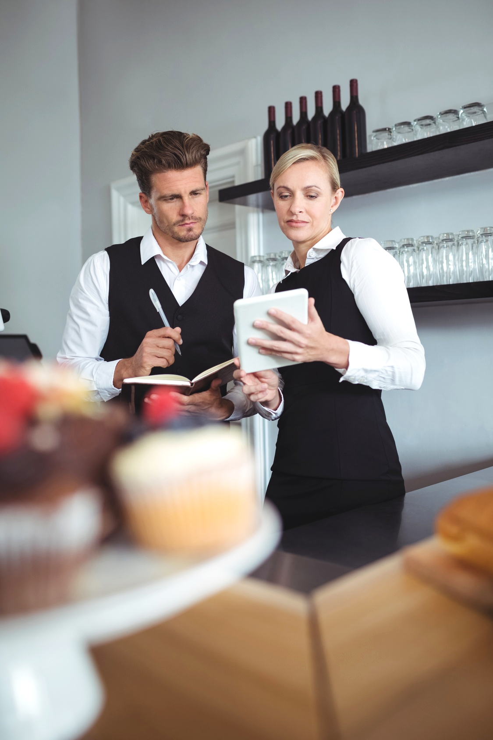
ADULT EDUCATION
BUILDING INTERPERSONAL RELATIONSHIPS IN THE TEAM. COMMUNICATING WITH PEOPLE WHO ARE IN VARIOUS PROFESSIONAL AND LIFE SITUATIONS.
The competences that significantly affect the image and quality of the waiter's work are:
quick contact,
active listening,
reading and giving feedback,
cooperation in a team and transfer of information.
The mentioned skills should also be possessed by a trainer in order to train the participants of the training.
PODCAST
Recording no 2

Slide 27
INTERPERSONAL COMMUNICATION
INTENTION
MESSAGE
SIGNAL
CODING
SENDER
FEEDBACK
DE-CODING
INTERPRETATION
DE-CODED MESSAGE
RECIEVING SIGNAL
RECIEVER
ATTACHMENT WORK CARD 2 AND 3
PODCAST recording no 2

Slide 28
INTERPERSONAL COMMUNICATION
ONE WAY COMMUNICATION
SENDER
RECIEVER
IS ADVISED :
when the message is simple and comprehensible, eg: the trainer informs that after the break everyone has to prepare a service trolley,
when communication must be fast, eg "Attention, please check if the cover is complete!"
when the sender depends on the undisputed transmission of the message, eg: "Ladies and gentlemen, the break is over!"

Slide 29
INTERPERSONAL COMMUNICATION
GROUP WORK
TWO-WAY COMMUNICATION
SENDER
RECIEVER
IS ADVISED:
when perfection is important, eg when handling exceptional guests, e.g. VIPs,
when the trainer wants beneficiaries to participate in something, e.g. in analysing the course of the KOLB’S CYCLE,
when we want to get to know the point of view, eg why flambéed vegetables and fruits are tastier than those given classically,
when the trainer wants to minimise the likelihood of error, eg incorrect table coverage.

Slide 30
VERBAL COMMUNICATION TECHNIQUES
INTERPERSONAL COMMUNICATION
Techniques that increase the visibility of the message
Techniques that increase the clarity of the message
Techniques for increasing tension
Techniques that improve the aesthetic impression

Slide 31
VERBAL COMMUNICATION TECHNIQUES Techniques that increase the visibility of the message
INTERPERSONAL COMMUNICATION
Example – yesterday when flambéing cherry for a dessert, it happened to me ...
Comparison - These caramelised fruits were just as the most sophisticated dessert ...
Illustration – Inelegant waiter is the terror of guests ...
Narration – Once you get through the room, before you start presenting the flambéed dessert to guests on plates ....

Slide 32
VERBAL COMMUNICATION TECHNIQUES Techniques that increase the clarity of the message
INTERPERSONAL COMMUNICATION
Repetition – "Water should be poured into the glass, definitely and efficiently. It is necessary to pour water on the wall of the glass, with a determined motion ... ..
Strengthening – "I explained to my colleague that he would improve the arrangement of tableware, I asked ..."
Appeal – "You can not afford to have inappropriate attention during customer service or taking orders."
Quotes, proverbs – Should be used in individual situations.

Slide 33
VERBAL COMMUNICATION TECHNIQUES Techniques for increasing tension
INTERPERSONAL COMMUNICATION
Contrast – You must speak and note while serving guests.
Chain – If you can serve flambéed fruit then you are a good waiter. If you can prepare them for guests, then you are a better waiter. If you can effectively sprinkle them with alcohol and light up for guests and give a burning dessert then you are a very good waiter.
Surprise – I am also for shortening the workshops, but I think that we should do all the exercises correctly.
Preview – And after the break surprise! I have prepared something special for you. We will flambé fruit for the dessert.
33

Slide 34
VERBAL COMMUNICATION TECHNIQUES Techniques that improve the aesthetic impression
INTERPERSONAL COMMUNICATION
Word play – Do not throw a napkin on the table. Lay it elegantly.
Alussion – You know what behaviour I meant.
Hyperbole (intended exaggeration) - And when you give dirty cutlery, they will land on your head.
Paradox – What is cheap is expensive. These fish cutlery are not good for anything.

Slide 35
INTERPERSONAL COMMUNICATION
VERBAL COMMUNICATION
DON’T SAY EVERYTHING YOU KNOW,
BUT KNOW WHAT
AND WHY YOU ARE SAYING
H.Hamer

Slide 36
INTERPERSONAL COMMUNICATION
FEEDBACK INFORMATION - LISTENING TO MESSAGES
While actively listening to what both guests in the venue and participants of the training have to say, remember:
concentrating attention so that you do not miss anything,
visual contact when someone talks to you,
using encouraging phrases such as "yes", "I understand",
openness to the point of view of the person you are listening to,
empathy
asking questions (explaining, appealing).
ATTACHMENT
WORK CARD 2 AND 3
PODCAST 2

Slide 37
INTERPERSONAL COMMUNICATION
FEEDBACK INFORMATION - LISTENING TO MESSAGES
While actively listening to what the trainees have to say, pay special attention to:
showing respect, acceptance and warmth (eg when someone says that the waiter in a large restaurant is just starting to work, and previously worked only serving events such as weddings or banquets and can not lead a conversation freely,
avoiding moralising and judging, even though the participant did not listen attentively to your instruction and improperly arranged dinnerware.
37

Slide 38
INTERPERSONAL COMMUNICATION
FEEDBACK INFORMATION - LISTENING TO MESSAGES
You are not a good listener when:
you are too concentrated on what you want to say and do not listen carefully to what others say,
you are just waiting to get in your word in someone elses speech and present your own point of view,
you only hear what you want to hear,
you interrupt the speaker and finish speaking for him, distorting it to your own goals.

Slide 39
INTERPERSONAL COMMUNICATION
NON-VERBAL COMMUNICATION
- BODY LANGUAGE
FACICAL EXPRESSION
TOUCHING AND PHYSICAL CONTACT
GESTURES
PARALINGUISTIC SOUNDS
ASSOCIATIONS
PHYSICAL DISTANCE
APPEARANCE
VOCAL CHANNEL
BODY POSITIONING
SIGNALS OF NON VERBAL COMMUNICATION
ATTACHMENT WORK CARD 4
PODCAST recording no 2

Slide 40
INTERPERSONAL COMMUNICATION
NON-VERBAL COMMUNICATION- BODY LANGUAGE
Signals of non-verbal communication in professional work are particularly visible in people working with other people, establishing contacts, listening and transmitting information.
Performing the job of a waiter and trainer conducting training requires full awareness of the body's own speech, its reception from other people and the ability to control it.

Slide 41
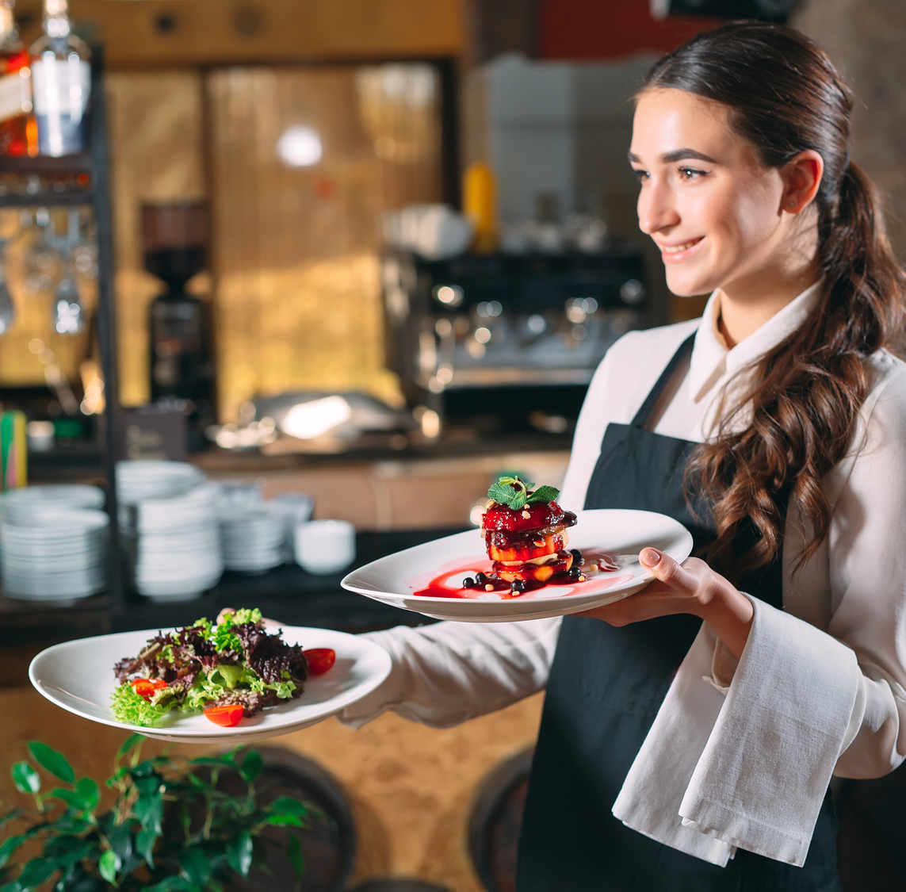
THE MEANING OF NON-VERBAL COMMUNICATION
INTERPERSONAL COMMUNICATION
maintaining verbal communication (advising the choice of wine to a meal, indicate where it is located in the card, so that the customer could be oriented in the price, emphasize with facial expressions and gestures of its advantages),
communicating attitudes and emotions (if the participants of the training stop listening to you and take care of something else, then for a moment you have to change the subject, tell a joke, anecdote or take a break),
self-presentation, (if you show flambéing of fruits, stand straight, do things efficiently and at the same time explain what you do, it emphasizes your professionalism as a trainer),
ritual (for example, religious or covering the table).

Slide 42
INTERPERSONAL COMMUNICATION
CULTURAL CONTEXT
SITUATIONAL CONTEXT
CONTEXT OF MUTUAL COMPOUNDS
The meanings of the same gestures may differ in different cultures. So if you are serving a foreign guest, consider using them wisely.
Many non-verbal signals change their meaning depending on the situation in which the sender is located, eg clenched hands can be a signal of aggression, a sign of encouraging someone or a playful gesture.
If the interpretation of the words confirms several non-verbal signals, they become more unambiguous and reliable. If you do not recommend something to guests, emphasize it with facial expressions and a balanced gesture.
CONTEXT READING OF NON-VERBAL SIGNALS

Slide 43
INTERPERSONAL COMMUNICATION
READING BODY LANGUAGE
 | POSITIVE SIGNALS | NEGATIVE SIGNALS
position and body movements (waiter, trainer) | Relaxed silhouette, naturally upright, sitting and walking calm, respecting the intimate zone of the other person | cowering, standing over someone, stiffness, shuffling legs, shuffling, getting too close, spinning
Face (waiter, trainere) | relaxed and cheerful, light smile also in the eyes, easy eye contact | dead look, intrusive staring at the interlocutor
Shoulders and arms(waiter, trainer) | moderate gestures | waving with your arms, keeping your hands still, constantly touching your face, crossing your arms
Hands (waieter, trainer) | open | clenched fists, twisting and squeezing fingers, playing with objects or hair
Legs (trainer) | in the sitting position resting freely | crossed , swinging your legs

Slide 44
INTERPERSONAL COMMUNICATION
CAUSES OF BUILDING A BARRIER IN COMMUNICATION
Obstacles to communication are all factors hindering the exchange of information. They can be:
differences in views, recognised values,
ignorance of the issue,
lack of due attention,
the level of distrust,
negative effects of emotions, eg nervousness, jealousy,
discrepancy between verbal and non-verbal messages (false messages).

Slide 45
INTERPERSONAL COMMUNICATION
BARRIERS TO COMMUNICATION AND WAYS TO PREVENT THEM
TYPE OF BARRIER | PREVENTION
Judgment - triggers defensive attitudes | Use of descriptive messages
Orientation on people and yourself - suggests a willingness to control others | Orientation to the problem - willingness to solve the problem together
Manipulation, forcing - causes a reaction of resistance and reluctance | Spontaneity in giving honest messages
Indifference - leads to a rigid exchange of information | Empathy - getting into the role of a listener
Showing superiority - releases unfriendly attitudes | Equality (partnership) indicate mutual trust and respect
Overconfidence - blocks listening to other people's arguments | Openness - allows you to consider new information

Slide 46
INTERPERSONAL COMMUNICATION
SENDER!
RECIEVER!
separate important matters from less important ones,
talk to your partner and not about him,
express needs, fears, feelings
do not interupt,
dedicate your time and attention,
check if you understand correctly
provide feedback
refrain from judging, do not arouse in the interlocutor a sense of shame or guilt,
do not generalise too often,
do not interpret it if someone does not want it,
do not give "good advice" - they are good for you,
get to know the interlocutor carefully and gently, let yourself be known.
ATTACHMENT
WORK CARD 2 AND 3

Slide 47
GO TO NEXT
MODULE MATERIALS

