Slide 1
BUILDING A CAREER PATH
CHEF
2

Slide 2
WHAT IS A CAREER PATH?
CAREER PATH is a system of education stages leading to a particular profession or a higher professional position.
PODCAST
Recording no 1

Slide 3
WHAT IS A CAREER PATH?
CAREER PATH : YOUNG PEOPLE
In order to become a chef you need to:
Have inished your GCSEs
Completed college/ BTEC in hospitality/ food technology etc
Continue college to a higher level such as Level 4 in a chosen BTEC/NVQ etc.

Slide 4
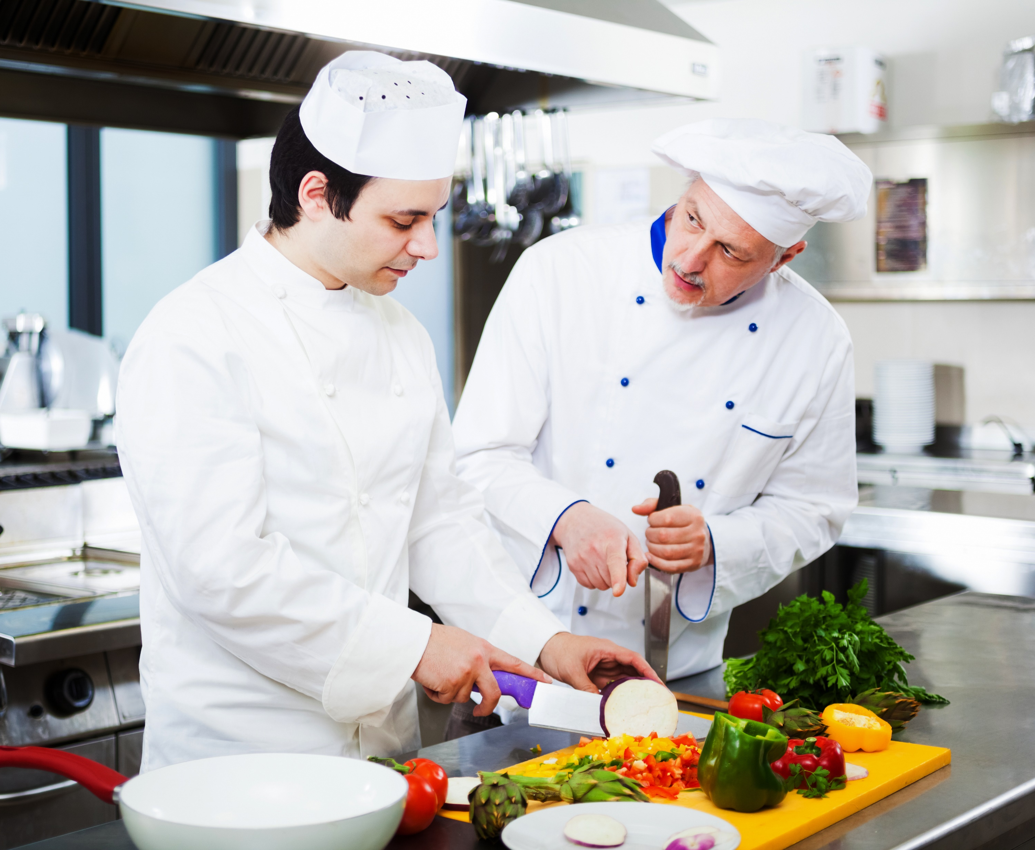
WHAT IS A CAREER PATH ?
CAREER PATH : ADULT
An adult learner decides about his professional career, which usually includes:
adjusting qualifications to the actual requirements related to the job position,
extending qualifications to improve their work experience.

Slide 5
WHAT IS A CAREER PATH?
CAREER PATH OF A CHEF
An adult who would like to become a qualified chef can:
complete the qualifying professional course in the qualification of the cook (TG.07) and confirm this qualification with a professional exam or
gain professional experience by working as a kitchen assistant or cook without qualifications for at least 2 years or
graduate from the secondary school and confirm the qualification of TG.07 with a professional exam or
Have an education in the profession, complete 1st and 2nd degree cookery courses.

Slide 6
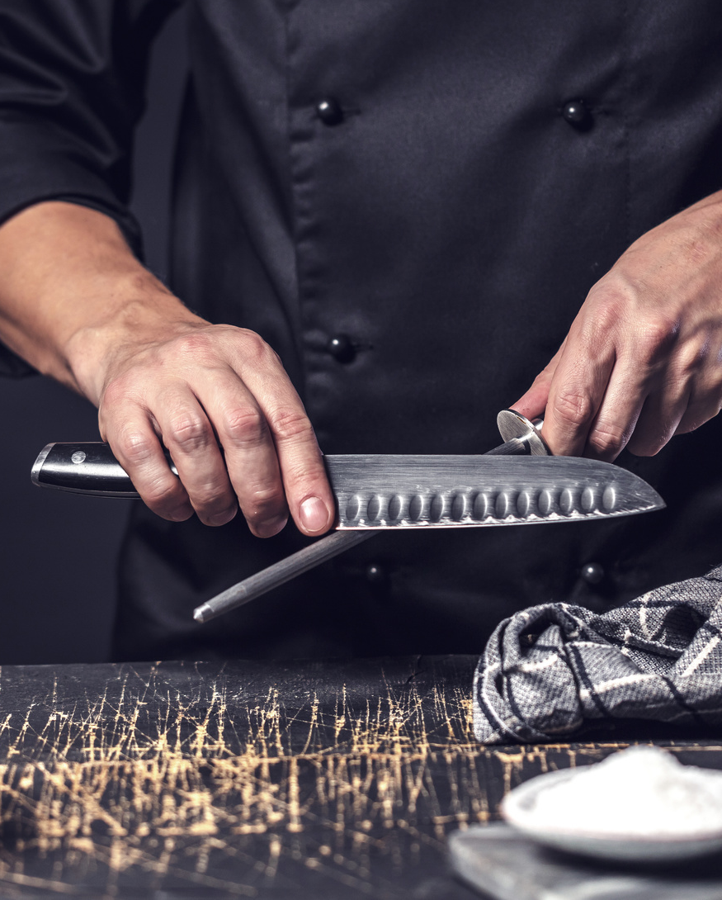
WHAT IS A CAREER PATH ?
CAREER PATH OF A CHEF
An adult working in the chef's profession, open to innovation and self-improvement in order to consolidate his position in the profession, can complete various refresher courses and trainings.
They will allow to extend professional competences and increase the quality of services provided by him as well as professional performance of additional tasks.

Slide 7
WHAT IS A CAREER PATH?
CONSTRUCTING A CAREER DEVELOPMENT PATH
The conscious implementation of the chef's professional development plan connects to the process of improving self-esteem and self-fulfillment skills.
Answer the following questions:
Why do I want to work in this profession?
What especially interests me in this industry?
To what extent would I want to specialise?
ATTACHMENT
WORK CARD 1 AND 5
PODCAST recording no 1

Slide 8
CAREER PLAN DEVELOPMENT
THE CHEF’S CAREER DEVELOPMENT ALSO DEPENDS ON THE EMPLOYER
The mission and vision of the company's development as well as its financial potential are the priority for designing the professional development of chefs.
The chef should be educated all the time, because technological progress, fashion, tastes and other realities of everyday life pose high expectations for him.
Owner - the employer decides about the direction of the company's development and operation. He can support the employee in the implementation of these professional aspirations, which will improve the company's image and improve the quality of provided services.

Slide 9
CAREER PLAN DEVELOPMENT
CAREER PLAN DEVELOPEMENT IS BASED ON:
indicating the necessary professional experience,
defining further work positions or competences as possible to achieve,
defining the objectives to achieve and qualifications necessary for a given position,
anticipating the period of time in which it is possible to occupy a given position ,
taking into account social factors and processes that each person is subject to (age, health, family commitments, needs and opportunities of the company, etc.).

Slide 10
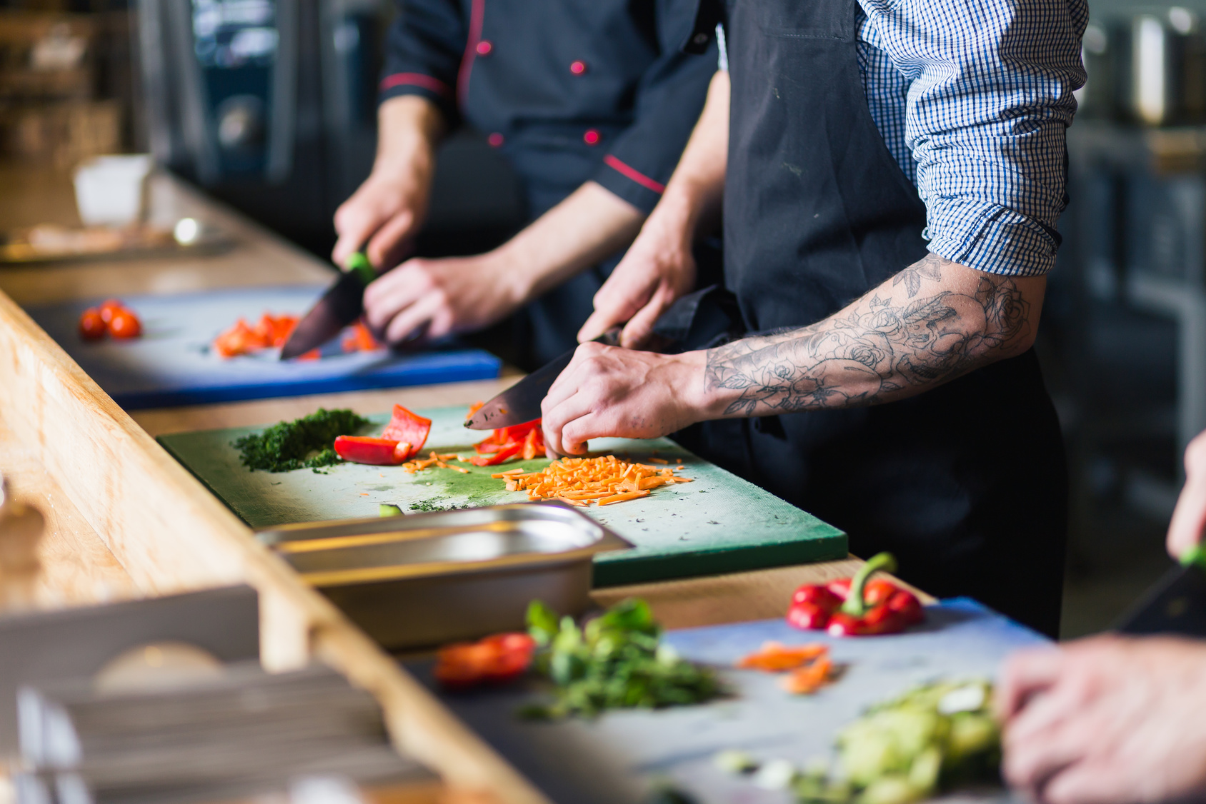
CAREER PLAN DEVELOPMENT
THESE SKILLS REQUIRE A PERFECT PERFORMANCE ACCORDING TO CHANGING TRENDS, FASHION AND DEVELOPMENT OF TECHNOLOGY.
The waiter's professional development plan should take into account professional skills that are already available and those that need developing.
The basic skills of a chef are:
storage of food,
preparing meals and drinks,
doing activities related to the pricing of dishes and drinks.

Slide 11
CHEF CAREER PATH- EXAMPLE
KITCHEN ASSISTANT
JUNIOR COOK
COOK
DEPUTY CHEF
CHEF
MASTER CHEF

Slide 12
CHEF CAREER PATH- EXAMPLE
PRACOWNIK KUCHNI – POMOC KUCHENNA
KITCHEN ASSISTANT
Molecular cuisine
HACCP course
MŁODSZY KUCHARZ
JUNIOR COOK
Italian cuisine
In a conscious proffesional-educational path there is a constant desire to develop qualifications by participating in trainings and courses.
Vegan cuisine
KUCHARZ SAMODZIELNY
COOK
Cooking course of 1st and 2nd degree.
Master course of 3rd degree
STARSZY KUCHARZ
DEPUTY CHEF
French cuisine
ZASTĘPCA SZEFA KUCHNI
Grilling techniques
CHEF
Carving course
MASTER CHEF
Ship Chef
Confectioner

Slide 13
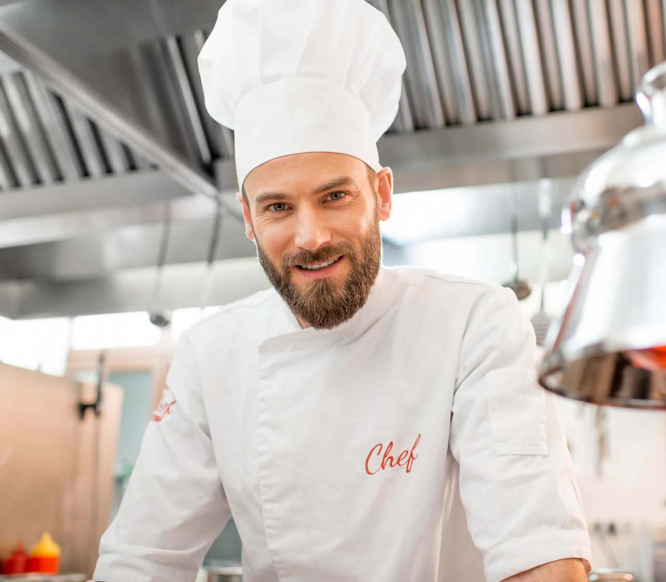
CHEF
DRESS CODE
CHEF SMOCK
CHEF TROUSERS
APRONS
CHEF GLOVES
HATS
CHEF SHOES

Slide 14
LEARNING ADULT
RAISING QUALIFICATIONS -ADULTS
Is a concipous participant of the learning- teaching process,
Has a small or large work experience,
independently guides the learning process,
His educational needs arise from changing employment conditions and opportunities,
Has internal motivation.

Slide 15
RAISING QUALIFICATIONS- ADULTS
CHARACTERISTICS OF LEARNING ADULTS
different levels of life and professional experience and different age,
diversified educational activity,
different habits regarding styles, techniques and learning skills,
already formed professional habits and attitudes towards work,
lack of time resulting from professional and family responsibilities,
the practical dimension of decisions regarding professional development or the beginning of education,
the skill of abstract thinking,
ability to focus.

Slide 16
RAISING QUALIFICATIONS -ADULTS
ADULTS LEARN BEST WHEN:
they can speak without fear of criticism,
they can make mistakes,
they have an impact on the course of the training, they see a practical and measurable aspect of raising
they are accepted in the environment in which they learn,
they are actively involved in the learning process by sharing ideas, impressions and variants of solutions,
they understand the value and meaning of what they are learning,
they solve real problems on the training, and not only implement theoretical content,
they have the opportunity to refer to their own experience.

Slide 17
RAISING QUALIFICATIONS- ADULTS
THE METHODS OF ADULT LEARNING do not differ much from learning-teaching methods of young people.
Adult learners achieve better results when:
they are treated individually,
have specific learning goals,
they optimally use time.
METHODS OF ADULT LEARNING

Slide 18
RAISING QUALIFICATIONS -ADULTS
TEACHING SPECIFICATION - ADULTS
targeting education to target groups,
the perspectives of the trainer and participant,
direct confrontation with the content of education,
clear influence of emotions and motivation on the teaching-learning process,
big need of individualisation,
high share of self-education and self-improvement.

Slide 19
RAISING QUALIFICATIONS -ADULTS
Effective educational technique, according to which achieving success in education is connected with going through four key stages of learning
REFLEXION AND OBSERVATION
EXPERIENCE through concreto experinces
THEORY ordering, generalisation of information and conclusions
PRACTICE active experimentation
KOLB’S CYCLE
The order of implementation of the individual stages of education
in KOLB’S CYCLE is optional. Its effectiveness is achieved when all stages are completed.

Slide 20
RAISING QUALIFICATIONS -ADULTS
Observation of steps during melon carving.
Carving roses under the supervision of a trainer during training.
REFLEXION AND OBSERVATION
EXPERIENCE through concreto experiences
REFLEKSJA I OBSERWACJA
DOŚWIADCZENIE poprzez konkretne przeżycie
THEORY ordering, generalisation of information and conclusions
PRACTICE active experimentation
KOLB’S CYCLE
EXAMPLE: CARVING ROSES IN A MELON
Confrontation of knowledge about the carving methods and knives.
Carving roses outside of training.

Slide 21
RAISING QUALIFICATIONS -ADULTS
BARRIERS IN ADULT EDUCATION
great sensitivity to criticism,
lack of self-confidence - fear of failure, ridicule in the group forum,
understated or over-estimated self-esteem,
disinterest,
lack of motivation.
no or little visible benefits from the training being carried out,
lack of ability to build interpersonal relationships.

Slide 22
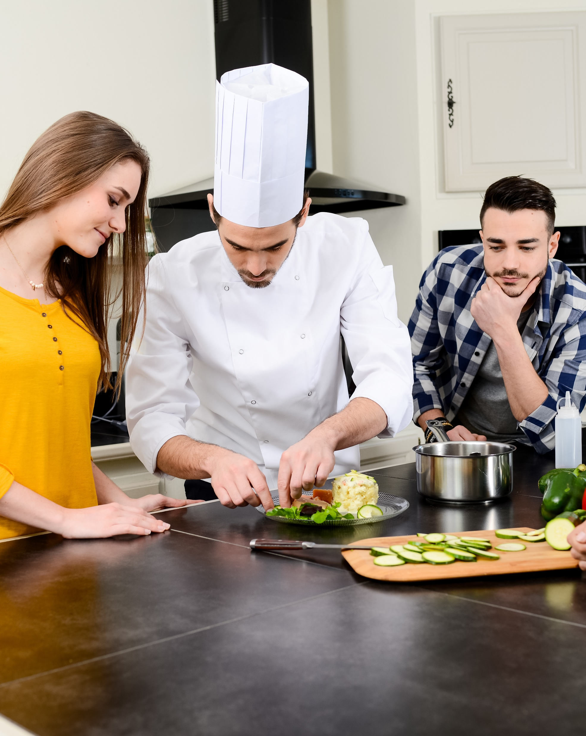
RAISING QUALIFICATION -ADULTS
DURING THE IMPLEMENTATION OF GROUP TASKS IT IS NECESSARY IS TO HAVE THE SKILLS OF BUILDING INTERPERSONAL RELATIONS, OR THE ABILITY TO COMMUNICATE WITH PEOPLE IN DIFFERENT SITUATIONS.
The basic skills of a chef in this area are:
precise transmission of commands and other information,
active listening and proper response,
reading messages and giving feedback,
cooperation in a team and providing information to other kitchen employees,
communicating with waiters.
The aforementioned skills should be possessed by a trainer in order for him to transfer them to the participants of the training.
PODCAST
Recording no 2

Slide 23
INTERPERSONAL COMMUNICATION
INTENTION
MESSAGE
SIGNAL
CODING
SENDER
FEEDBACK
DE-CODING
INTERPRETATION
DE-CODED MESSAGE
RECIEVING SIGNAL
RECIEVER
ATTACHMENT WORK CARD
2 AND 3
PODCAST 2

Slide 24
INTERPERSONAL COMMUNICATION
ONE WAY COMMUNICATION
SENDER
RECIEVER
IS ADVISED :
when the message is simple and comprehensible, eg: the trainer informs that eacg participant must prepare a bowl with cold water and a set of knives
when communication must be fast, eg ” please be careful those knives are sharp”
when the sender depends on the undisputed transmission of the message, eg: ” Now please put your vegetables in the cold water”

Slide 25
INTERPERSONAL COMMUNICATION
GROUP WORK
TWO-WAY COMMUNICATION
SENDER
RECIEVER
IS ADVISED:
when perfection is important, eg when carving flowers from turnips
when the trainer wants beneficiaries to participate in something, e.g. in comparing the carved flowers
when we want to get to know the point of view, eg why are they using a large “U” knife instead of a medium sized one
when the trainer wants to minimise the likelihood of error, eg wrong cut

Slide 26
1. FORMAL: To provide information in an obvious way: what I am informing about (for example, that when carving a watermelon it must be stably placed in a bowl).
INTERPERSONAL COMMUNICATION
1
4 LEVELS OF COMMUNICATION
1
2. AUTOPRESENTATION:
what I say about myself (for example, I have experience in it, because I have done it many times).

Slide 27
1. MUTUAL RELATIONSHIP: conveys the relationship of the interlocutor to the environment: what I think of you, what interconnections we have
INTERPERSONAL COMMUNICATION
2
4 LEVELS OF COMMUNICATION
2. APPEAL:
to forward your own wishes to the recipient: what would I like to encourage, what I would like to ask for. (for example, in order to carve a rose in a watermelon you need to practice it many times).

Slide 28
VERBAL COMMUNICATION TECHNIQUES
INTERPERSONAL COMMUNICATION
Techniques that increase the visibility of the message
Techniques that increase the clarity of the message
Techniques for increasing tension
Techniques that improve the aesthetic impression

Slide 29
VERBAL COMMUNICATION TECHNIQUES Techniques that increase the visibility of the message
INTERPERSONAL COMMUNICATION
Example – One time during training in Thailand…
Comparison – A Thai knife kind of looks like one for meat carving
Illustration – A radish should be ripe and hard
Narration – In order for you to carve many shapes you will need a set of knives not just one

Slide 30
VERBAL COMMUNICATION TECHNIQUES Techniques that increase the clarity of the message
INTERPERSONAL COMMUNICATION
Repetition – The cut should be done carefully, the cut should be done precisely… the cut should be done carefully and precisely
Strengthening – "I explained to my colleague that he should use a Thai knife, I asked ..."
Appeal – for carving leaves out of carrot please do not take the ones which are very thin
Quotes, proverbs – Should be used in individual situations.

Slide 31
VERBAL COMMUNICATION TECHNIQUES Techniques for increasing tension
INTERPERSONAL COMMUNICATION
Contrast – The smaller leaves you cut the more of them should be done.
Chain – When you cut out the first row of leaves in this piece of cucumber, cut the second one. When you cut the second one, cut out the third one. When all three are done, cut out the middle ...
Surprise – I thought this would take longer !
Preview – And after the break surprise! Be prepared to carve a watermelon
31

Slide 32
VERBAL COMMUNICATION TECHNIQUES Techniques that improve the aesthetic impression
INTERPERSONAL COMMUNICATION
Word play – A watermelon is not tough but it hs tough skin.
Alussion – You know which fruit I meant
Hyperbole (intended exaggeration) – if before carving the watermelon you will not stabilize it, it will fall down and break your foot
Paradox – It is better to have a less than more

Slide 33
INTERPERSONAL COMMUNICATION
VERBAL COMMUNICATION
EFFECTIVE VERBAL COMMUNICATION IS NOT EXCLUSIVELY BASED ON CLEAR SPEAKING. IT IS ALSO ABOUT THAT THE WORDS REACH THE RECIPIENT AND HE UNDERSTANDS THEM.
S.Payne

Slide 34
INTERPERSONAL COMMUNICATION
FEEDBACK INFORMATION - LISTENING TO MESSAGES
During active listening about what the guests are saying when viewing sculptures of fruit and vegetables , remember to focus attention,
concentrating attention so that you do not miss anything,
visual contact when someone talks to you,
using encouraging phrases such as "yes", "I understand",
openness to the point of view of the person you are listening to,
empathy
asking questions (explaining, appealing).
ATTACHMENT
WORK CARD 2 AND 3
PODCAST recording no 2

Slide 35
INTERPERSONAL COMMUNICATION
FEEDBACK INFORMATION - LISTENING TO MESSAGES
While actively listening to what the trainees have to say, pay special attention to:
showing respect, acceptance and warmth (e.g. when someone says that they are in the cooking profession for 7 years but they don’t think they’ll master the carving technique)
avoiding moralising and judging, even though the participant did not listen attentively to your instruction and the sculpture looks really poor.
35

Slide 36
INTERPERSONAL COMMUNICATION
FEEDBACK INFORMATION - LISTENING TO MESSAGES
You are not a good listener when:
you are too concentrated on what you want to say and do not listen carefully to what others say,
you are just waiting to get in your word in someone else's speech and present your own point of view,
you only hear what you want to hear,
you interrupt the speaker and finish speaking for him, distorting it to your own goals.

Slide 37
INTERPERSONAL COMMUNICATION
NON-VERBAL COMMUNICATION
- BODY LANGUAGE
FACICAL EXPRESSION
TOUCHING AND PHYSICAL CONTACT
GESTURES
PARALINGUISTIC SOUNDS
ASSOCIATIONS
PHYSICAL DISTANCE
APPEARANCE
VOCAL CHANNEL
BODY POSITIONING
SIGNALS OF NON VERBAL COMMUNICATION
ATTACHMENT WORK CARD 4
PODCAST 2

Slide 38
INTERPERSONAL COMMUNICATION
NON-VERBAL COMMUNICATION- BODY LANGUAGE
Signals of non-verbal communication in professional work are particularly visible in people working with other people, establishing contacts, listening and transmitting information.
Performing the job of a waiter and trainer conducting training requires full awareness of the body's own speech, its reception from other people and the ability to control it.

Slide 39
THE MEANING OF NON-VERBAL COMMUNICATION
INTERPERSONAL COMMUNICATION
maintaining verbal communication (if you are showing the participants how to use a V knife, show with your facial expressions that you are comfortable with using it ),
communicating attitudes and emotions (if the participants of the training are scared to show their sculptures to you then that means they do not accept you as a friendly person ),
self-presentation, (if you show the cutting of carrot cones, stand straight, do things efficiently and at the same time you explain and show what you do, it emphasises your professionalism as a trainer),
ritual (e.g. religious).
When giving feedback body language serves the same purpose as when giving messages

Slide 40
INTERPERSONAL COMMUNICATION
CULTURAL CONTEXT
SITUATIONAL CONTEXT
CONTEXT OF MUTUAL COMPOUNDS
The meanings of the same gestures may differ in different cultures. So if you meet a Thai Chef his hands put together are a sign of respect not prayer.
Many non-verbal signals change their meaning depending on the situation in which the sender is located, eg a strong punch of a knife into a watermelon can be a sign of aggression or the fact that the watermelon has a very hard skin
If the interpretation of the words confirms several non-verbal signals, they become more unambiguous and reliable. Therefore, if you like a participants sculpture emphasise it with a smile
CONTEXT READING OF NON-VERBAL SIGNALS

Slide 41
INTERPERSONAL COMMUNICATION
READING BODY LANGUAGE
 | POSITIVE SIGNALS | NEGATIVE SIGNALS
position and body movements (waiter, trainer) | Relaxed silhouette, naturally upright, sitting and walking calm, respecting the intimate zone of the other person | cowering, standing over someone, stiffness, shuffling legs, shuffling, getting too close, spinning
Face (waiter, trainere) | relaxed and cheerful, light smile also in the eyes, easy eye contact | dead look, intrusive staring at the interlocutor
Shoulders and arms(waiter, trainer) | moderate gestures | waving with your arms, keeping your hands still, constantly touching your face, crossing your arms
Hands (waieter, trainer) | Open, often placed upwards | clenched fists, twisting and squeezing fingers, playing with objects or hair
Legs (trainer) | in the sitting position resting freely | crossed , swinging your legs
ATTACHEMENT
WORK CARD 4
PODCAST 2

Slide 42
INTERPERSONAL COMMUNICATION
CAUSES OF BUILDING A BARRIER IN COMMUNICATION
Obstacles to communication are all factors hindering the exchange of information. They can be:
differences in views, recognised values,
Different tasks and responsibility, ,
Ignoring or not hearing the message,
negative effects of emotions, eg nervousness, jealousy,
discrepancy between verbal and non-verbal messages (false messages).

Slide 43
INTERPERSONAL COMMUNICATION
BARRIERS TO COMMUNICATION AND WAYS TO PREVENT THEM
TYPE OF BARRIER | PREVENTION
Judgment - triggers defensive attitudes | Use of descriptive messages
Orientation on people and yourself - suggests a willingness to control others | Orientation to the problem - willingness to solve the problem together
Manipulation, forcing - causes a reaction of resistance and reluctance | Spontaneity in giving honest messages
Indifference - leads to a rigid exchange of information | Empathy - getting into the role of a listener
Showing superiority - releases unfriendly attitudes | Equality (partnership) indicate mutual trust and respect
Overconfidence - blocks listening to other people's arguments | Openness - allows you to consider new information

Slide 44
INTERPERSONAL COMMUNICATION
SENDER!
RECIEVER!
separate important matters from less important ones,
talk to your partner and not about him,
express needs, fears, feelings
do not interrupt,
dedicate your time and attention,
check if you understand correctly
provide feedback
refrain from judging, do not arouse in the interlocutor a sense of shame or guilt,
do not generalise too often,
do not interpret it if someone does not want it,
do not give "good advice" - they are good for you,
get to know the interlocutor carefully and gently, let yourself be known.
ATTACHMENT
WORK CARD 2 AND 3

Slide 45
GO TO NEXT
MODULE MATERIALS

