Slide 1
BUILDING A CAREER PATH
BARTENDER
2

Slide 2



WHAT IS A CAREER PATH?
CAREER PATH
is a system of education stages leading to a particular profession or a higher professional position.
PODCAST
Recording no 1

Slide 3
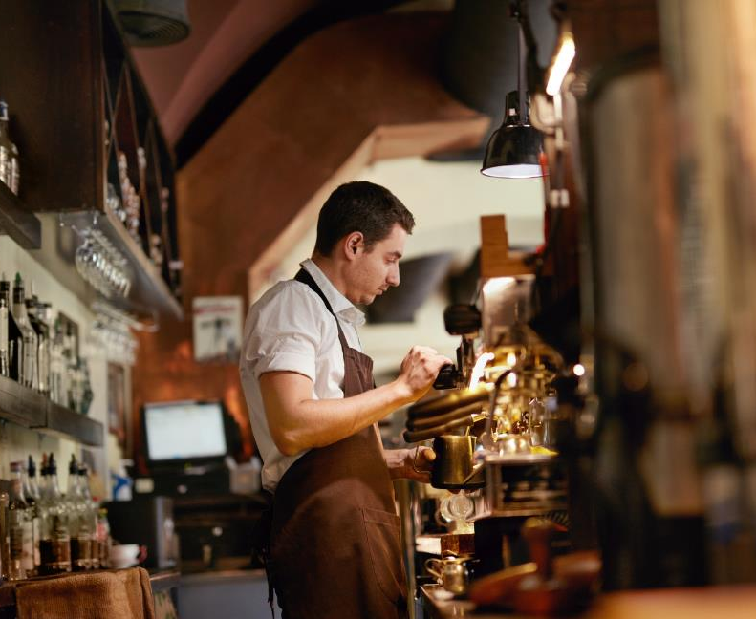

WHAT IS A CAREER PATH?
BARTENDER CAREER PATH
The bartender is a profession whose education is addressed to people over the age of 18 due to direct contact with alcoholic beverages in the workplace.
Acquisition of the profession may include:
adjusting qualifications to the actual requirements related to the job position,
extending qualifications.

Slide 4
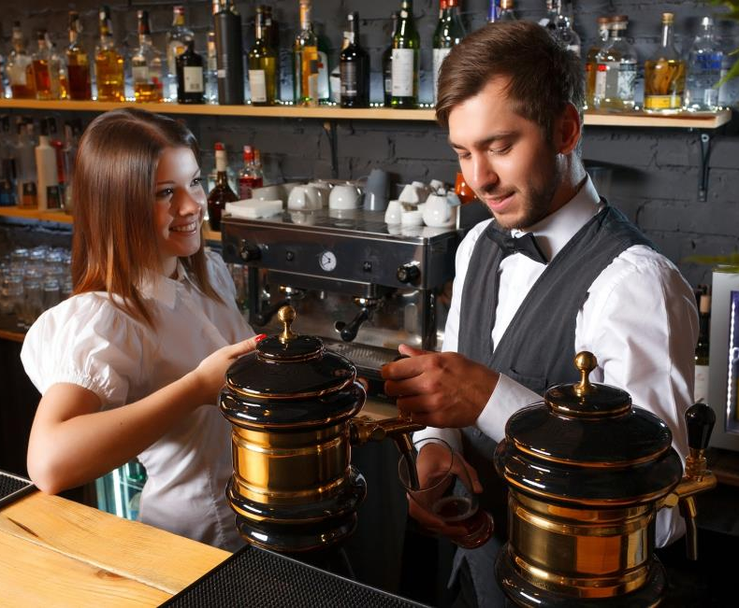
WHAT IS A CAREER PATH ?
BARTENDER CAREER PATH
An adult who would like to become a qualified bartender can:
complete college qualifications,
gain professional experience by working as a bar-assistant (bartender assistant) and then complete the first and second degree bartending courses,
Have an education (indicated education in the catering industry) to complete the first and second degree bartending courses,
improve work skills at numerous directional courses.

Slide 5
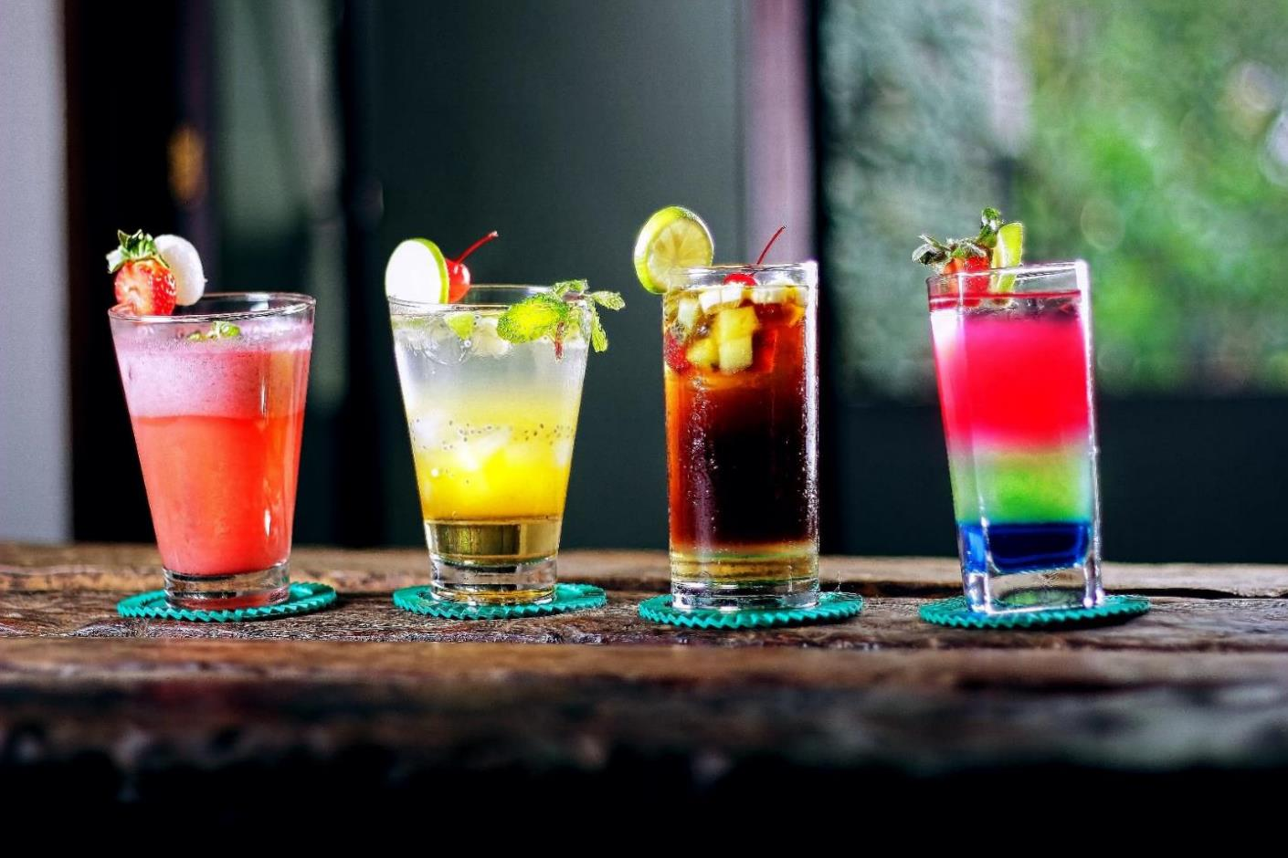

WHAT IS A CAREER PATH ?
BARTENDER CAREER PATH
In order to implement your own educational and professional development plan, it is necessary to develop the skills of self-realisation and self-assessment.
In addition, the following questions are important:
What do I really want to do in the future?
Are the working hours ok for me?
What bar do I want to work at ? (nightclub, restaurant, hotel, pub)

Slide 6
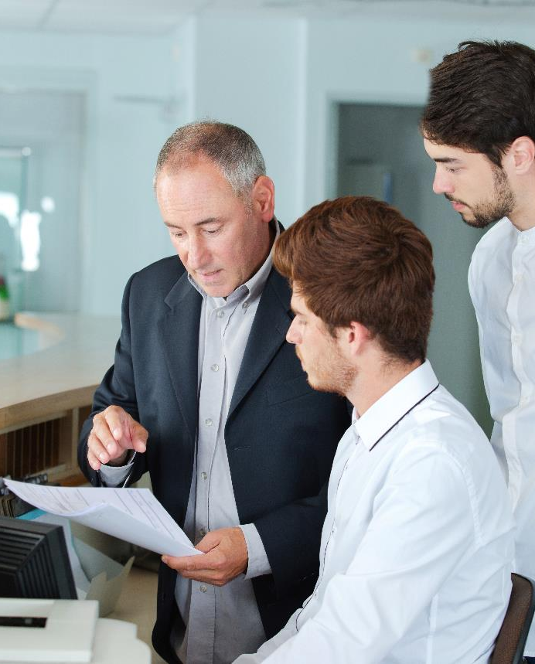
PREPARATION OF A CAREER PATH PLAN
YOUR CAREER DEVELOPMENT PLAN IS ALSO LINKED TO THE EMPLOYER
From the employer's point of view, the primary direction of professional development of waiters is the vision and mission of the company's development.
In the case of training bartenders, this applies only to hotels and premises that have bars, especially alcoholic ones.
Expanding the professional competences of employees (eg waiters) on barista or sommelier courses may be useful in premises where there is no alcohol bar.

Slide 7

PREPARATION OF A CAREER PATH PLAN
PREPARING A PLAN IS BASED ON:
defining further job positions or skills to master
indicating the necessary professional experience,
Indicating goals and aims of achievement
taking into account social factors and development processes to which every human being is subject (age, health, family obligations, needs and possibilities of the company, etc.).

Slide 8
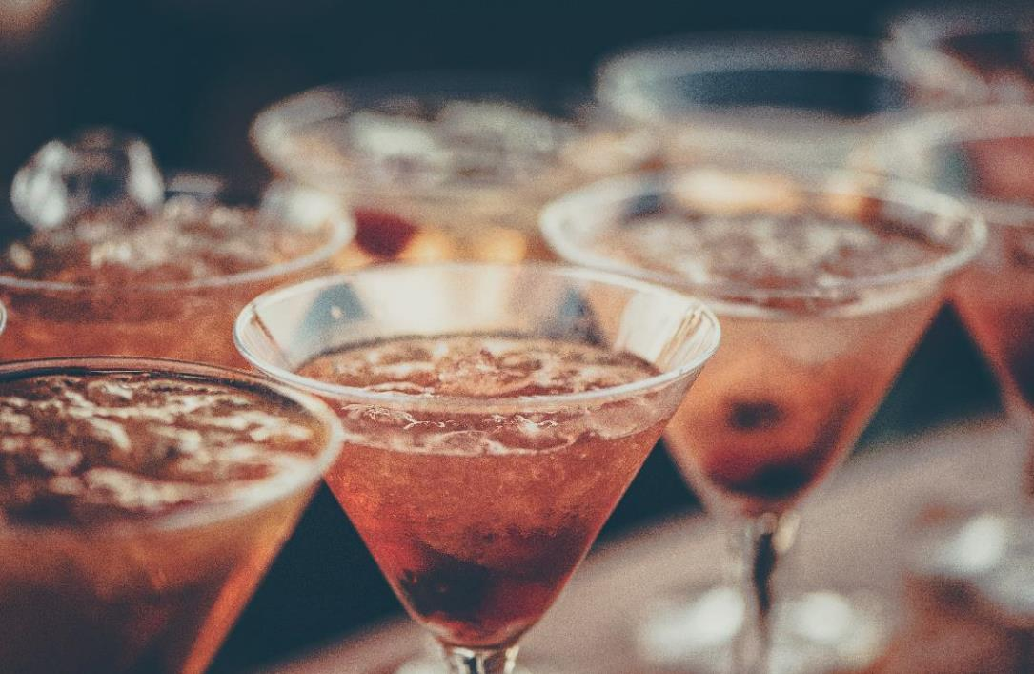

PREPARATION OF A CAREER PATH PLAN
THESE SKILLS REQUIRE A PERFECT PERFORMANCE ACCORDING TO CHANGING TRENDS, FASHION AND DEVELOPMENT OF TECHNOLOGY.
The bartender’s professional development plan should take into account professional skills that are already available and those that need developing.
The basic skills of the bartender are:
performing activities related to the preparation of various non-alcoholic and alcohol beverages,
performing activities related to the service of guests,
settlement of services at the bar.

Slide 9

EXAMPLE OF A BARTENDER CAREER PATH
WAITER, CHEF
BARBACK
BARTENDER 1ST DEGREE, BARISTA
BARMAN – MIXOLOGIST
MASTER – BARTENDER

Slide 10

EXAMPLE OF A BARTENDER CAREER PATH
WAITER, CHEF
1ST DEGREE BARTENDER COURSE
MODERN COCKTAIL DECORATIONS
BARBACK
BRANDY AND WHISKEY COURSE
DURING YOUR CAREER PATH DEVELOPMENT IT IS IMPORTANT TO RAISE YOUR QULAIFICATIONS DURING COURSES AND TRAININGS.
BARTENDER 1ST DEGREE, BARISTA
SOMMELIER COURSE
FLAIR COURSE
BARMAN – MIXOLOGIST
HYDRO-SOMMELIER COURSE
MASTER – BARTENDER
BARISTA 1ST & 2ND DEGREE COURSE
BARTENDER 2ND DEGREE COURSE

Slide 11


ADULT EDUCATION
IN ADULT EDUCATION YOU SHOULD CONSIDER:
an adult is autonomous and independently guides the learning process,
has more or less professional experience,
That adult learning needs arise from changing social roles and employment conditions,
the adults are oriented on the problem, not on the subject,
adults have inner motivation

Slide 12

ADULT EDUCATION
CHARACTERISTICS OF LEARNING ADULTS:
different levels of life and professional experience and different age,
diversified educational activity,
different habits regarding styles, techniques and learning skills,
already formed professional habits and attitudes towards work,
lack of time resulting from professional and family responsibilities,
the practical dimension of decisions regarding professional development or the beginning of education,
the skill of abstract thinking,
ability to focus

Slide 13

ADULT EDUCATION
ADULTS LEARN BEST WHEN:
they can speak without fear of criticism,
they can make mistakes,
They have an impact on the course of the training, they see a practical and measurable aspect of raising qualifications (eg professional or financial promotion at work),
they are accepted in the environment in which they learn,
They are actively involved in the learning process by sharing ideas, impressions and variants of solutions,
they understand the value and meaning of what they are learning,
they solve real problems on the training, and not only implement theoretical content,
they have the opportunity to refer to their own experience.

Slide 14


ADULT EDUCATION
RULES OF ADULT EDUCATION
Bartenders are often young people who are focused on:
individuality in teaching,
specific learning goals,
optimal use of time.

Slide 15

ADULT EDUCATION
It is an interesting and effective technique of education, according to which in order to achieve success in learning, it is necessary to go through four key stages of learning:
experience,
reflextion,
theory,
practice.
KOLB’S CYCLE
The order of realisation of individual stages of education according to the Kolb cycle is free. It is important that all of them are completed during education.

Slide 16

ADULT EDUCATION
REFLEXION AND OBSERVATION
EXPERIENCE
through concreto experinces
THEORY
ordering, generalisation of information and conclusions
PRACTICE
active experimentation
KOLB’S CYCLE

Slide 17
ADULT EDUCATION
Observation of the trainer's preparation of various decorations of cocktails served in martini glasses.
Making decoration of cocktails served in martini glasses
REFLEXION AND OBSERVATION
EXPERIENCE
through concrete experiences
REFLEKSJA I OBSERWACJA
DOŚWIADCZENIE
poprzez konkretne przeżycie
THEORY
ordering, generalisation of information and conclusions
PRACTICE
active experimentation
KOLB’S CYCLE
EXAMPLE: MODERN COCKTAIL DECORATIONS
Confrontation of knowledge about decorative materials and the principles of composition
Independent decoration of cocktails served in martini glasses outside the training

Slide 18
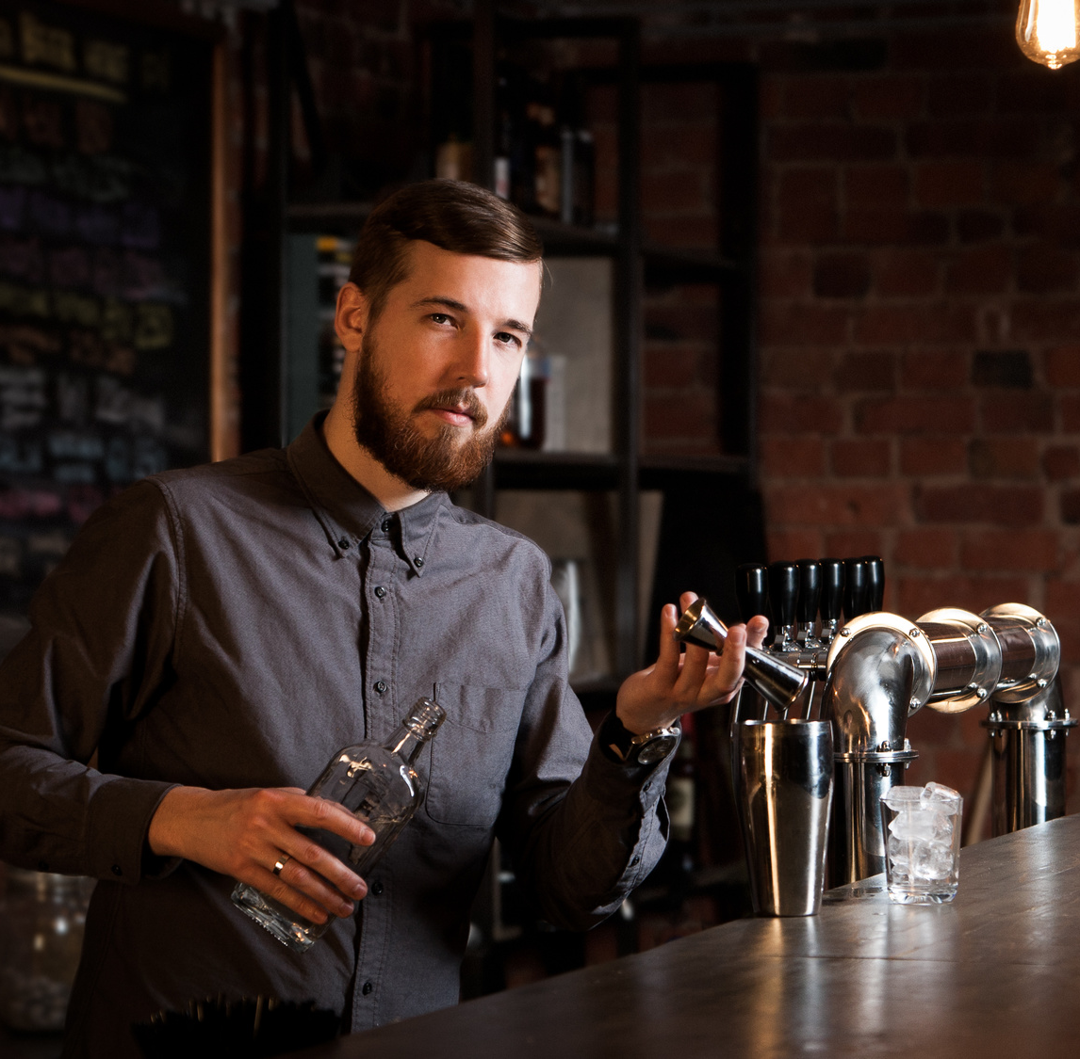
ADULT EDUCATION
IN ADULT TRAINING JUST LIKE IN THE PROFESSION
OF A BARTENDER, COMMUNICATING WITH DIFFERENT PEOPLE IN DIFFERENT SITUATIONS IS A KEY SKILL.

Slide 19

ADULT EDUCATION
THE BASIC SKILLS OF THE BARTENDER AND TRAINER IN THIS AREA ARE, AMONG OTHERS:
quick contact establishment,
active listening,
reading and giving feedback,
strong and quick response to messages,
team cooperation and information transfer.
PODCAST
Recording no 1 and 2

Slide 20


INTERPERSONAL COMMUNICATION
INTENTION
MESSAGE
SIGNAL
CODING
SENDER
FEEDBACK
DE-CODING
INTERPRETATION
DE-CODED MESSAGE
RECIEVING SIGNAL
RECIEVER
ATTACHMENT
WORK CARD 2 AND 3
PODCAST
recording no 2

Slide 21
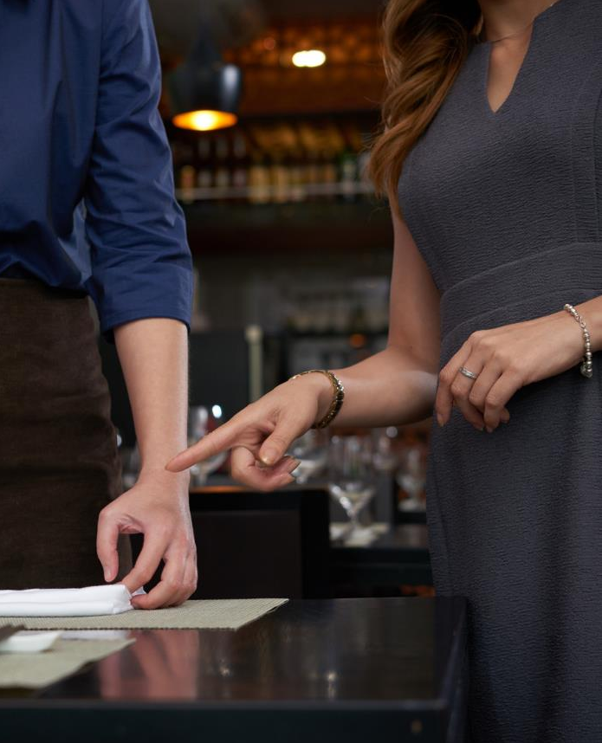
INTERPERSONAL COMMUNICATION
ONE WAY COMMUNICATION
SENDER
RECIEVER
IS ADVISED :
when the message is simple and comprehensible, eg: the trainer informs that everyone should cool their glass withb ice
when communication must be fast, eg “ Please be careful, there is some split ice on the floor”
when the sender depends on the undisputed transmission of the message, eg: "Ladies and gentlemen, please try the cocktail samples!"

Slide 22

INTERPERSONAL COMMUNICATION
GROUP WORK
TWO-WAY COMMUNICATION
SENDER
RECIEVER
IS ADVISED:
when perfection is important, eg when polishing glass
when the trainer wants beneficiaries to participate in something, e.g. in preparing cocktail decorations
when we want to get to know the point of view, eg why the glass wasn’t cooled with ice before cocktail pouring
when the trainer wants to minimise the likelihood of error, eg incorrect ingredient measurements

Slide 23
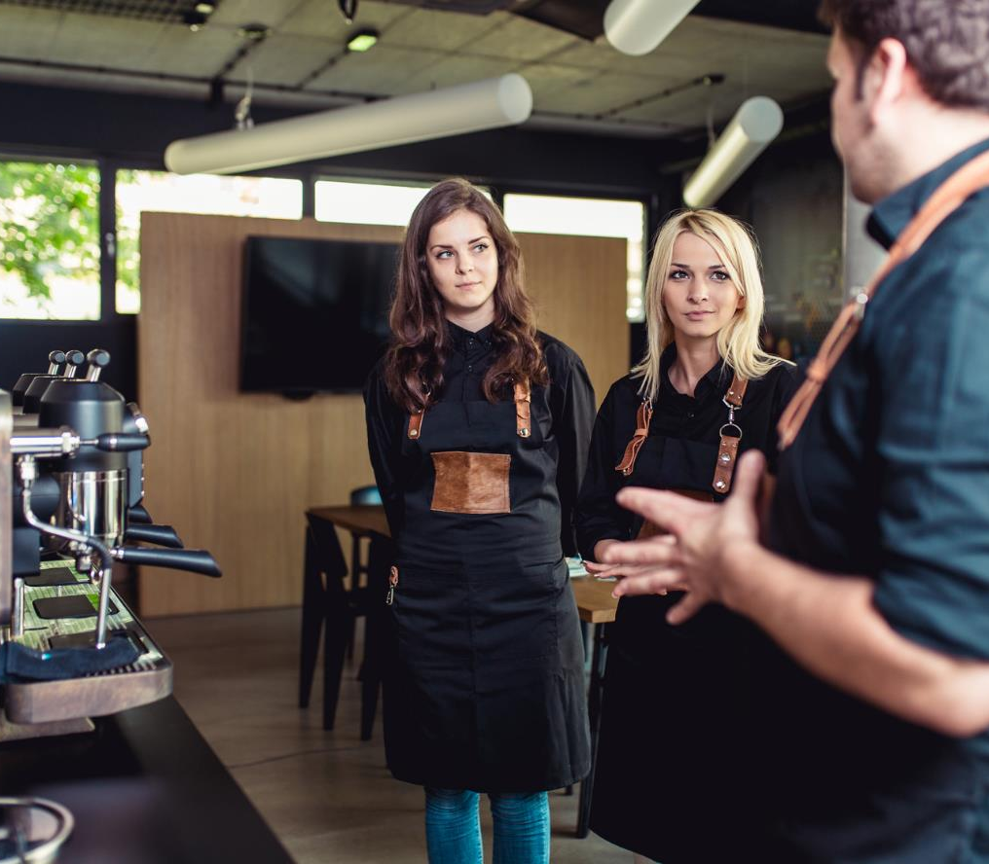

VERBAL COMMUNICATION TECHNIQUES
INTERPERSONAL COMMUNICATION
Techniques that increase the visibility of the message
Techniques that increase the clarity of the message
Techniques for increasing tension
Techniques that improve the aesthetic impression

Slide 24

VERBAL COMMUNICATION TECHNIQUES
Techniques that increase the visibility of the message
INTERPERSONAL COMMUNICATION
Example – one time when I was shaking a cocktail…
Comparison – This cocktail colour is just like a peach.
Illustration – the glass must shine…
Narration - – Please restock the bar before opening so we don’t run out of any alcohol.

Slide 25

VERBAL COMMUNICATION TECHNIQUES
Techniques that increase the clarity of the message
INTERPERSONAL COMMUNICATION
Repetition – The glass should be polish carefully. The glass should be polished thoroughly. The glass should be polished carefully and thoroughly.
Strengthening – "I explained to my colleague that the cherries should be kept in the fridge, I said it many times..."
Appeal – you have to be assertive
Quotes, proverbs – Should not be used often

Slide 26
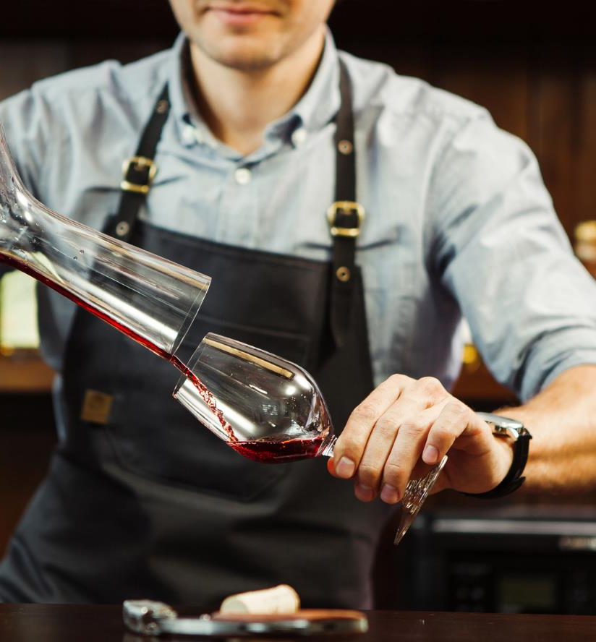
VERBAL COMMUNICATION TECHNIQUES
Techniques for increasing tension
INTERPERSONAL COMMUNICATION
Contrast – You must not speak much but listen more
Chain – if you can harmonize the flavors of cocktail ingredients, then you're a good bartender. If you can decorate this cocktail, you are a better bartender. If you can put it in the right temperature and with a smile, then you're a very good bartender.
Surprise – I didn’t think this decoration would look nice but wow ! It really does.
Preview – the next theme will be the decorations of dry drinks. Please, prepare olives and pickles.
26

Slide 27
VERBAL COMMUNICATION TECHNIQUES
Techniques that improve the aesthetic impression
INTERPERSONAL COMMUNICATION
Word play – If you put a bad straw in a drink the drink doesn’t have to be bad
Alussion – You know what to use in order for the cocktail to be blue
Hyperbole (intended exaggeration) – if you have a loud blender you and your guests will go deaf
Paradox – Sometimes a cold drink makes you hot

Slide 28

INTERPERSONAL COMMUNICATION
VERBAL COMMUNICATION
DON’T SAY EVERYTHING YOU KNOW,
BUT KNOW WHAT
AND WHY YOU ARE SAYING
H.Hamer

Slide 29

INTERPERSONAL COMMUNICATION
FEEDBACK INFORMATION - LISTENING TO MESSAGES
While actively listening to what both guests at the bar and participants of the training have to say, remember:
concentrating attention so that you do not miss anything,
visual contact when someone talks to you,
using encouraging phrases such as "yes", "I understand",
openness to the point of view of the person you are listening to,
empathy
asking questions (explaining, appealing).
ATTACHMENT
WORK CARD 2 AND 3
PODCAST
recording no 2

Slide 30
INTERPERSONAL COMMUNICATION
FEEDBACK INFORMATION - LISTENING TO MESSAGES
The bartender often becomes a confidant of confessions and a listener like a psychotherapist. Alcohol makes people become more open and allows to vent about their problems.
The bartender has to listen patiently, do not criticise, do not at laugh customers.
A good bartender is respectful of everyone and does not let everyone know that he is in a bad mood, someone annoys him or is dissatisfied with the amount of tips.

Slide 31
INTERPERSONAL COMMUNICATION
FEEDBACK INFORMATION - LISTENING TO MESSAGES
While actively listening to what the trainees have to say, pay special attention to:
showing respect, acceptance and warmth for example when someone says they are struggling with pouring
avoiding moralising and judging, even though the participant dropped the shaker twice when preparing a cocktails using flair.
31

Slide 32
INTERPERSONAL COMMUNICATION
FEEDBACK INFORMATION - LISTENING TO MESSAGES
You are not a good listener when:
you are too concentrated on what you want to say and do not listen carefully to what others say,
you are just waiting to get in your word in someone elses speech and present your own point of view,
you only hear what you want to hear,
you interrupt the speaker and finish speaking for him, distorting it to your own goals.

Slide 33

INTERPERSONAL COMMUNICATION
NON-VERBAL COMMUNICATION
- BODY LANGUAGE
FACICAL EXPRESSION
TOUCHING AND PHYSICAL CONTACT
GESTURES
PARALINGUISTIC SOUNDS
ASSOCIATIONS
PHYSICAL DISTANCE
APPEARANCE
VOCAL CHANNEL
BODY POSITIONING
SIGNALS OF NON VERBAL COMMUNICATION
ATTACHMENT WORK CARD 4
PODCAST
recording no 2

Slide 34

INTERPERSONAL COMMUNICATION
NON VERBAL COMMUNICATION- BODY LANGUAGE
Signals of non-verbal communication at work are particularly visible in people working with other people who make contacts, listen and communicate information.
Performing the profession of a bartender, barista or sommelier as well as a trainer conducting a training requires full awareness of his own body language, the ability to control it, and possible interpretations of appearance and behaviour of other people.

Slide 35
INTERPERSONAL COMMUNICATION
NON VERBAL COMMUNICATION- BODY LANGUAGE
The bartender has to adapt his appearance to the place where he works.
You can not allow yourself to wear a casual outfit if you want to serve guests in a luxury hotel restaurant.
Similarly at banquets and wedding receptions, where the bartenders became popular. In such places, the requirements are particularly high.

Slide 36
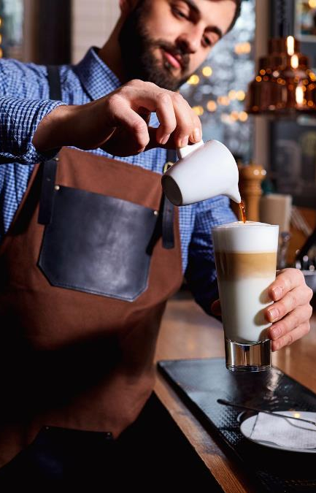
INTERPERSONAL COMMUNICATION
ROLES OF NON-VERBAL COMMUNICATION
maintaining verbal communication (if a guest places an order, nod your head as a sign that you have accepted the order),
communicating attitudes and emotions (if the course participants are bored, change the way the classes are conducted immediately, the bartenders are constantly on the move),
self-presentation (if you explain the principles of pouring straight, act smoothly and explain what you do, it will emphasize your professionalism as a trainer),
ritual (eg religious) (you should not refer to any religious ritual in the bar, even if the nature of this reference is to be a joke, because it can be misread).
In the transmission of feedback, body language plays the same role as in communicating messages.

Slide 37

INTERPERSONAL COMMUNICATION
CULTURAL CONTEXT
SITUATIONAL CONTEXT
CONTEXT OF MUTUAL COMPOUNDS
The meanings of the same gestures may differ in different cultures. So if you are serving a foreign guest, consider using them wisely.
Many non-verbal signals change their meaning depending on the situation in which the sender is located, eg a thumbs up can be a sign of acceptance
If the interpretation of the words confirms several non-verbal signals, they become more unambiguous and reliable. If you do not like contacts with strangers then your behaviour will be dishonest and this will show.
CONTEXT READING OF NON-VERBAL SIGNALS

Slide 38
INTERPERSONAL COMMUNICATION
READING BODY LANGUAGE
 | POSITIVE SIGNALS | NEGATIVE SIGNALS
position and body movements (bartender, trainer) | freedom, naturalness, comfort, sitting and walking calmly, respecting the intimate zone | cowering, standing over someone, stiffness, shuffling legs, shuffling, getting too close, spinning
Face (bartender, trainere) | relaxed and cheerful, light smile also in the eyes, easy eye contact | dead look, intrusive staring at the interlocutor
Shoulders and arms( bartnder, trainer) | moderate gestures | waving with your arms, keeping your hands still, constantly touching your face, crossing your arms, tapping with your fingers
Hands (bartender, trainer) | Open and often directed upwards | clenched fists, twisting and squeezing fingers, playing with objects or hair
Legs (trainer) | in the sitting position resting freely | crossed , swinging your legs

Slide 39


INTERPERSONAL COMMUNICATION
CAUSES OF BUILDING A BARRIER IN COMMUNICATION
Obstacles to communication are all factors hindering the exchange of information. They can be:
differences in views, recognised values,
ignorance of the issue,
lack of due attention,
the level of distrust,
negative effects of emotions, eg nervousness, jealousy,
discrepancy between verbal and non-verbal messages (false messages).

Slide 40
INTERPERSONAL COMMUNICATION
BARRIERS TO COMMUNICATION AND WAYS TO PREVENT THEM
TYPE OF BARRIER | PREVENTION
Judgment - triggers defensive attitudes | Use of descriptive messages
Orientation on people and yourself - suggests a willingness to control others | Orientation to the problem - willingness to solve the problem together
Manipulation, forcing - causes a reaction of resistance and reluctance | Spontaneity in giving honest messages
Indifference - leads to a rigid exchange of information | Empathy - getting into the role of a listener
Showing superiority - releases unfriendly attitudes | Equality (partnership) indicate mutual trust and respect
Overconfidence - blocks listening to other people's arguments | Openness - allows you to consider new information

Slide 41

INTERPERSONAL COMMUNICATION
SENDER!
RECIEVER!
separate important matters from less important ones,
talk to your partner and not about him,
express needs, fears, feelings
do not interupt,
dedicate your time and attention,
check if you understand correctly
provide feedback
refrain from judging, do not arouse in the interlocutor a sense of shame or guilt,
do not generalise too often,
do not interpret it if someone does not want it,
do not give "good advice" - they are good for you,
get to know the interlocutor carefully and gently, let yourself be known.

Slide 42
GO TO NEXT
MODULE MATERIALS

