Slide 1
January 2019
COMPETENCE MODEL OF THE HORECA TRAINER,
ERASMUS + PARTNERSHIP PROJECT,
„STAFF TRAINER OF THE TOURISM SECTOR”
Aleksandra Fabin
The University College of Tourism and Ecology in Sucha Beskidzka

Slide 2
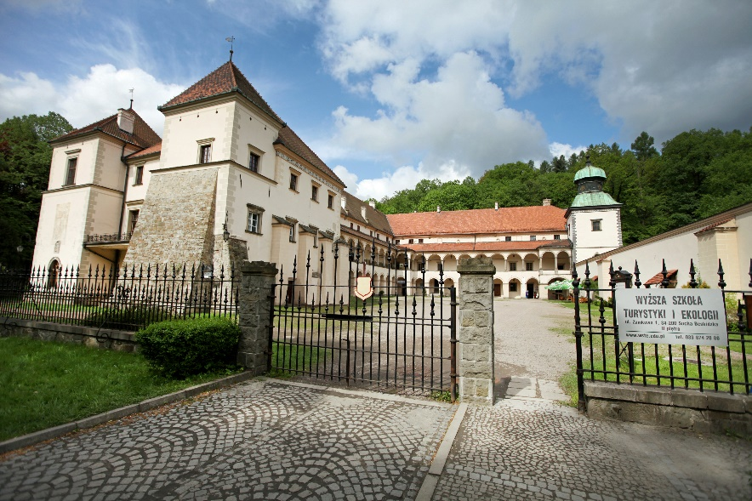
The University College of Tourism and Ecology
UCTE is a stable and recognized brand among universities on the educational market in Europe. Bachelor's, engineering and master's studies are high quality education, which has been confirmed by numerous awards, accreditations and certificates.
Amongst universities, we are distinguished by creativity and innovation in making attractive career perspectives.
Our mission is to guarantee graduates a comprehensive education based on the current knowledge of business practitioners.

Slide 3
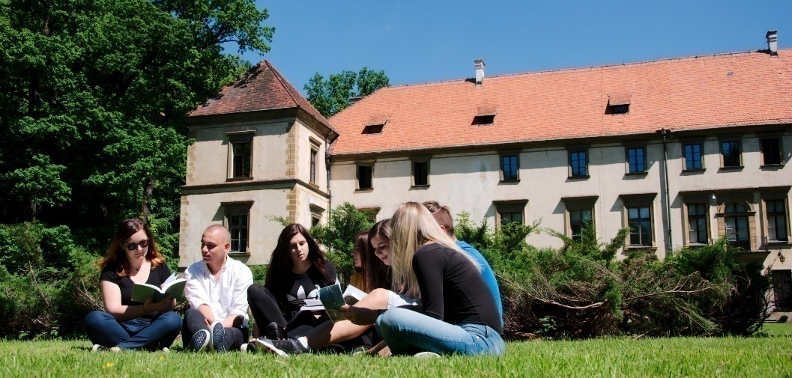
Educational offer
Bachelor studies (tourism and recreation, political science – 1st degree)
Master's studies (tourism and recreation – 2nd degree)
Engineering studies (IT – 1st degree)
Postgraduate studies
MBA studies
Courses and training
Internships and apprenticeships

Slide 4
The project „Staff trainer of the tourism sector” is co-financed from the Erasmus+ program.
It is implemented in key action 2 Strategic partnerships in the vocational education and training sector.
Implementation period: November 2017 - October 2019
The University College of Tourism and Ecology in Sucha Beskidzka, Poland – project leader
Lake Balaton Development Coordination Agency (LBDCA), Siofok, Hungary – partner
UK SPOT Ltd., Bradford, United Kingdom – partner
Are involved :
Notes:
Magda’s slide 3

Slide 5
The goal of the project
The main objective of the project is to develop a standard for the description of the qualification of a vocational trainer / VET in the HORECA industry, and a comprehensive training program for trainers, in order to increase the number of qualified professional trainers in the catering industry.
Based on the experience of partner organizations, we want to build a standard of competence of the HORECA trainer together with ready-made educational materials. They will serve as equipment for everyone who wants to improve their competence in conducting training for HORECA in a package of coaching and interpersonal competences
The target group of the project are HORECA trainers.

Slide 6
Based on our own experience and interviews with people who conduct training addressed to HORECA, three professional standards have been distinguished, for which we will develop and validate educational paths within the project:
trainer of culinary professions (teaching kitchen assistants, cooks, chefs)
trainer of bartending professions (teaching bartenders, baristas, sommeliers),
trainer of waiters (teaching waiters).

Slide 7
The project is implemented in three stages:
Stage I
Research on expected, owned and missing competencies among trainers and educators in the HORECA industry.
At present, the HORECA training market does not have a standard of knowledge and competence of a trainer for the staff of the HORECA industry.
In order to build a complete model of a trainer for the staff of the HORECA sector, it is necessary to clarify what competencies are missing from HORECA specialists in order to transfer their knowledge and experience in a professional manner.

Slide 8
The implementation of the first stage of the project included experts/ specialists/ scientists from each of the Partners.
In order to achieve full comprehensiveness of the research, employees, employers, entrepreneurs, trainers and educators from the HORECA industry were also included. Interviews, surveys and focus studies were conducted with them.

Slide 9
General assumptions of the research
a minimum of 80 CAWI surveys (online survey) in each country, a minimum of 240 surveys in the project – a quantitative study,
a minimum of 10 IDIs in each country, a minimum of 30 IDIs in the project – a qualitative study,
a minimum of 3 focus groups (3-5 on average) in each country, a minimum of 9 focus interviews – a qualitative study.

Slide 10
Subject of the research
Competency 1: IDENTIFYING TRAINING NEEDS IN THE SCOPE OF THE DEMAND OF THE HORECA INDUSTRY
Competency 2: CONDUCTING VOCATIONAL TRAINING FOR HORECA INDUSTRY IN REAL WORKING CONDITIONS
Competency 3: PERSONAL AND SOCIAL COMPETENCIES OF THE TRAINER
Notes:
I need a questionnaire to be printed

Slide 11
Conclusions from the research
lack of a specific competency model of the HORECA trainer on the markets of 3 partner countries and in Europe
lack of standards for building and developing competencies of HORECA trainers
potential on the HORECA market – people with experience lacking coaching skills
Effect: lack of knowledge sharing with the younger generation

Slide 12
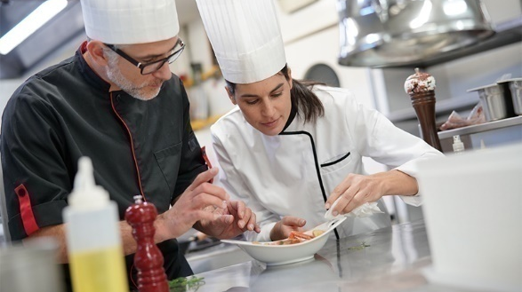
Stage II
Development of competence standards of the VET trainer in the HORECA industry together with the preparation of an education platform.
Experts and trainers associated with vocational and continuing education, adult education in the HORECA industry as well as graphic designers, IT specialists working on the preparation of the platform from the technical side are involved in the implementation of the second stage of the project.

Slide 13
Synthesis of the profession
The HORECA trainer takes an active part in consulting, designing, creating and preparing training courses for professionals in the HORECA industry. The trainer is also responsible for their organization, implementation and evaluation.
The trainer ensures the quality of the training process and the awarding of qualifications within non-formal education and workplace learning. The trainer analyses the needs and problems, adapts the tools to the requirements of a given group.

Slide 14
Synthesis of the profession
The HORECA trainer collects and develops a database of methodological materials, teaching aids and other tools necessary for the learning process. The trainer also participates in the design of multimedia presentations and other interactive forms used in teaching. The trainer selects appropriate techniques and multimedia tools for the material and learning objectives and assesses their effectiveness.
Common names:
HORECA coach,
trainer of the catering industry,
trainer of the tourism industry,
HORECA trainer,
HORECA advisor.

Slide 15
Job description
The HORECA trainer:
carries out an analysis of training needs related to a given profession,
takes care of creating a coherent concept of training with the use of tools meeting the specific needs of the target group,
constantly deepens knowledge of the chosen field.

Slide 16
Job description
The aim of the work of the HORECA trainer is to train employees of a specific specialization in accordance with the adopted program and according to established conditions.
The activity of the HORECA trainer also involves creating substantive multimedia content of didactic materials in cooperation with programmers and graphic designers.
Multimedia tools:
quizzes,
tutorials,
instructional videos,
word clouds,
multimedia presentations,
animations.

Slide 17
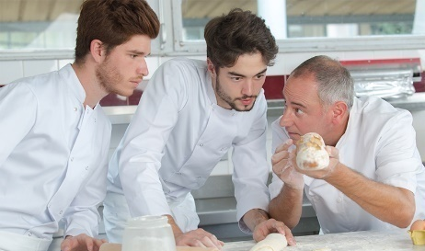
Ways of performing work
The work of the HORECA trainer is based primarily on:
analysis of the education market for adults,
analysis of competency gaps in teams,
developing trainings for specific needs (tailor-made courses),
co-creation of didactic materials, including multimedia materials for the industry.

Slide 18
Professional tasks
Z1 Identifying, analysing and diagnosing training needs of employees from the HORECA industry.
Z2 Designing training solutions that meet the needs of a given professional group.
Z3 Development of a teaching framework for the implementation of a specific training program for employees of the HORECA industry.
Z4 Implementation of vocational training for the HORECA industry.
Z5 Evaluation of the training process.
Z6 Documenting the training process in accordance with the accepted procedures and client's needs.
Z7 Analysis and assessment of competencies based on training experience.
Z8 Conducting advisory processes and formulating recommendations.
Z9 Conducting conversations with the client, transparent communication of the scope of services and activities necessary for their implementation.

Slide 19
Competencies specific to HORECA trainers
who train in selected occupations and selected positions
The description of the HORECA industry trainer assumes that he will acquire key competencies to perform professional tasks regardless of the profession in which he will specialize. However, the specificity of the HORECA industry and the positions that appear in it requires the trainer to have a large knowledge related to a given profession. To be reliable for people who are trained, the trainer must have advanced skills in a given field. The main emphasis in this industry is put on practical skills.

Slide 20
The competence model of the HORECA trainer
The specificity of the HORECA industry related to, among others, work time, high physical loads, changing customer trends and preferences, as well as increased competitiveness, cause that the challenges faced by those who create and implement training in this industry are large.
Coach competencies can be defined as the sum of experiences, abilities, skills, behaviors and knowledge correlating with relevant personality traits. They are closely related to practice and professional development

Slide 21
The competence model of the HORECA trainer
The HORECA trainer should:
know the specificity of the industry and constantly monitor the hotel and catering sector,
identify specific dynamics for a certain position,
analyse trends in order to present the offer and educational tools,
understand industry competencies to determine the competencies and the need to train them,
motivate and give direction to a certain person in HORECA.
Notes:
The trainer of the HORECA industry through professional tasks must take into account the specificity of the industry for which the solutions are dedicated. It is therefore important to constantly monitor the hotel and catering sector both in terms of expectations and needs of employers, as well as specific employee requirements.
Identifying the specific dynamics for a given position is also crucial. An in-depth analysis will allow to present the offer and tools corresponding to the group's ability to acquire knowledge and skills in a friendly and transparent way.
The understanding of industry competences of a given group is also very important. Lack of knowledge of the gastronomy and hotel market may cause erroneously defined low competences and the need to educate them.
First of all, the trainer should know the industry and be such a coach who can motivate and give direction to the development of a given person at HORECA.

Slide 22
The competence profile of the HORECA trainer
Level of education
Trainer competencies
Specialized experience
Personality traits
Trainer of the HORECA industry

Slide 23
The competence model of the HORECA trainer
The trainer's tasks will also include shaping in clients the personal qualities that are important for this industry. These include:
flexibility,
creativity,
innovativeness,
availability,
entrepreneurship.

Slide 24
The competence profile of the HORECA trainer
TRAINER HORECA INDUSTRY SPECIALIST *specializations for the HORECA trainer distinguished as part of the project
specialization | trainer of cooking professions | trainer of bartending professions | trainer of waiters
scope of tasks | the trainer teaches kitchen assistants, cooks, chefs | the trainer teaches bartenders, baristas, sommeliers | the trainer teaches waiters

Slide 25
The competence profile of the HORECA trainer
The coach, depending on the level of personal development and level of knowledge and experience should be prepared for:
independent design and conducting of training addressed to a selected professional group;
creating original methods according to the selected thematic specialization;
using the group's potential to create new educational paths;
cooperation with industry organizations and employers in developing educational solutions tailored to the target group.

Slide 26
Stage III
Validation – testing of developed solutions
People willing to undergo training with the use of standards will be invited to participate in the implementation of this stage.

Slide 27
Thank you for your attention.
Aleksandra Fabin
The University College of Tourism and Ecology in Sucha Beskidzka

