Slide 1
PREPARING TRAINING(1)
WAITER
3

Slide 2
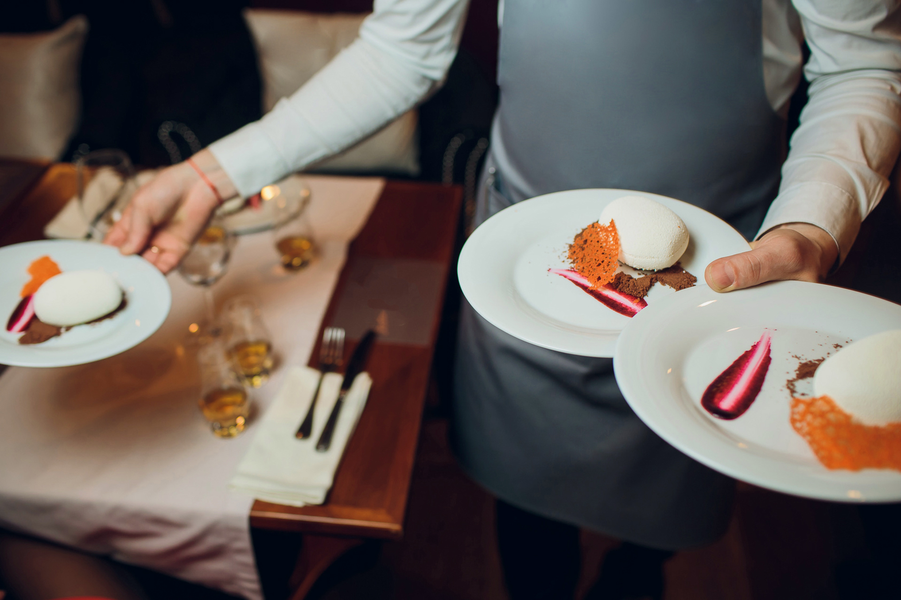
AIM OF TRAINING PREPERATION
Thanks to the correct preparation of the training, the trainer will fulfil his task, which will enable the participants to achieve the assumed effects.
To achieve this, you should take into account a number of elements.
PODCAST 1

Slide 3
WHAT ELEMENTS SHOULD BE PREPARED?
SUBSTANTIVE SIDE
METHODOLOGY SIDE
Adapt methods and techniques of training and teaching resources to the designated goals, opportunities and preferences of participants.
Define the rules and methods of cooperation with the group.
Plan the training time.
Set a main goal and specific training goals in connection with the diagnosed training needs.
Prepare concepts and keywords in the field of training.

Slide 4
PREPARING TRAINING FROM THE SUBSTANTIVE SIDE
SUBSTANTIVE SIDE

Slide 5
WHERE TO START?
What is the purpose of the training?
What do the participants need?
If it is a 1st degree waiter course, participants may not have a professional experience in this field.
If it is a second-level waiter course or training for waiters, then participants already have a professional experience.
What can you teach the training participants?
Which elements of knowledge and experience should be passed on to participants and which ones should not?
What form of workshops is the best?
What to do to give the participants maximum benefit?
WHEN YOU KNOW THE THEME OF TRAINING, START FROM THE CONSIDERATION AND THINKING THROUGH THE FOLLOWING ELEMENTS
PODCAST 1

Slide 6
WHERE TO START ?
Begin by making a list of known and unknown elements influencing the implementation of the training.
YOU WERE ASKED TO CONDUCT TRAINING FOR WAITERS ON THE TOPIC OF
”SPECIAL SERVICE OF WHOLE ROASTED FISH”
You should analyse your substantive preparation and organisational issues, and then answer the following questions:
WHAT DO I KNOW?
WHAT DO I NOT KNOW?

Slide 7
SUBSTANTIVE SIDE
ORAGNISATIONAL SIDE
what is the special service as an above-standard form of customer service,
what are the differences in the service of different species of fish,
what is the service of roasted fish,
what tableware should be prepared on the guest table,
Which wine types should be recommended to guests for certain species of fish.
my listeners may not have the knowledge of theoretical foundations,
my listeners may not have any experience in the selection of tableware,
they may not have experience in the area of wine recommendation for the menu and increase in sales results.
WHAT DO I KNOW ?
EXAMPLES IN THE SCOPE OF THE GIVEN TRAINING TITLE

Slide 8
SUBSTANTIVE SIDE
ORGANISATIONAL SIDE
what is the construction of fish,
how to fillet the baked fish,
how to serve baked fish,
what equipment and utensils are needed for this,
I should present participants with a professional task execution,
each participant should practice the task in class.
my listeners have varied experience in the work of the waiter,
each participant must have his or her own workstation prepared,
I can train 8-10 people at the same time,
the training will last 6 hours,
where the training will take place.
WHAT DO I KNOW?
EXAMPLES IN THE SCOPE OF THE GIVEN TRAINING TITLE

Slide 9
SUBSTANTIVE SIDE
ORGANISATIONAL SIDE
Do the listeners have theoretical foundations necessary in the profession of a waiter?
Did they have previous experience in the field of restaurant service?
Have they previously filleted a fish?
Have they served roasted fish before?
What difficulties will occur during the exercise?
How to adjust the material to the time and needs of participants?
Will I be able to consolidate my knowledge and transfer it efficiently?
Will I be able to prepare good raw materials for exercises?
What to focus on to maximise the effectiveness of the training?
How to organise a course of work to deplete the topic at a given time?
Who will help me organise the training?
WHAT DO I NOT KNOW?
EXAMPLES IN THE SCOPE OF THE GIVEN TRAINING TITLE

Slide 10
DETERMINATION OF THE TRAINING AIMS
Determination of the training aim is based on the clarification of what parts of knowledge and skills the participant of the training should aquire and develop.
The answer to this question is the
MAIN GOAL OR EXPECTED EDUCATIONAL EFFECT,
which determines the result of the implementation of the entire training program.
ATTACHMENT
WORK CARD 1
PODCAST 1

Slide 11
DETERMINATION OF THE TRAINING AIMS
TO ACHIEVE THE MAIN GOAL OF THE TRAINING, A PARTICIPANT SHOULD RECEIVE SPECIFIC KNOWLEDGE AND CHARACTERISTICS WHICH ARE GIVEN AND IN SPECIFIC STEPS OF TRAINING FROM BASICS TO ADVANCED ELEMENTS.
They are:
SPECIFIC TRAINING OBJECTIVES
(educational outcomes)

Slide 12
EXAMPLE
After completing the training on „ Special service of a whole roasted fish” the participant should know:
PRINCIPLES OF THE SPECIAL SERVICE
EQUIPMENT REQUIRED FOR THE EXECUTION OF A SPECIAL SERVICE
COMPOSITION OF A TABLE AND TABLEWARE FOR A SPECIAL SERVICE

Slide 13
EXAMPLE
After completing the training on „ Special service of a whole roasted fish” the participant should be able to:
PREPARE A WORK POSITION TO PERFORM THE TASK
PREPARE A GUEST TABLE
USE YOUR RESTAURANT FACILITIES TO EXECUTE A TASK
CARRY OUT A SPECIAL SERVICE OF A WHOLE ROASTED FISH

Slide 14
DETERMINATION OF SPECIFIC OBJECTIVES
MAIN GOAL
SPECIFIC OBJECTIVE
SPECIFIC OBJECTIVE
SPECIFIC OBJECTIVE
SPECIFIC OBJECTIVE
SPECIFIC OBJECTIVE
ATTACHMENT
WORK CARD 1
PODCAST 1

Slide 15
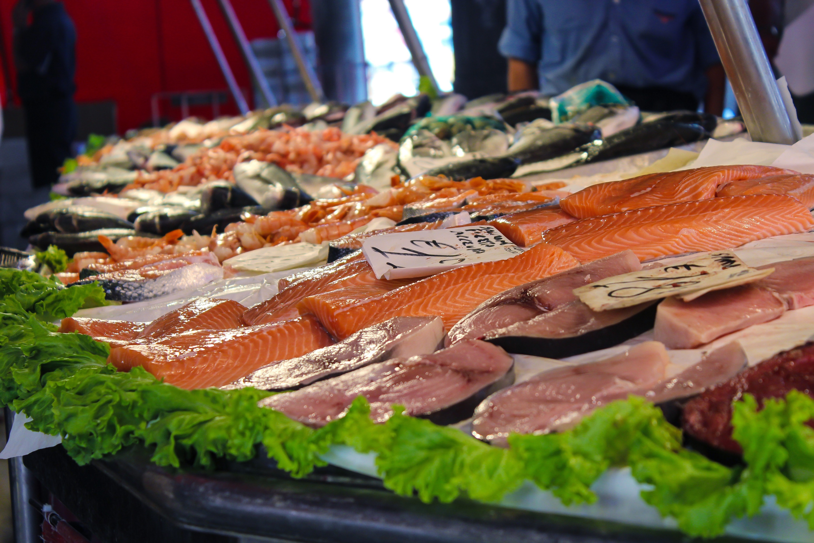
DETERMINATION OF SPECIFIC OBJECTIVES
TO CARRY OUT A SPECIAL SERVICE OF THE WHOLE FISH , YOU NEED TO KNOW:
how to set a table,
what is needed for the service (equipment, tableware),
how the fish is built and what fish is served in its entirety,
what additives and drinks to recommend to fish,
how to talk to a restaurant guest,
what types of behaviours can be presented by guests,
how to respond correctly to customer behaviour, including difficult customers.

Slide 16
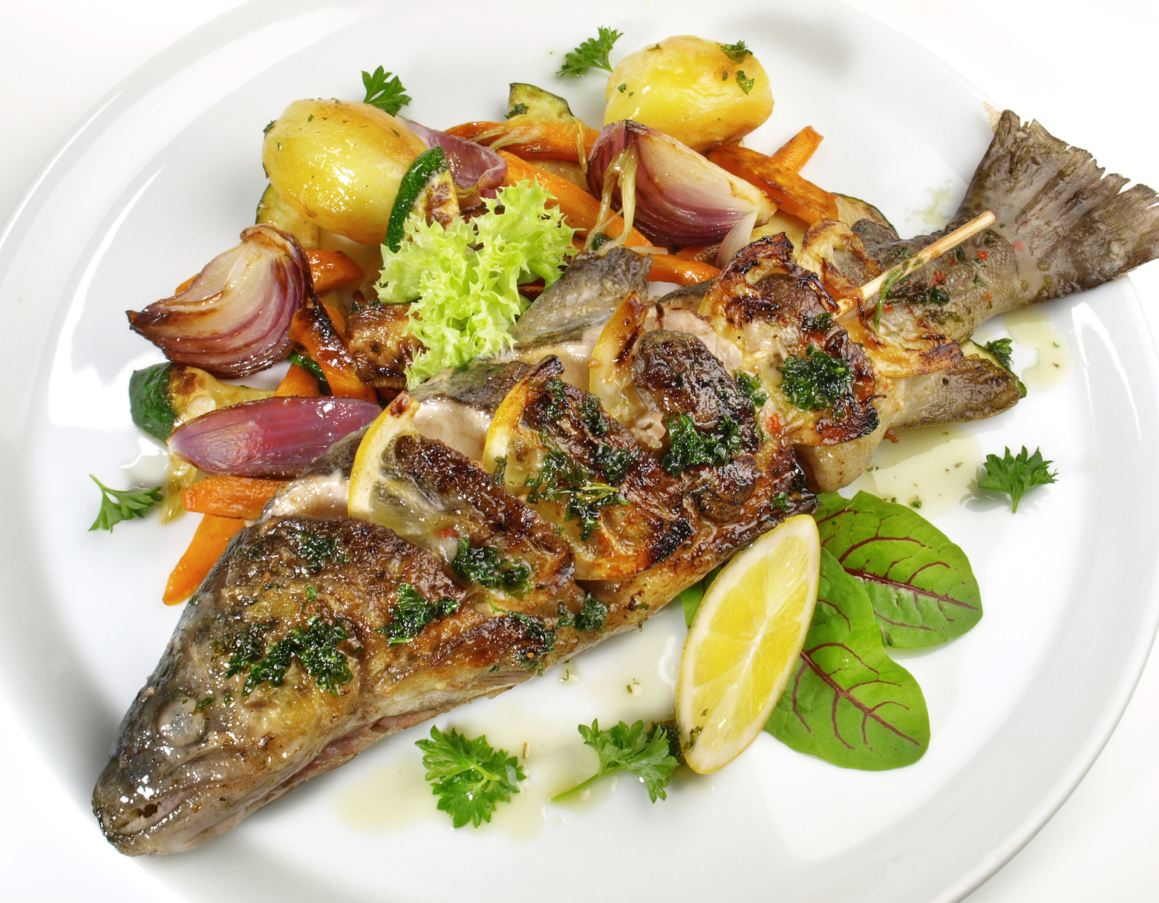
TO CARRY OUT A SPECIAL SERVICE OF A WHOLE BAKED FISH , YOU NEED TO BE ABLE TO :
carry out a proper conversation with the consumer,
set a table for guests,
use the right equipment and tools,
efficiently and accurately perform the individual activities from the preparation of the workplace to serving the dish,
maintain constant contact with supported guests,
control the stress.
ATTACHMENT
WORK CARD 1
PODCAST 1

Slide 17
CHOOSING CONTENT AND SKILLS
THE CONTENT AND SKILLS MUST BE SUBJECT TO THE ASSUMED GOALS
If the overriding goal is to transfer knowledge - the content can be detailed and broad.
If the main goal is to develop skills - content should be selected in terms of their use in real conditions, and skills expanded.
In the work of the waiter, the emphasis is on practical skills, omitting the necessary theoretical foundations, recognising them as obvious

Slide 18
CHOOSING CONTENT AND SKILLS
CONTENT OF EDUCATION AND SKILLS MUST BE SUBJECT TO ASSUMED OBJECTIVES
ATTENTION:
In the work of the waiter the emphasis is put on practical skills, but one should not omit the necessary theoretical foundations.

Slide 19
EXAMPLE
IN ORDER TO KNOW HOW TO FILET A FISH DURING SPECIAL SERVICE, THE PARTICIPANTS NEED TO KNOW THE :
types of fish,
differences in the firmness of fish meat,
types of kitchen knives,
health and safety at work rules.

Slide 20
EXAMPLE
IN ORDER TO FILET A BAKED FISH IN FRONT OF A GUEST, THE PARTICIPANTS DO NOT NEED TO KNOW:
the distribution of fish stocks and methods of fishing,
environmental conditions of life of particular fish species,
the characteristics of steel used to produce knives,
nutrient content in 100 g meat of different fish.

Slide 21
The trainer who trains the special service of whole roasted fish can know which fishery the best fish come from, whether fishing methods affect the quality of fish as a raw material, which producers produce good filleting equipment, what are the nutritional values of fish, how to bake fish. IT MAY MAKE IT EASIER TO ANSWER QUESTIONS AND PROBLEMS WHICH ARISE FROM THE TRAINING PARTICIPANTS.
CHOOSING CONTENT AND SKILLS
THE KNOWLEDGE AND KNOWLEDGE AND SKILLS OF THE TRAINER SHOULD BE BROAD BE GREATER THAN THOSE PRESENTED TO LISTENERS.
PODCAST 2

Slide 22
EXAMPLE
IN ORDER TO FILLET THE BAKED FISH IN WHOLE, THE TRAINING PARTICIPANTS NEED TO HAVE THE SKILLS IN THE FIELD OF:
selection of the necessary equipment: knives, cutlery, dishes and others,
organisation of a position for fish filleting in the restaurant room
presenting dishes to guests,
separating the fish's muscles from the head and spine, regardless of the shape of the carcass,
removal of skin and bones,
portioning of fish and guest service.
THE TRAINER HAS TO HAVE THESE SKILLS AND BE ABLE TO USE THEM PERFECTLY
ATTACHMENT
WORK CARD 2
PODCAST 2

Slide 23
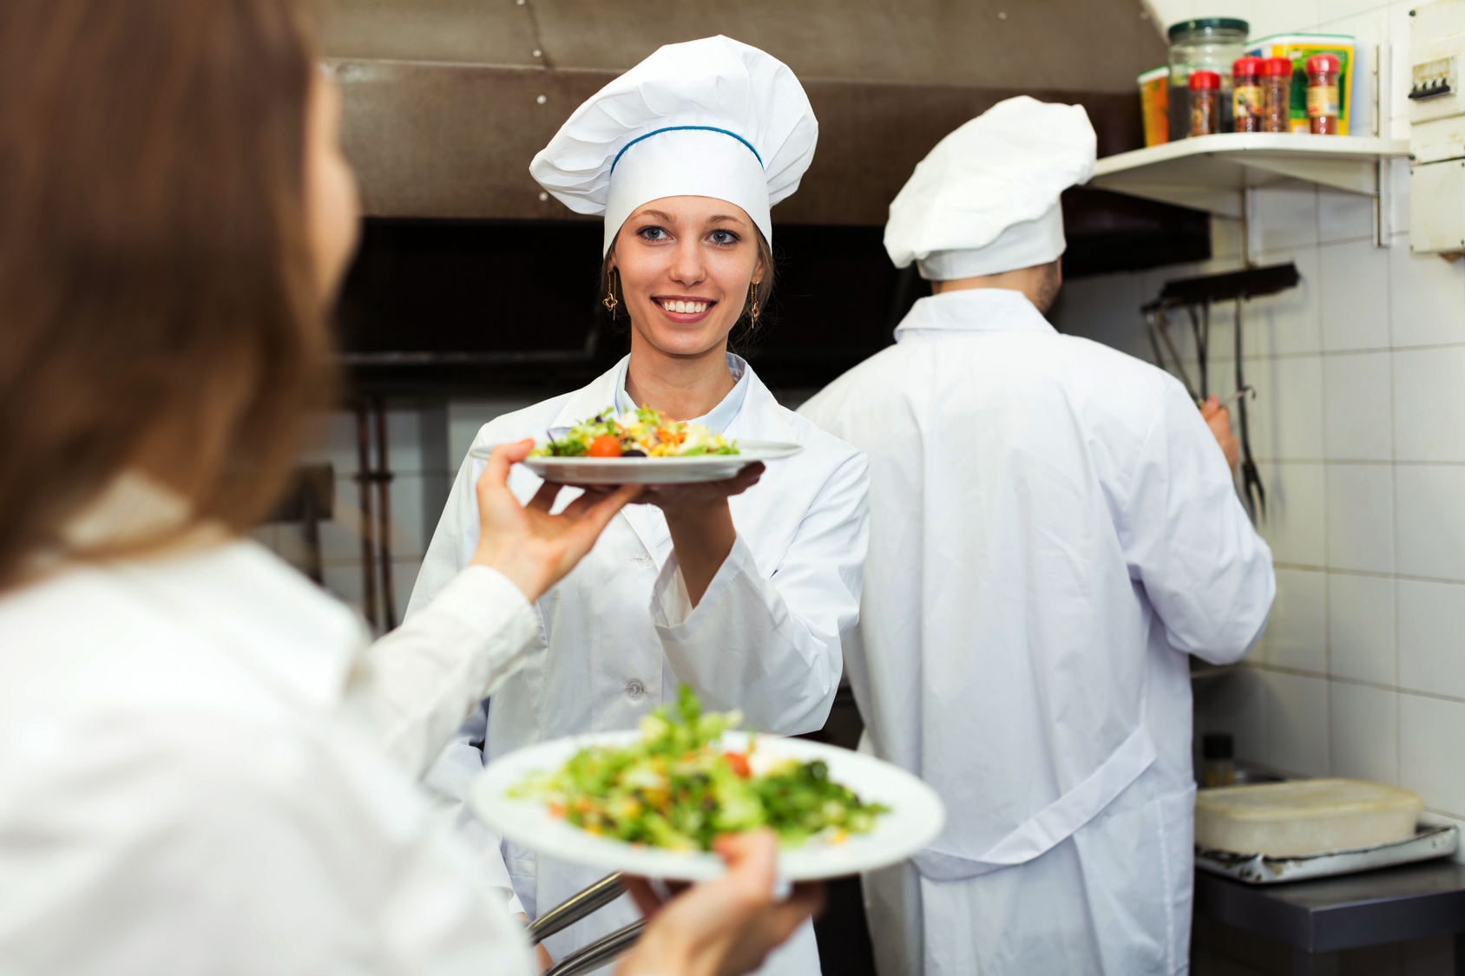
PREPARATION FOR THE TRAINING OF SOCIAL COMPETENCES
SOCIAL COMPETENCES FROM R. WHITE ARE THESE ASSETS THAT CONTRIBUTE TO EFFECTIVE INTERACTION WITH THE ENVIRONMENT.
In the case of WAITER work, their scope is very wide and covers both competences related to team work, communication with foreign languages and constant contact formation as well as independent work ....

Slide 24
SOCIAL COMPETENCES ARE PART OF KEY SOCIAL OBLIGATIONS WHICH TAKE PLACE DURING VOCATIONAL ACTIONS.
PREPARATION FOR THE TRAINING OF SOCIAL COMPETENCES
THESE SKILLS SHOULD NOT BE DONE AS A SEPERATE PART HOWEVER, INCORPORATED INTO THEIR PROFESSIONAL ACTIVITY AND TRAINED ALONSIDE THEM.

Slide 25
PREPARATION FOR THE TRAINING OF SOCIAL COMPETENCES
BASIC SOCIAL COMPETENCES IN THE WORK OF A WAITER
raising trust,
effective interpersonal communication with various types of clients,
active listening,
precise and clear information transfer,
knowledge of mother and foreign language,
ability to work in a team,
ATTACHMENT
WORK CARD 3
PODCAST 2

Slide 26
PREPARATION FOR THE TRAINING OF SOCIAL COMPETENCES
BASIC COMPTENCES IN THE WORK OF A WAITER
ability to manage time,
ability to deal with stress,
knowledge of the etiquete,
knowledge of dress-code,
knowledge and application of the principles of accompaniment and precedence.

Slide 27
EXAMPLE
EXAMPLE OF SELECTING ADDITIONAL SOCIAL COMPETENCES
In order to be able to provide a special service for whole roasted fish, you need to master your personal skills:
control stress,
have a good divisibility,
independently and quickly make decisions,
solve problems in a creative way.

Slide 28
EXAMPLE
EXAMPLE OF SELECTING ADDITIONAL SOCIAL COMPETENCES
In order to be able to carry out a special service of baked fish in its entirety, you need to master interpersonal skills:
take care of the right self-presentation,
accept feedback,
manage the work of a helper (if we have one ;-).

Slide 29
PREPARATION FOR THE TRAINING OF SOCIAL COMPETENCES
IN ORDER TO EFFECTIVELY RAISE THE SOCIAL COMPETENCES, THE TRAINER SHOULD BE ABLE TO:
use advanced presentation skills and advanced communication tools,
create appropriate conditions (in terms of organisation and content) of participants' learning,
adjust the level of training to the level of all participants,
conduct a dialogue with participants, be open to feedback,
draw from the participants' training experiences,
critically evaluate their own actions,
to be responsible for the efficiency of their work,
PODCAST 2

Slide 30
PREPARATION FOR THE TRAINING OF SOCIAL COMPETENCES
IN ORDER TO PREPARE FOR THIS TASK, THE TRAINER SHOULD:
reflect on what social competences will be needed by participants to perform professional tasks after completing the training,
self-assessment in the field of possessing these competences.

Slide 31
PREPARATION FOR THE TRAINING OF SOCIAL COMPETENCES
IN ORDER TO PREPARE FOR THIS TASK, THE TRAINER SHOULD:
prepare a list of sources and development methods for training participants,
prepare a training including the development of these skills during its conduct,
conduct the training, while maintaining all the discussed principles arising from the area of social competences.

Slide 32
PREPARATION FOR THE TRAINING OF SOCIAL COMPETENCES
THE TRAINER SHOULD ALSO BE ABLE TO :
constantly expand knowledge in the area of the trainer's work,
continually improve their own professional skills,
stimulate participants to participate in the training,
precisely convey information,
keep the listeners' attention during classes,
engage in an interactive learning process,
be open to alternative styles and methods of training,
cooperate with a group,
arouse respect with your attitude and behaviour as well as knowledge and skills.

Slide 33
CONCLUSIONS- THE BENFITS FROM TRAINING PREPARATION FROM THE SUBSTANTIVE SIDE
1
2
3
4
5
SELECTING CONTENT WHICH RAISES THE KNOWLEDGE AND SHAPES PRACTICAL SKILLS
PLANNING THE MATERIAL IN A WAY WHICH ALLOWS A GRADUAL GAIN OF COMPETENCES
OBTAINING THE GOALS OF THE TRAINING AND PARTICIPANT SATISFACTION
HIGH JUDGEMENT OF THE TRAINERS’ KNOWLEDGE AND SKILLS
INCREASING THE SALES OF YOUR TRAINING SERVICES

Slide 34
GO TO NEXT
MODULE MATERIALS

