Slide 1
PREPARING TRAINING (1)
BARMAN
3

Slide 2
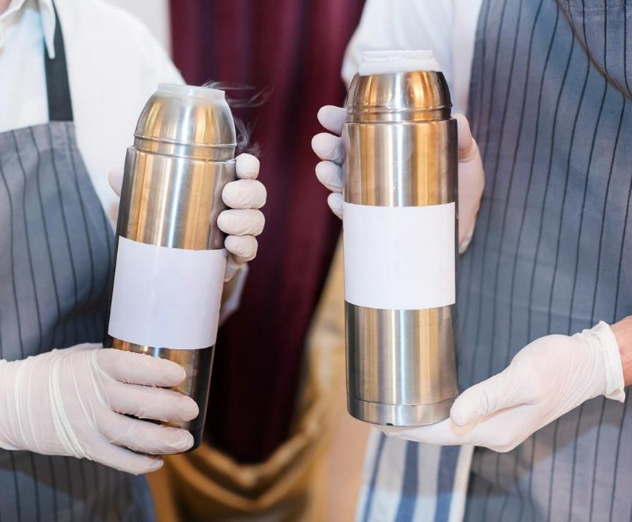
AIM OF TRAINING PREPARATION
Each training requires good preparation. Without it, it is not possible to achieve the intended results by the participants.
To prepare the training in the right way, the trainer should take into account a number of elements.

Slide 3
WHAT ELEMENTS SHOULD BE PREPARED?
SUBSTANTIVE SIDE
METHOD SIDE
define the goals of the training,
choose material, i.e. content and skills,
determine ways to motivate participants,
choose teaching-learning methods,
choose teaching resources,
define the rules and methods of cooperation with the group,
schedule classes over time
PODCAST
1

Slide 4
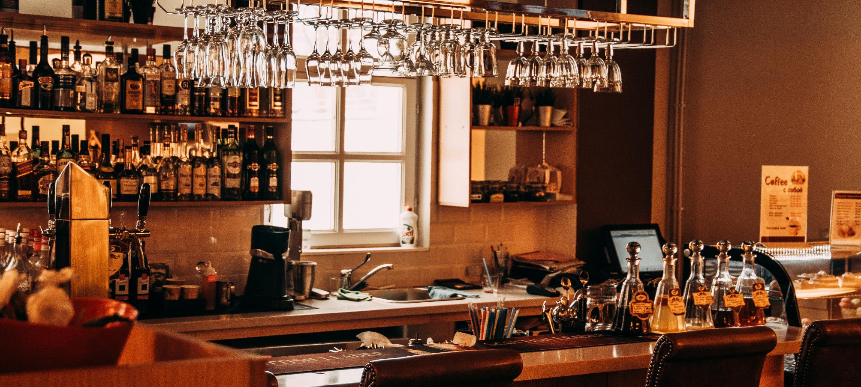
PREPARATION OF TRAINING FROM THE SUBSTANTIVE SIDE

Slide 5
WHERE TO START?
What is the purpose of this topic?
If it is a 1st degree bartending course, then participants may not have professional experience in this field.
If it is a second-degree bartending, Sommelier, Hydro-sommelier, Barista or otherwise, participants already have professional experience.
What is my knowledge in this field?
Where to verify your information or look for new ones?
Which of these content to choose and which not to?
How to present them best?
What to do to present the material as in a way that will gain as much benefits as possible?
If you already know the subject of the training, you should start by answering a few questions about its individual elements.

Slide 6
WHERE TO START?
You have been asked to provide training on the subject
MODERN COCKTAIL DECORATIONS
OR
THE BARISTIC 1ST DEGREE COURSE WITH ELEMENTS OF LATTE ARTICLE
START FROM PREPARING THE LIST OF KNOWN AND UNKNOWN ELEMENTS TO YOU THAT WILL IMPROVE THE IMPLEMENTATION
You should analyse your substantive preparation and organizational issues and then answer the following questions:
WHAT DO I KNOW?
WHAT DO I NOT KNOW?
PODCAST
1

Slide 7
MODERN COCKTAIL DECORATIONS
SUBSTANTIVE SIDE
what kind of decorations should I present,
which decorative materials should I use,
how to present examples and techniques of decorating,
what participants should be able to do after the training
ORGANISATIONAL SIDE
what conditions of work should each participant have,
how many hours will the training last (7 hours),
what will be the demand for equipment and glass in the right amount,
where the training will take place,
what will be the conditions for conducting workshops.
WHAT DO I KNOW?
Examples in the field of training "Modern cocktail decorations"

Slide 8
MODERN COCKTAIL DECORATIONS
SUBSTANTIVE SIDE
will participants' professional experience be useful?
Will I build their interest and how to do it?
will the diversity of the decorations being practiced be appropriate?
ORGANISATIONAL SIDE
will they cooperate?
Can I provide access to the necessary decorative materials?
What will be the conditions of cleaning the positions after the exercises?
WHAT DO I NOT KNOW?
Examples in the field of training "Modern cocktail decorations"

Slide 9
BARISTIC 1ST DEGREE COURSE WITH ELEMENTS LATTE ART
SUBSTANTIVE SIDE
That a theoretical and practical part should be prepared,
That the theoretical part should take into account the characteristics of coffee and the ways of brewing it,
That participants should be presented with different techniques of brewing and serving coffee,
You need to practice performing simple milk decoration.
ORGANISATIONAL SIDE
that the training will last 7 hours,
that 2-3 coffee machines will be enough for 10 participants,
that I will need specific equipment and vessels in the right amount,
that I have to provide the right amount of raw materials.
WHAT DO I NOT KNOW?
Examples of the 1st degree barista course with elements of Latte Art

Slide 10
BARISTIC 1ST DEGREE COURSE WITH ELEMENTS LATTE ART
SUBSTANTIVE SIDE
how detailed should the characteristics of coffee and its crops be?
whether to compare the taste of infusions depending on the method of brewing?
will the diversity of the decorations being practiced be appropriate
ORGANISATIONAL SIDE
what tasks to give to participants who can not brew coffee at the moment, because the coffee machines are occupied?
Can I provide enough glasses and equipment?
What will be the conditions for the show?
WHAT DO I NOT KNOW?
Examples of the 1st degree barista course with elements of Latte Art

Slide 11
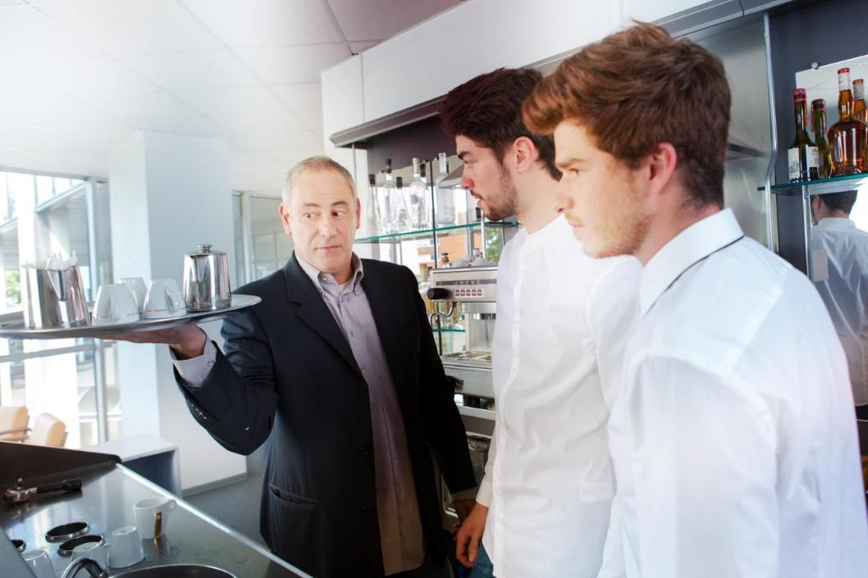
DETERMINATION OF THE TRAINING AIM
Ask yourself:
What is the training participant supposed to know and be able to do after finishing the training?
The answer to this question is the
MAIN GOAL OR EXPECTED EDUCATIONAL EFFECT,
which determines the result of the implementation of the entire training program.
ATTACHEMENT
WORK CARD 1 AND 2

Slide 12
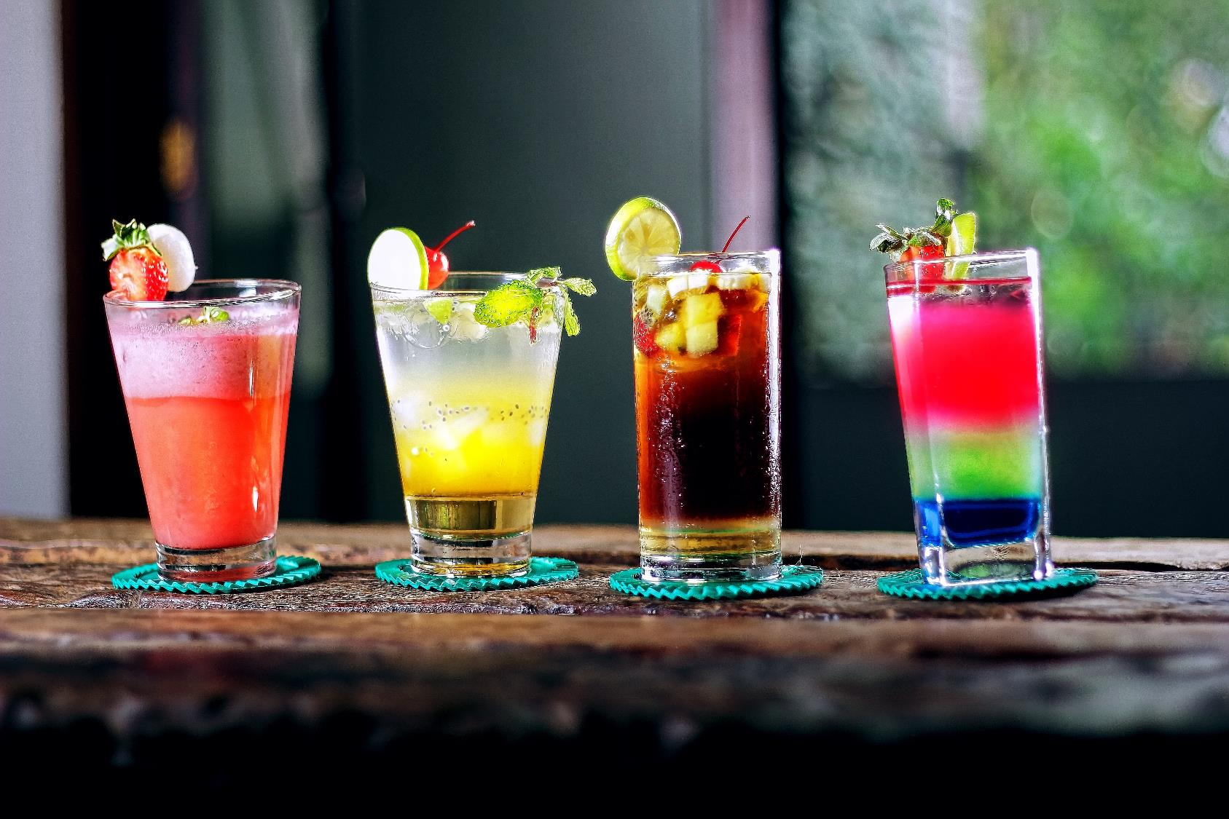
AFTER COMPLETION, THE PARTICIPANT SHOULD BE ABLE TO:
perform attractive decorations of cocktails and other beverages,
and adapt them to the type of glass and beverage
MODERN COCKTAIL DECORATIONS

Slide 13
AFTER COMPLETION, THE PARTICIPANT SHOULD BE ABLE TO:
make basic types of beverages from coffee and create simple drawings and patterns from milk on the surface of coffee,
prepare and serve coffee-based drinks and make simple milk decorations on their surface.
BARISTIC 1ST DEGREE COURSE WITH ELEMENTS LATTE ART

Slide 14
DETERMINATION OF SPECIFIC OBJECTIVES
.
In order to acquire the required knowledge and acquire specific skills in this or a different area, ie to achieve the general goal, one should first acquire the necessary, simpler information and practice single activities. They are the
SPECIFIC OBJECTIVES (EFFECTS) OF EDUCATION.
Attachment
Work card 1 and 2

Slide 15
DETERMINATION OF SPECIFIC OBJECTIVES
MAIN GOAL
SPECIFIC OBJECTIVE
SPECIFIC OBJECTIVE
SPECIFIC OBJECTIVE
SPECIFIC OBJECTIVE
SPECIFIC OBJECTIVE

Slide 16
DETERMINATION OF SPECIFIC OBJECTIVES
To make attractive cocktails decorations and adapt them to the type of glass and beverage
YOU NEED TO KNOW:
What equipment is necessary when decorating?
What types of decorative materials can be used?
What are the basic techniques of carving in vegetables and fruits?
What elements do you need to take into account when adapting the decoration to glass?
What do you need to take into account when adapting the decoration to the drink?
How to best protect the elements and compositions made?
What and how to do it?
ATTACHMENT
WORK CARD 1
PODCAST 1

Slide 17
DETERMINATION OF SPECIFIC OBJECTIVES
To make attractive cocktails decorations and adapt them to the type of glass and beverage
YOU NEED TO BE ABLE TO :
prepare the workplace,
choose vegetables, fruits and other decorative elements,
choose the right instruments,
use the necessary equipment,
one by one and efficiently perform individual decorative elements,
secure decorative elements,
perform aesthetic decoration with prepared elements.

Slide 18
DETERMINATION OF SPECIFIC OBJECTIVES
To make and serve coffee-based beverages and to make simple milk decorations on their surface
YOU NEED TO KNOW:
How are the different types of coffee different from each other?
Which coffee grades and degrees of burning are used for each type of beverage?
What additives can be used for individual beverages from coffee?
What types and proportions of individual ingredients in different drinks ?
What types of dishes and cutlery are used to serve coffee?
How should you prepare milk for decorating coffee?
Attachment
Work card 2
PODCAST 1

Slide 19
DETERMINATION OF SPECIFIC OBJECTIVES
To make and serve coffee-based beverages and to make simple milk decorations on their surface
YOU NEED TO BE ABLE TO :
prepare the workplace,
choose dishes, cutlery and other necessary equipment, depending on the drink,
use the necessary equipment,
prepare a basic assortment of coffee-based drinks (latte, machiato, americano, cappuccino, espresso etc.),
Make simple decorations and patterns from milk on the surface of the coffee.

Slide 20
CHOOSING CONTENT AND SKILLS

Slide 21
CHOOSING CONTENT AND SKILLS
THE CONTENT OF THE TRAINING AND SKILLS MUST BE IN LINE WITH THE ASSUMED EFFECTS
If the ultimate goal is to convey knowledge - the content can be detailed and broad.
If the main goal is to develop skills - content should be selected for their use in real conditions, and skills broadened.
Attachment
Work cards 3 and 4

Slide 22
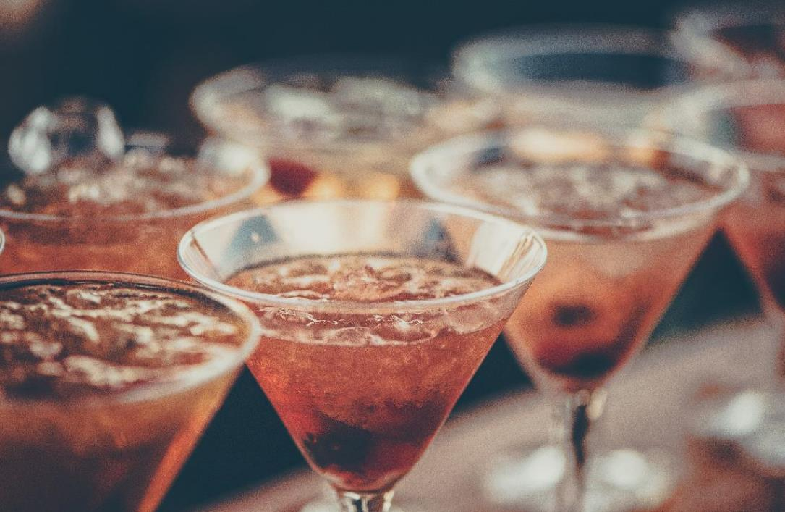
EXAMPLE
To make attractive decorations of cocktails and adapt them to the type of glass and drink, you need the knowledge of:
deselection of bar glass for drinks,
keeping the bar glass in good condition,
characteristics of the fruit suitable for carving,
carving techniques,
securing works performed,
rules of arranging decorative compositions and their colours,
health and safety at work rules.

Slide 23
EXAMPLE
To make attractive decorations of cocktails and adapt them to the type of glass and drink, you do not need knowledge in the field of:
scientific knowledge of plant materials,
the nutritional value of vegetables and fruits used in the art of carving,
methods of growing vegetables, fruits and other decorative plants,
production and characteristics of various types of utility glass.
ATTACHMENT
WORK CARD 3
PODCAST 1

Slide 24
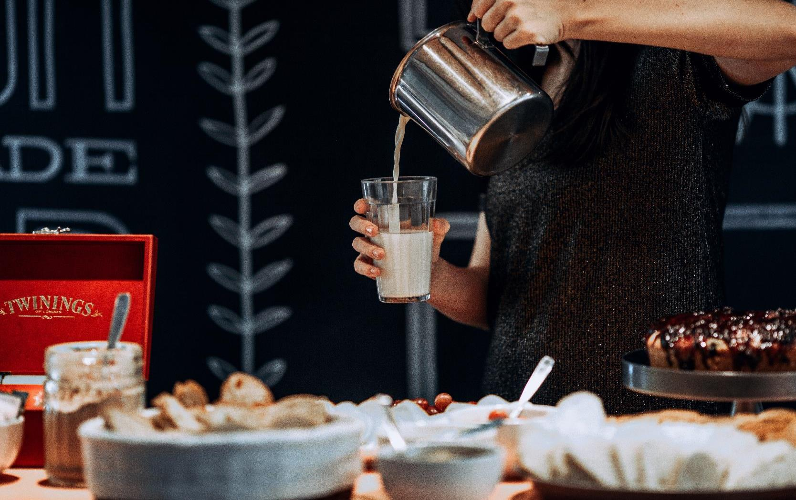
EXAMPLE
In order to be able to make and serve coffee-based drinks and make simple decorations and milk patterns on their surface, you need the knowledge in the field of:
characteristics of coffee types and differences between them,
techniques and grades of coffee,
characteristics of coffee additives,
requirements for storing coffee and additives,
ways of grinding coffee,
the impact of various factors on the coffee brewing effect,
ways of serving different beverages from coffee,
principles of occupational health and safety.
ATTACHMENT
WORK CARD 4

Slide 25
EXAMPLE
To make and serve coffee-based beverages and to make simple decorations and milk patterns on their surface, you do not need to know:
specific climatic conditions in different coffee growing regions,
the amount of coffee production in individual regions,
the nutritional value of coffee beverage additives,
characteristics of ceramic materials for the production of coffee dishes
features of various types of utility glass.

Slide 26
CHOOSING CONTENT AND SKILLS
KNOWLEDGE AND TRAINER SKILLS SHOULD BE BETTER THAN THOSE THAT ARE PRESENTED TO THE LISTENERS.
This will make it easier to explain problems that arise during the training and to answer any questions from participants

Slide 27
CHOOSING CONTENT AND SKILLS
TO MAKE ATTRACTIVE COCKTAIL DECORATIONS AND TO ADJUST THEM TO THE TYPE OF GLASS AND BEVERAGE, SKILLS REQUIRED ARE:
preparation of non-alcoholic and alcoholic cocktails,
proper selection of bar glass,
selection of the necessary equipment, including appropriate knives,
organization of a stand for the preparation of decorative elements,
protecting decorative elements,
joining made elements,
preparation of attractive and aesthetic decorations.
EXAMPLE OF SELECTING SKILLS
ATTACHMENT
WORK CARD 3
PODCAST 2

Slide 28
CHOOSING CONTENT AND SKILLS
TO MAKE AND SERVE COFFEE BASED BEVERAGES AND MAKE THE SIMPLE DECORATIONS AND MILK PATTERNS ON THEIR SURFACES, YOU NEED TO BE ABLE TO :
store coffee and other raw materials,
select coffee and necessary additives,
service coffee machines of various types,
select dishes and equipment needed,
organize the workplace,
make simple decorations and designs from milk on the surface of coffee,
serve coffee-based beverages.
EXAMPLE OF SELECTING SKILLS
ATTACHMENT
WORK CARD 4
PODCAST 2

Slide 29
PREPARATION FOR THE TRAINING OF SOCIAL COMPETENCES
SOCIAL COMPETENCES FROM R. WHITE ARE THESE ASSETS THAT CONTRIBUTE TO EFFECTIVE INTERACTION WITH THE ENVIRONMENT.
ATTACHMENT
WORK CARD 5 AND 6

Slide 30
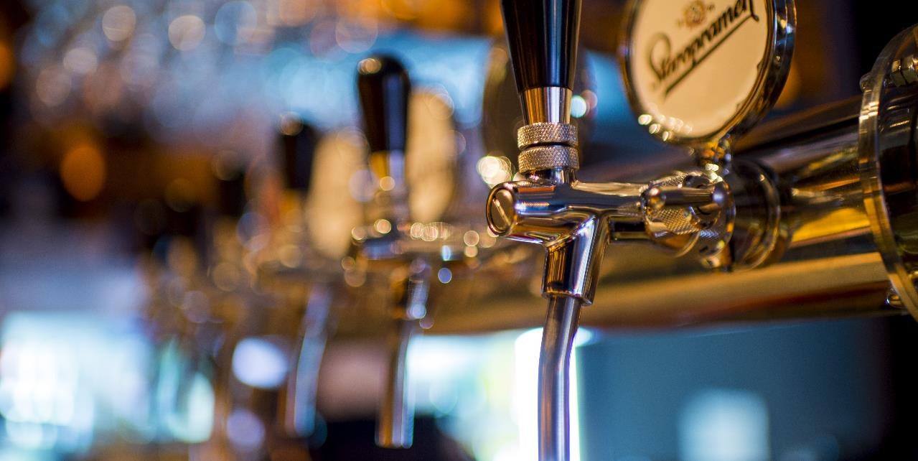
IN BARMAN, BARISTA, SOMMELIER WORK, SOCIAL COMPETENCES ARE AN IMPORTANT ELEMENT OF THEIR WORK.
PREPARATION FOR THE TRAINING OF SOCIAL COMPETENCES
TRAINING THESE SKILLS SHOULD NOT BE DONE AS A SEPERATE PART HOWEVER, INCORPORATED INTO THEIR PROFESSIONAL ACTIVITY AND TRAINED ALONSIDE THEM.

Slide 31
PREPARATION FOR THE TRAINING OF SOCIAL COMPETENCES
TO PREPARE FOR THIS TASK, YOU NEED TO:
think about what social competences will be needed by participants to perform professional tasks after completing the training?
make a self-assessment in terms of social competence,
prepare a training course using these skills while conducting training.

Slide 32
EXAMPLE
TO MAKE ATTRACTIVE COCKTAIL DECORATIONS AND TO ADJUST IT TO THE TYPE OF GLASS, AND TO PREPARE AND SERVE COFFEE BASED DRINKS WITHIN A BASIC ASSORTMENT, YOU MUST BE ANLE TO :
work confidently and efficiently,
communicate effectively in different situations,
solve problems in a creative way,
make decisions by yourself,
cooperate with others,
plan and organise your own work.
EXAMPLE OF SELECTING SKILLS

Slide 33
PREPARATION FOR THE TRAINING OF SOCIAL COMPETENCES
THE TRAINER SHOULD ALSO BE ABLE TO:
create the right learning conditions for participants,
be open to feedback,
critically evaluate their own actions,
to be responsible for the quality and efficiency of your work,
continually improve their own professional skills,
be open to alternative styles and methods of training,
collaborate with a group.

Slide 34
CONCLUSIONS - BENEFITS FROM THE PROPER PREPARATION OF TRAINING FROM THE SUBSTANTIVE SIDE
1
2
3
4
5
6
GOOD PACE AND HIGH LEVEL OF TRAINING
SELECTION OF CONTENT FOR EDUCATING PRACTICAL SKILLS
DISTRIBUTION OF MATERIAL IMPLEMENTATION THAT ALLOWS A GRADUAL GAIN OF QUALIFICATIONS
ACHIEVEMENT OF EXPECTED TRAINING RESULTS
HIGH RATING OF KNOWLEDGE AND TRAINER SKILLS
GAINING NEW PARTICIPANTS IN THE FUTURE

Slide 35
GO TO NEXT
MODULE MATERIALS

